Slide 1
Human-Robot Interaction for Object Transfer
Luís Almeida
Master's Dissertation in Mechanical Engineering
Supervisors:
Prof. Vítor Manuel Ferreira dos Santos
Prof. Filipe Miguel Teixeira Pereira da Silva
Aveiro, 13 December 2016

Slide 2
Overview
1
Introduction
2
Experimental Setup
3
Robot Control
4
Pre-contact Approximation using 3D Vision
5
Contact and Force-based Interaction
6
Conclusions and Future Work

Slide 3
Introduction
1
Overview
Context and Motivation;
Problem Formulation;
Dissertation Goals.

Slide 4
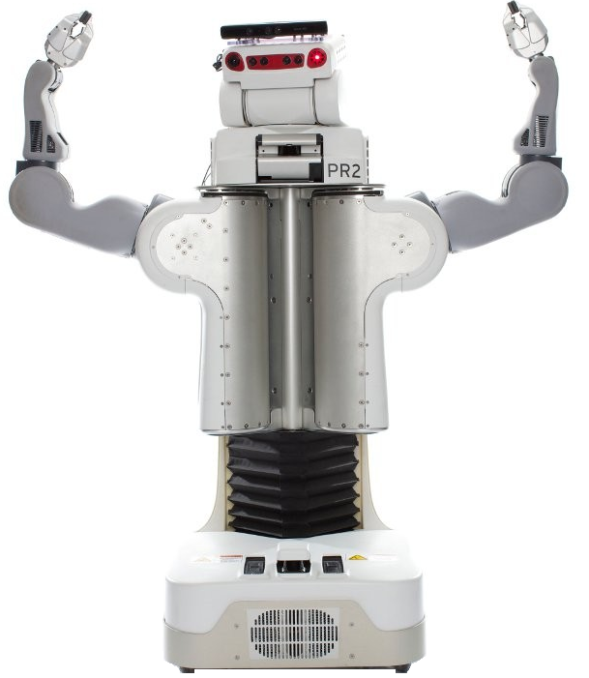
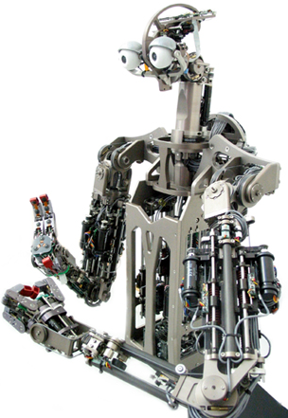
Introduction – Context and Motivation
1
“The HRI problem is to understand and shape the interactions between one or more humans
and one or more robots”
“Robots are designed and built to complement human abilities”
PR2
Physical human-robot interaction
Provide physical assistance to a worker on an assembly line;
Extend the time an elderly person can live at home;
Help with household chores.
Domo

Slide 5
Introduction – Problem Formulation
1
The robot control to perform the inherent movements of the transfer assignment;
The human-robot pre interaction;
The interaction by contact.

Slide 6
Introduction – Dissertation goals
1
Hardware and software infrastructure installation and familiarization;
Study of management mechanisms of pre-contact approximation using 3D vision;
Study and development of interaction mechanisms by contact.

Slide 7
Experimental Setup
2
Overview
Hardware;
Software.

Slide 8
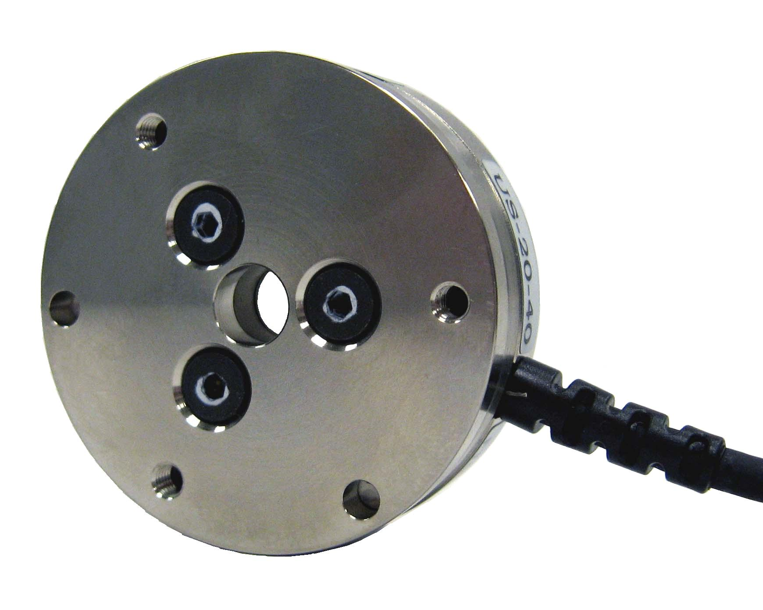
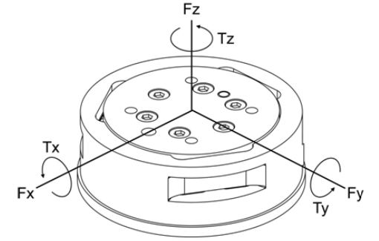
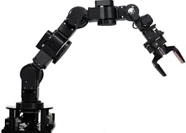
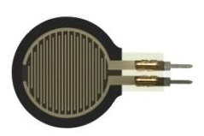
Experimental Setup – Hardware
2
ATI Mini40 Transducer
Cyton Gamma 1500 Manipulator
Kinect
7 DOF
Kinematically redundant
Force-Sensitive Resistor (FSR)

Slide 9
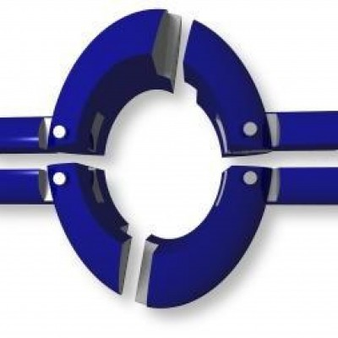
Experimental Setup – Software
2
Robot Operating System (ROS);
MoveIt!;
Kinematics and Dynamics Library (KDL);
OpenNI;

Slide 10
Robot Control
3
Overview
Joint Controller;
Forward Kinematics;
Inverse Kinematics;
Evaluations.

Slide 11
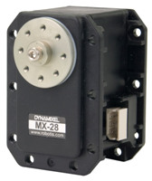
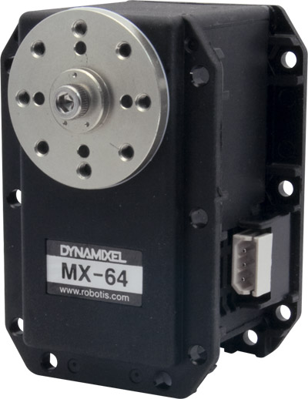
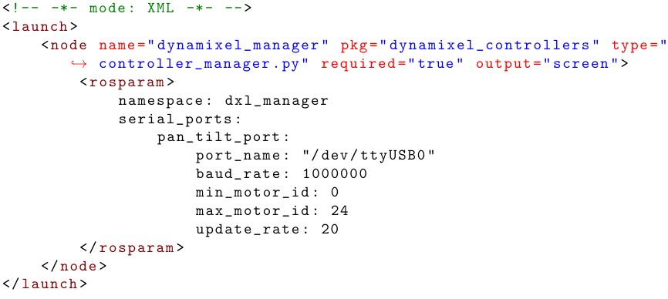
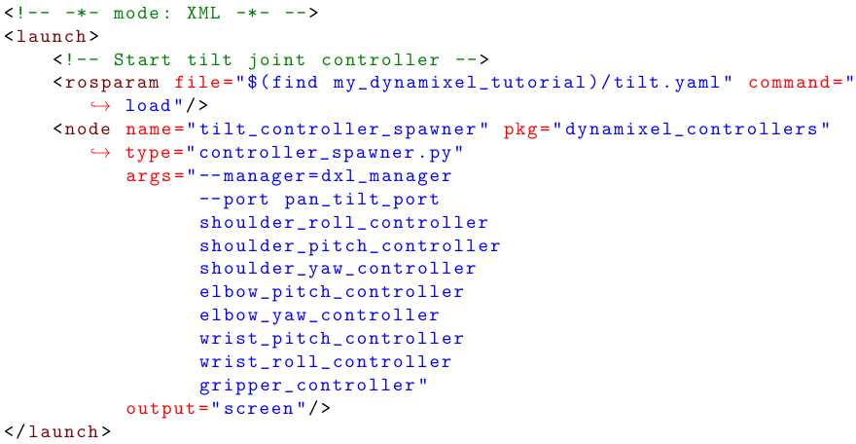
Robot Control – Joint Control
3
ROS stack dynamixel motor - used to interface with the Robotis Dynamixel line of servo motors
Roslaunch files - used to launch and start the controll of Cyton dynamixel servos
dynamixel driver
dynamixel controllers
dynamixel msgs

Slide 12
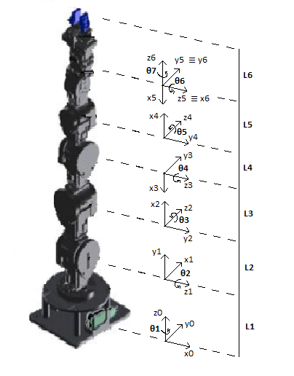
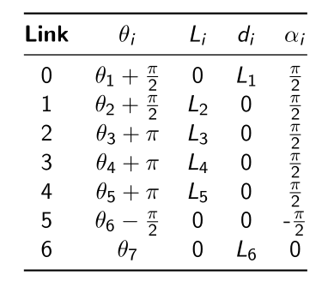
Robot Control – Foward Kinematics
3
Determination of end-effector position and orientation as a function of the joint angles
From the DH parameters it is possible to determinate the Cartesian position of the end-effector in terms of joint angles (${\text{θ}}_{1}$, ${\text{θ}}_{2}$,..., ${\text{θ}}_{7}$)

Slide 13
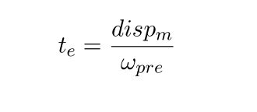
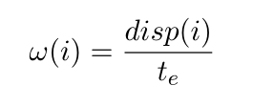
Robot Control – Synchronous Movement
3
Being [n] = {1,2,...,7} , the velocity for each joint (ω(i)) can be calculated as expressed
by the following equations:
$${disp}_{m}$$ | - maximum displacement
$$jαd$$ | - desired joint angle
$$jαs$$ | - joint angle state
$$t_{e}$$ | - time of execution
$$ω_{pre}$$ | - pre-defined max angular velocity
$$ω$$ | - angular velocity
$$disp$$ | - displacement
Reduce Cyton’s vibrations and overload problems
Smoother motion and precise control

Slide 14
Robot Control – Inverse Kinematics
3
Inverse Kinematics (IK) is the method of determining a set of joint angles that will satisfy a given end-effector pose in the Euclidean space
MoveIt! + KDL
ROS package robot_model - 3D robot model
MoveIt! Setup Assistant - configuration files

Slide 15
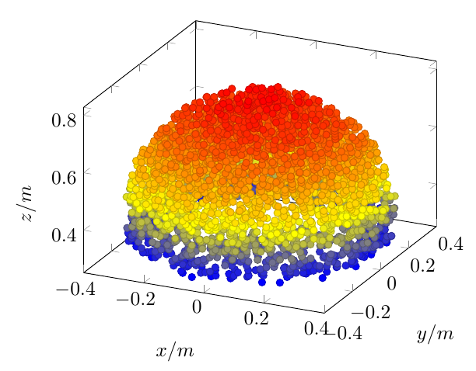
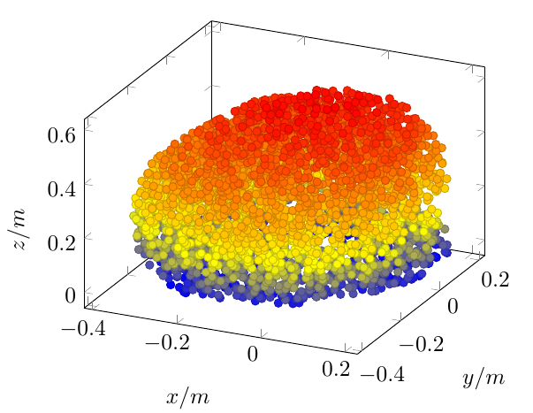
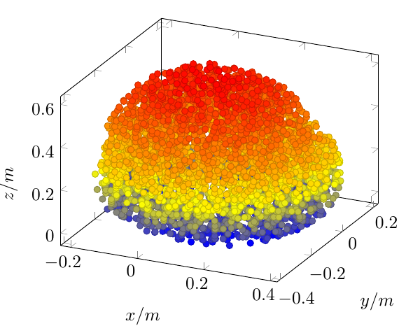
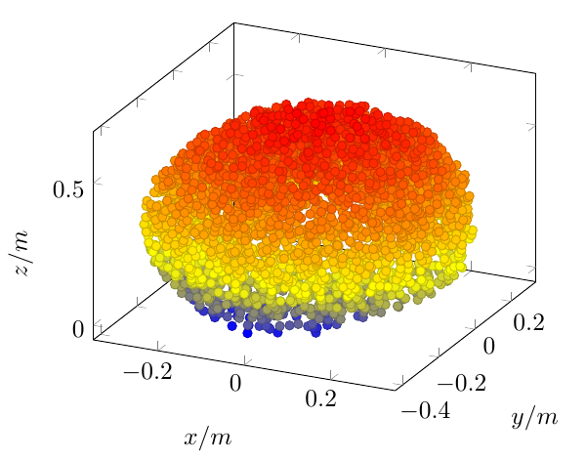
Robot Control – Workspace Analysis
3
Problem - Large workspace which leads to a large, not-suitable for
inverse kinematics, calculation time.
$$R1=\left[\begin{matrix}1 & 0 & 1 \\ 0 & 1 & 0 \\ 0 & 0 & 1\end{matrix}\right]$$
Limit the number of orientations for the end-effector
4 orientations are used to improve the interaction between robot and user
$$R2=\left[\begin{matrix} 0.71 & 0 & −0.71 \\ −0.71 & 0 & −0.71 \\ 0 & 1 & 0\end{matrix}\right]$$
$$R3=\left[\begin{matrix} 0.71 & 0 & 0.71 \\ 0.71 & 0 & −0.71 \\ 0 & 0 & 1\end{matrix}\right]$$
Maximum run rate 10 times better
Allow the user to make contact with the sensor, using the object, without considerable manipulation
$$R4=\left[\begin{matrix} 1 & 0 & 0 \\ 0 & 0.71 & −0.71 \\ 0 & 0.71 & 0.71\end{matrix}\right]$$

Slide 16
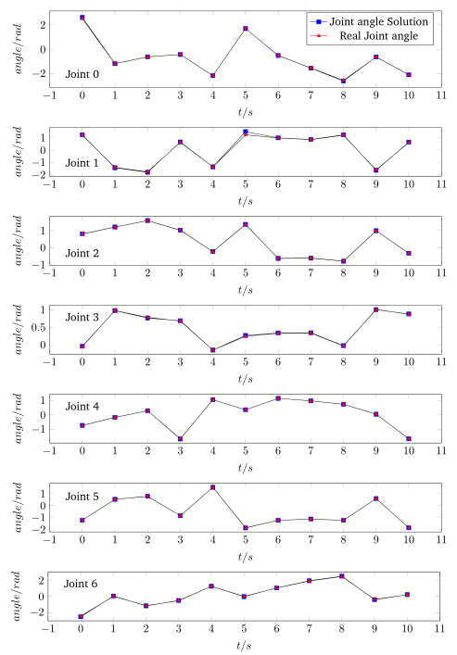
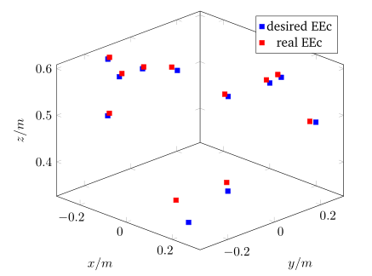
Robot Control – Reachability Analysis
3
11 random points inside Cyton workspace are used
The EE average error is approximately 1%
The accuracy of the robot control is very high

Slide 17
Pre-contact Approximation using 3D Vision
4
Overview
Human Hand Tracking;
Kinect-Robot Frame Transformation;
Object Detection;
Evaluations.

Slide 18
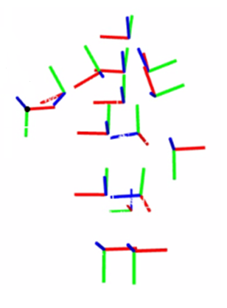
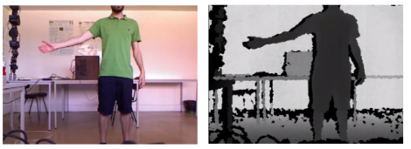
3D Vision – Human Hand Tracking
4
OpenNI tracker – allows a user to track his own skeleton using a 3D sensor
Right hand
The position of the hand is published as a tf transform

Slide 19
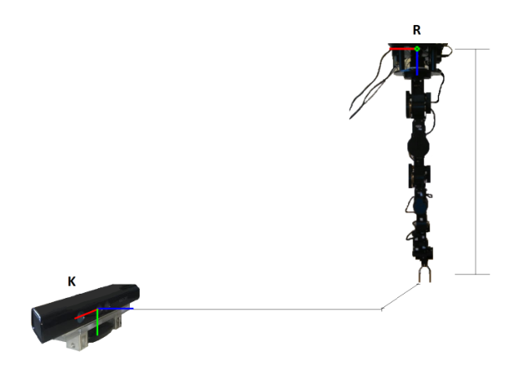
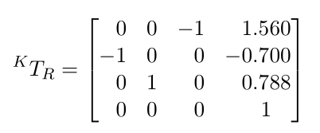
4
3D Vision – Kinect-Robot Frame Transformation
Two methods to transform the Kinect frame to the robot frame:
Method 1. Done manually with a measurement tape
Method 2. Uses two point clouds; use the function ”estimateRigidTransformation”
0.788 m
0.700 m
1.560 m
The workspace is within the 3D sensor field of view and nominal depth range
The layout ensures that the robotic arm does not block the human hand relatively to the sensor

Slide 20
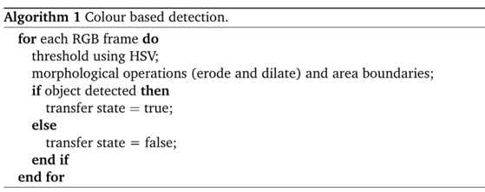
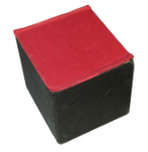
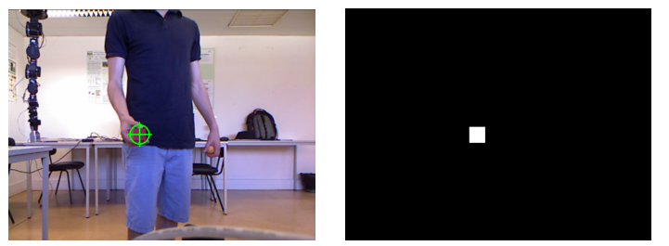
4
3D Vision – Colour Based Object Detection
Object detection - so that robot knows when the user intends to enter in a transfer state
Colour based detection
Uses OpenCV features to handle image colour processing
HSV values are within the following range:
140 ≤ H ≤ 179
179 ≤ S ≤ 255
126 ≤ V ≤ 191

Slide 21
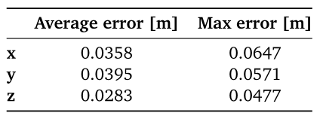
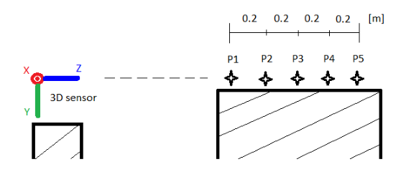
4
3D Vision – Accuracy Analysis
100 readings of the hand positioned on those points are recorded
3D sensor average and max error
Offset: 7cm in robot y axis

Slide 22
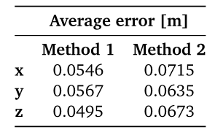
4
3D Vision – Frame Transformation Analysis
A set of coordinates well known to the robot are used as the input for the transformation
Concerning the first method, the average error showed up as approximately 5.36%, on average less 1.38% when compared with the second transform approach
Frame transformation methods comparison

Slide 23
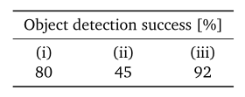
4
Pre-contact Approximation using 3D Vision
Data was recorded 5 times daily for 10 days:
Only the environment luminosity changes are considered;
Environment luminosity changes plus red objects in the environment (such as: red clothes, red figures in wallpapers and red writing material);
The HSV parameters are adapted daily.
If the environment conditions don’t significantly change, this algorithm can always detect the object

Slide 24
Contact and Force-based Interaction
5
Overview
ATI mini40 integration;
FSR integration;
Evaluations.

Slide 25
5
Force-based Interaction – ATI mini40 Integration
A device to acquire the signals
Send them to a PC for conversion into forces and torques
Special components to install the sensor in the robotic arm

Slide 26
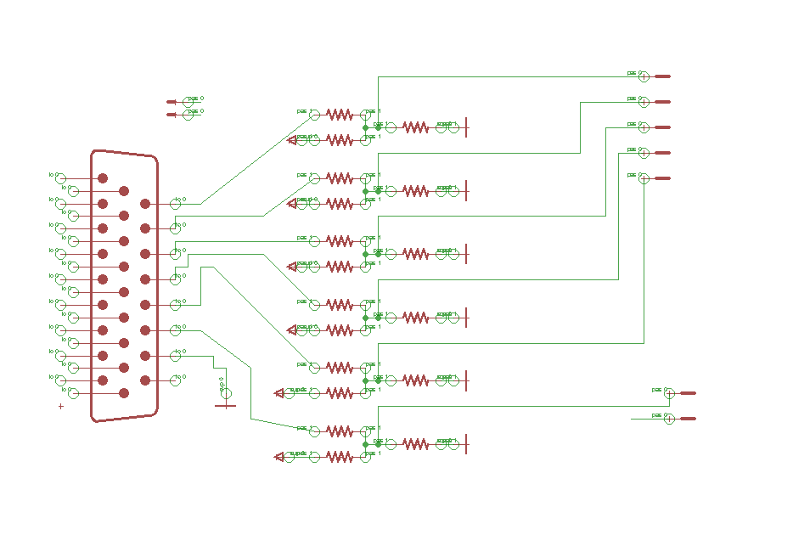
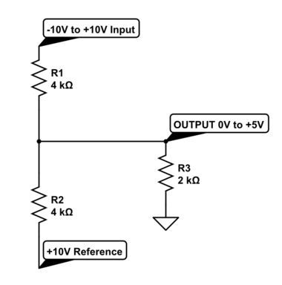
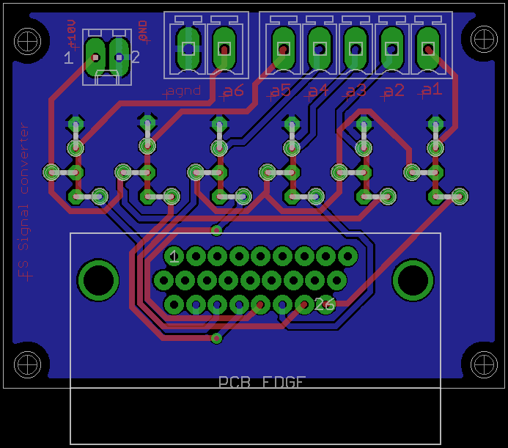
5
Force-based Interaction – Signal Converter
Arduino plus Ethernet shield (sends a message through TCP/IP )
Arduino can only read analogue inputs within a range of 0-5V
A dedicate circuit was developed to perform signal conditioning
Operating principle of the developed circuit

Slide 27
5
Force-based Interaction – Code implementation
Each gauge does not match a single force or torque in a single
direction, which means that each of them depends on all six gauges
Multiplying the transform matrix by a vector of gauges readings ($V$), it is possible to find
the forces and torques values for these readings
${Ft}^{⊺}$ - transpose vector of $Ft$= [$F_{x }F_{y }F_{z}{ T}_{x}{ T}_{y }T_{z}$]
${Ft}^{⊺}$ = $T_{M }× V^{⊺}$
$V^{⊺}$ - transpose vector of $V$ = [G0 G1 G2 G3 G4 G5]

Slide 28
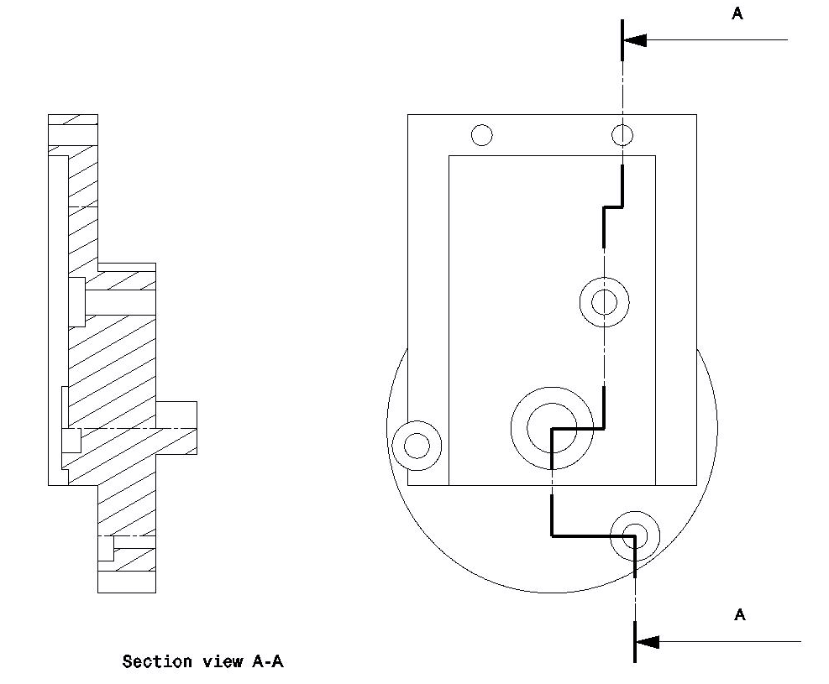
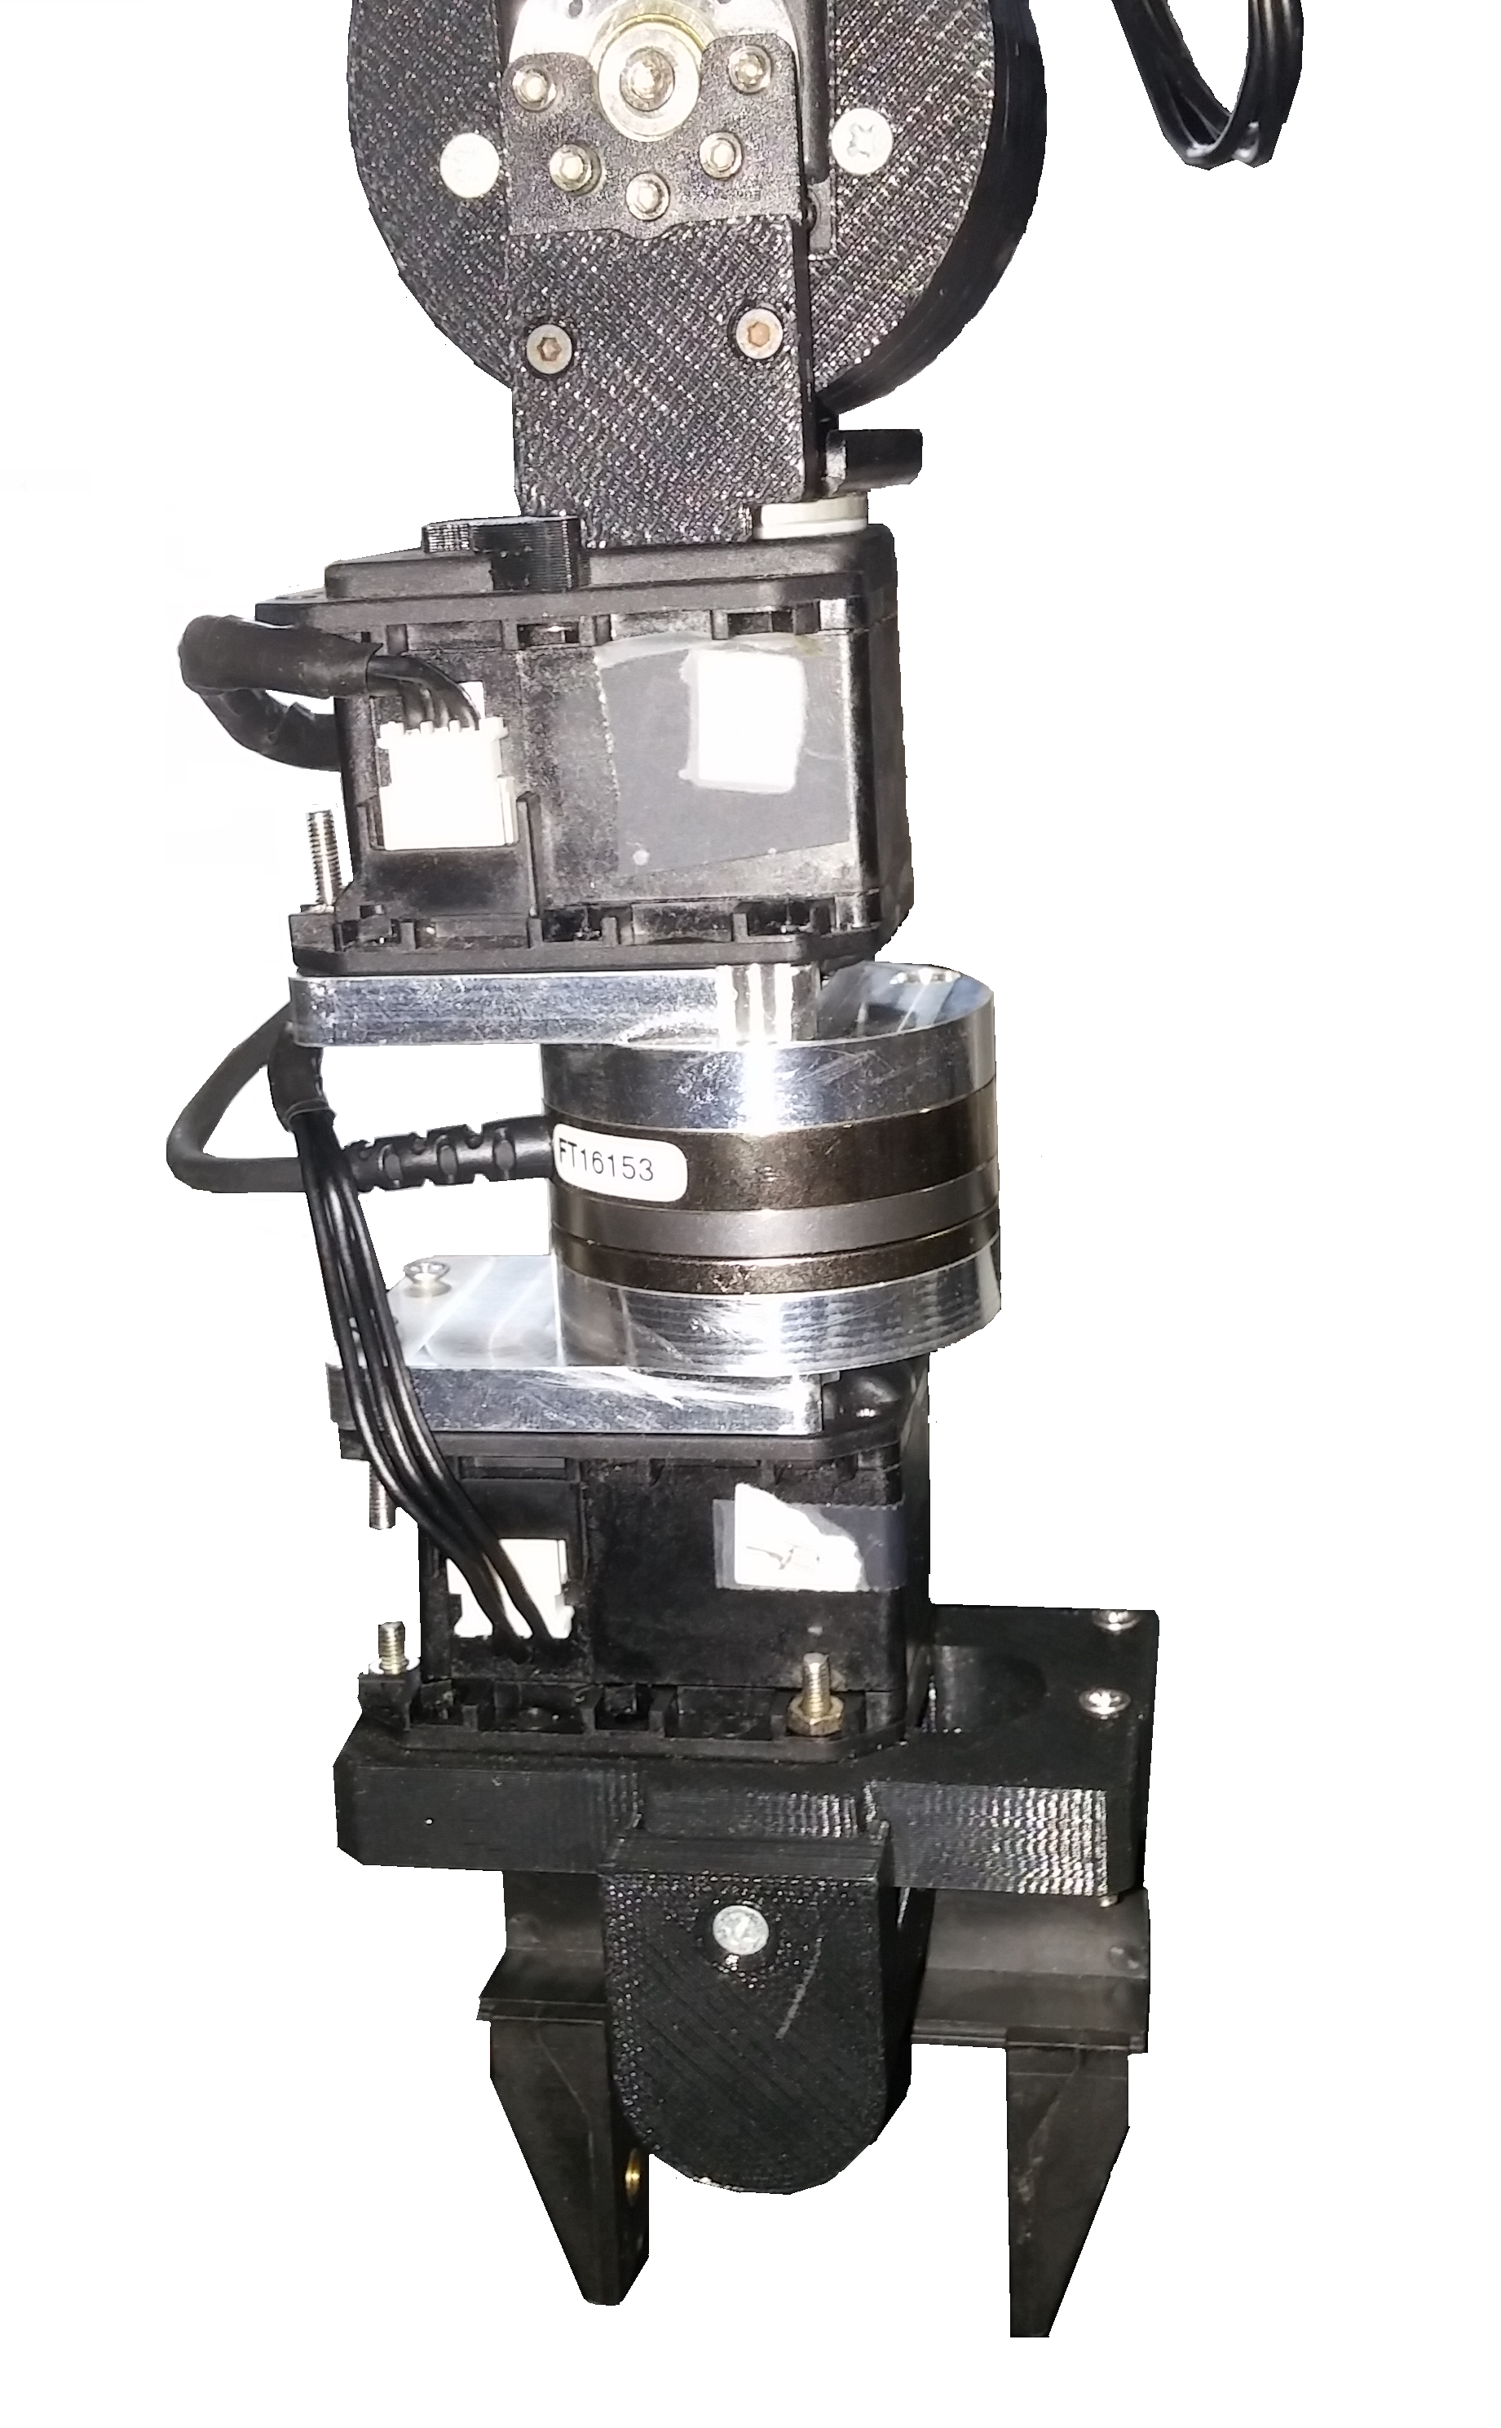
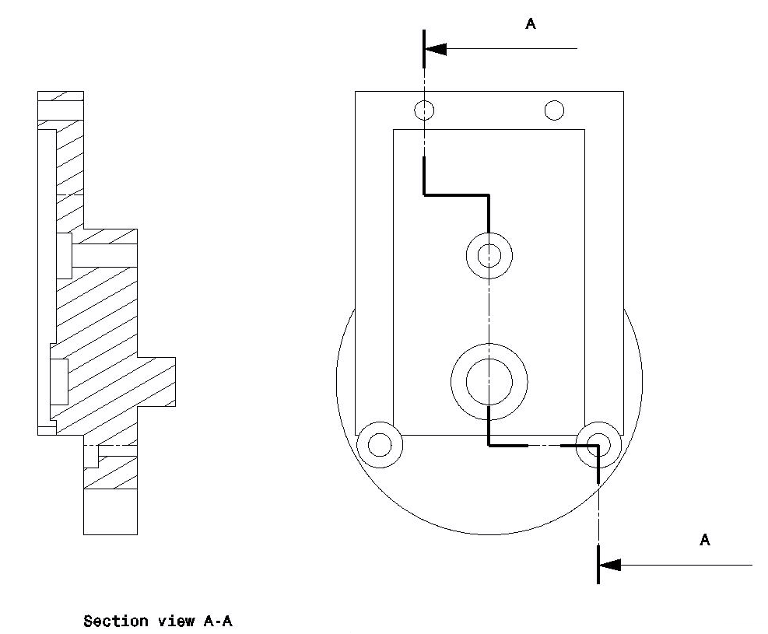
5
Force-based Interaction – Sensor Installation
Mounting side adapter
Mounting side adapter
ATI sensor
Tool side adapter
Tool side adapter

Slide 29
5
Force-based Interaction – FSR Integration
ATI transducer got damaged throughout the work
Feel the object between gripper’s fingers
Detect the starting and ending phases of the object transference
To fulfil these needs, two FSR are installed in Cyton’s gripper
The idea is to observe FSR’s feedback and use it to dictate gripper actions

Slide 30
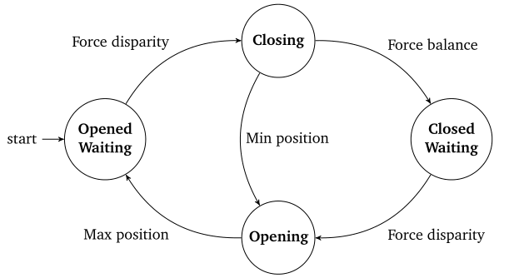
5
Force-based Interaction – FSR Integration
Diagram with states and transitions modeling the objet transfer between a human and the robot

Slide 31
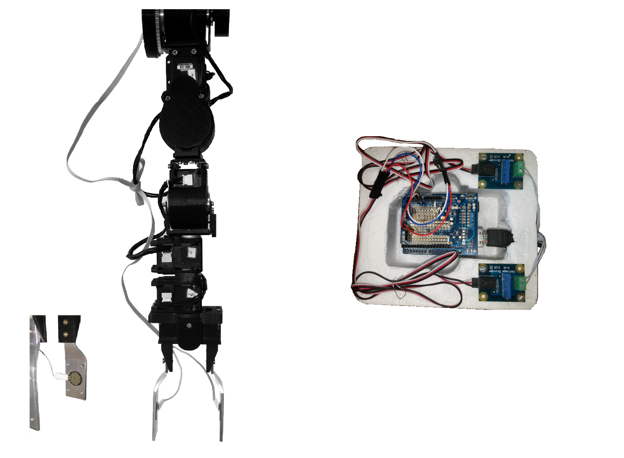
5
Force-based Interaction – FSR’s Overall Assembly
Flex cable
The FSR’s are glued in the center of the gripper’s fingers
These are connected to a box, containing the Arduino plus shields and the voltage dividers, through flex cable
The Arduino is connected through Ethernet to the client computer
Arduino + Ethernet shield + Proto shield
2 Voltage divider
2 FSR

Slide 32
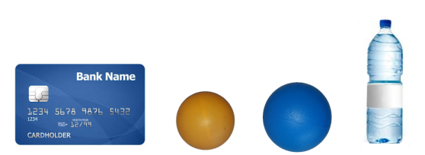
5
Force-based Interaction - Evaluations
Robot arm stiffness is reduced, which affects the force propagation between the object and the sensor
The experimental tests are done with symmetric objects
The object transfer task mainly consists of 4 objects being handed over from the user to the robot gripper
Object: A B C D

Slide 33
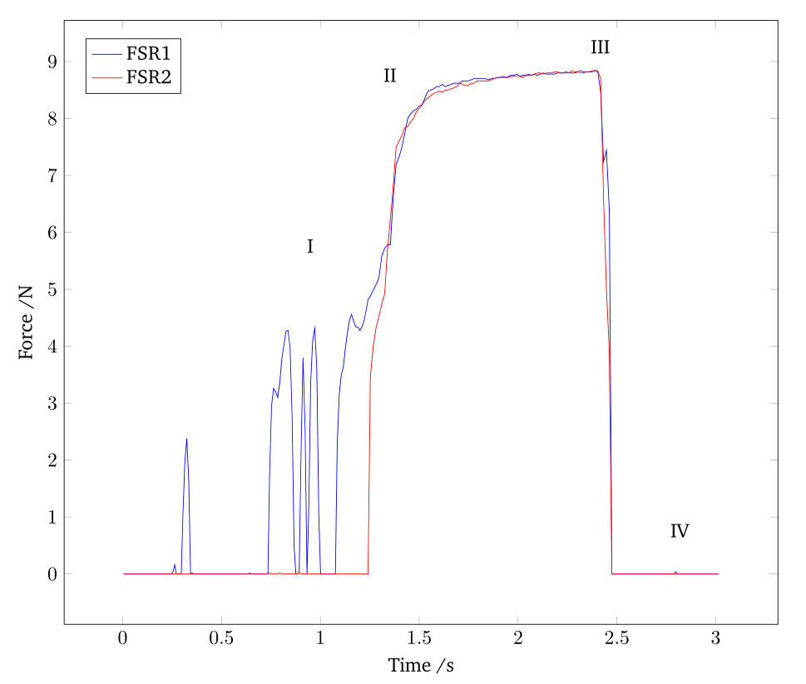
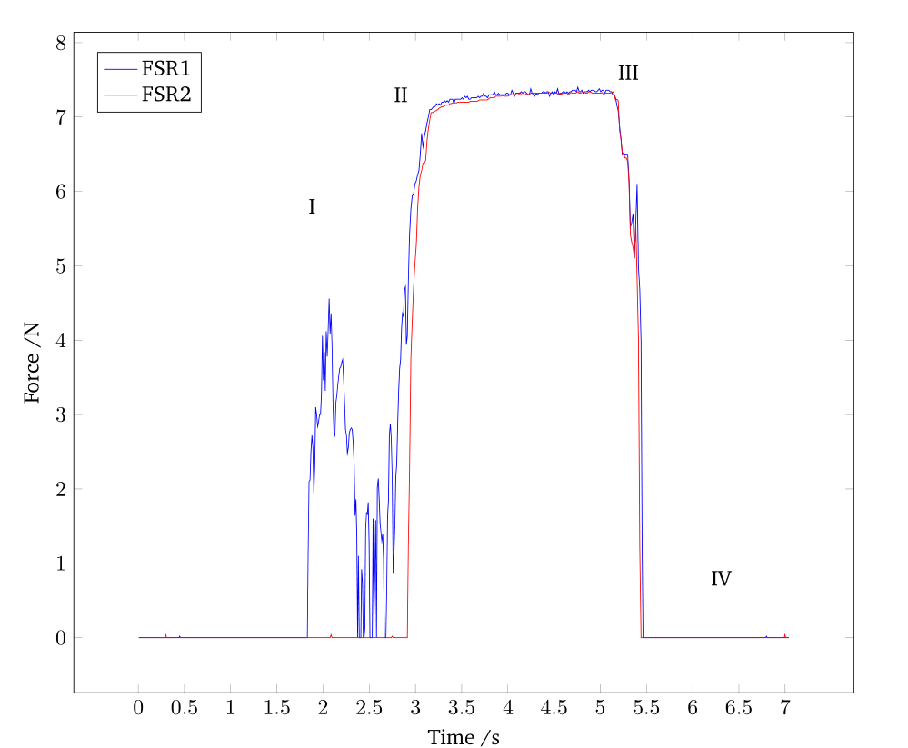
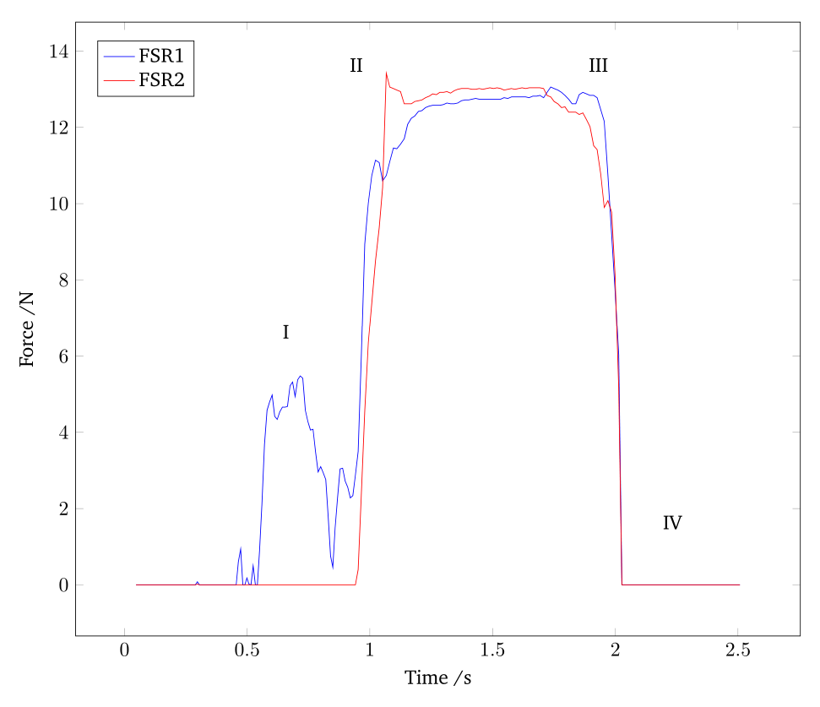
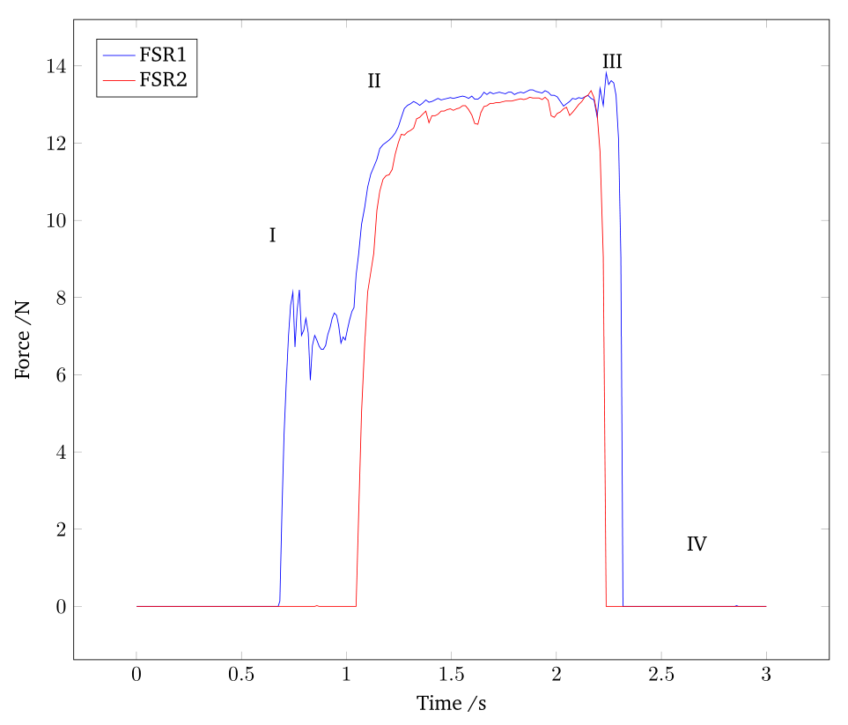
5
Force-based Interaction – Force Evolution
Object A
Object B
I
Object C
Object D
III

Slide 34
5
Force-based Interaction – Force Evolution
I
III

Slide 35
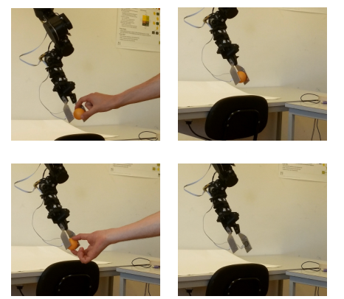
5
Force-based Interaction – Force Evolution
Force evolution for object B in a transference
Illustrations corresponding to the phases (I, II, III and IV) marked on the force evolution graphs
I
II
III
IV

Slide 36
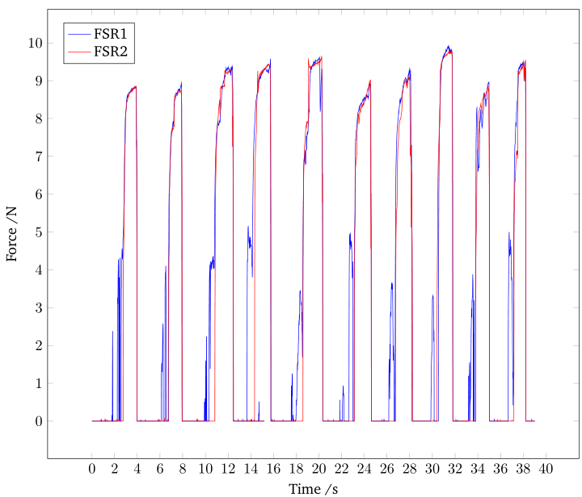
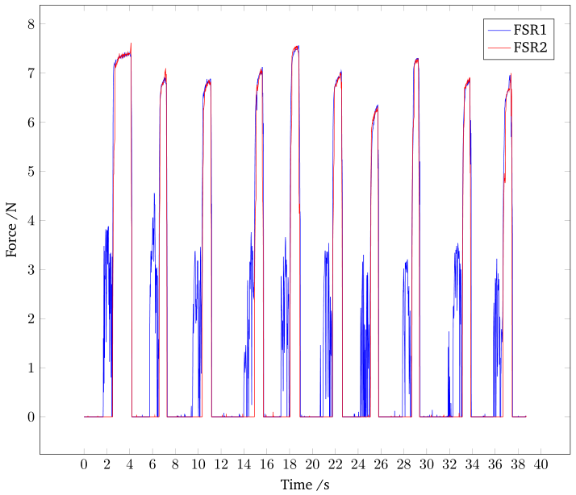
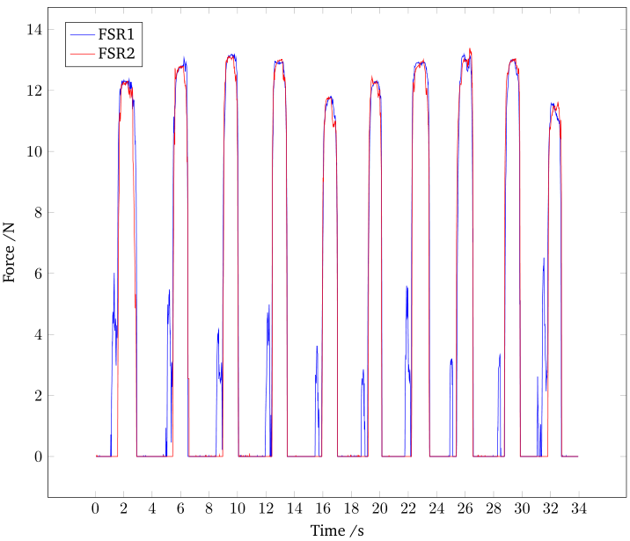
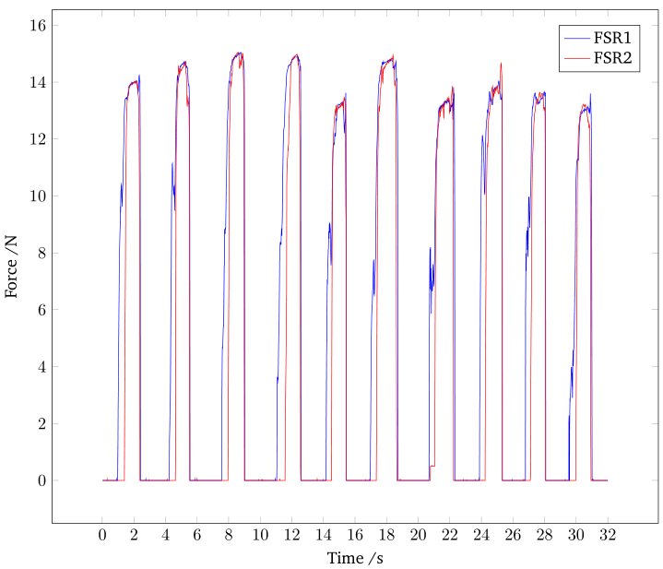
5
Force-based Interaction – Repeatability Analysis
A
B
the forces required to hold the objects are approximately 9, 7, 13 and 14 Newton
force differences are mainly caused by the objects different properties and geometries
a stiffer object (e.g. object A and B when compared with object C and D), requires lower force
C
D

Slide 37
5
Force-based Interaction – Success Rate
Each object is transferred 100 times in order to analyse the success rate
One successful transfer corresponds to the fulfillment of the four phases
Transfer Algorithm Success Rate
The success rate for the objects A and B is quite good
The water bottle object is the one presenting the lower success rate
because not only its properties affect the transference, but its surface
irregularities makes the contact even more difficult

Slide 38
Conclusions and Future Work
6
Overview
Conclusions;
Future Work.

Slide 39
6
Conclusions
The low level control of the robotic arm is accomplished by making use of the dynamixel packages and the MoveIt! software incorporated with a kinematic and dynamic library
The pre-interaction approach using vision is successfully achieved using a 3D sensor
Concerning the interaction by contact approach, despite the misfortune occurred with the ATI sensor mini 40, the implementation of force sensitive resistors made it possible to achieve the proposed goal

Slide 40
6
Future Work
A better robotic manipulator should be used for this kind of task
A torque/force sensor should be implemented in the wrist joint of the manipulator arm
The gripper’s fingers should have more force sensitive resistors to improve the diversity of objects that can be handed over
A complete force analysis, taking into consideration object friction and weight
A database with different objects properties, so that the 3D sensor can recognize the objects and thus adjust the gripper position, orientation and force required to hold these objects

Slide 41
Human-Robot Interaction for Object Transfer
Luís Almeida
Thank You

