Slide 1
Proprioceptive Visual Tracking of a Humanoid Robot Head Motion
João Peixoto[1], Vitor Santos[1;2], and Filipe Silva[1;2]
1 Universidade de Aveiro,
2 Institute for Electronics Engineering and Informatics of Aveiro - IEETA
{joao.peixoto,vitor,fmsilva}@ua.pt

Slide 2
The Problem
1
2
3
4
5
6
Develop a balance algorithm based on the motion of the head;
Measure the motion of the head;
Improve measurements accuracy by merging different sources of data.
7

Slide 3
Experimental Setup
1
2
3
4
5
6
Inertial sensors;
Visual sensors;
Processing Unit.
7

Slide 4
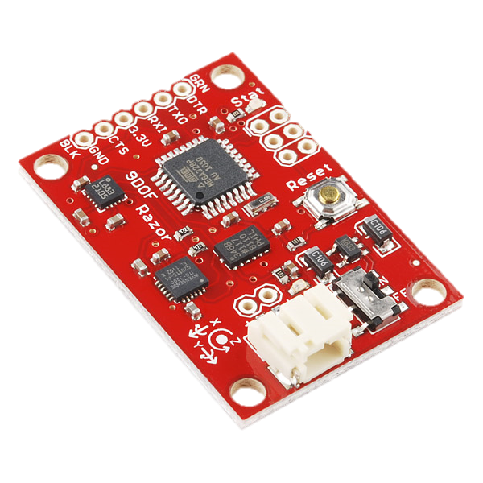
Experimental Setup
1
2
3
4
Sensor A
Sensor B
Processing Unit
Fire-wire Camera
5
6
7
RAZOR 9DOF - SEN 10736

Slide 5
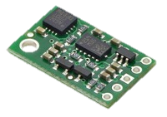
Experimental Setup
1
2
3
4
Sensor A
Sensor B
Processing Unit
Fire-wire Camera
5
6
7
POLOLU - MinIMU9DOF v2

Slide 6
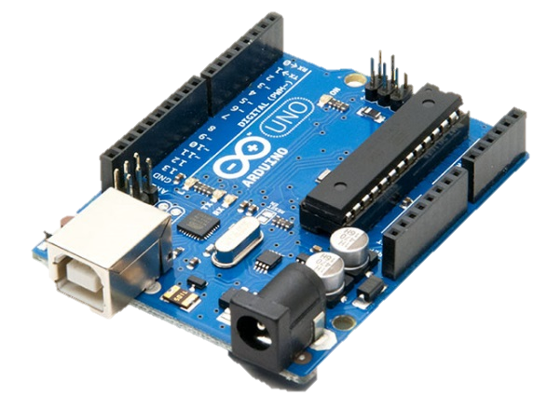
Experimental Setup
1
2
3
4
Sensor A
Sensor B
Processing Unit
Fire-wire Camera
5
6
7
Arduino UNO R3

Slide 7
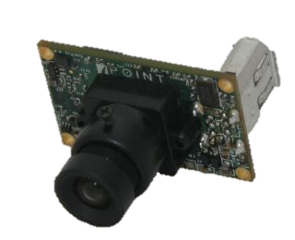
Experimental Setup
1
2
3
4
Sensor A
Sensor B
Processing Unit
Fire-wire Camera
5
6
7
Firefly MV-03MTC - Pointgrey

Slide 8
Experimental Setup
1
2
3
4
5
6
Experiment design problem:
Lack of accurate ground truth.
7

Slide 9
Experimental Setup
1
2
3
4
5
6
FANUC LR Mate 200iB
7
High repeatability;
High end-effector position accuracy;
Reliable ground truth;
Easy experiment design.

Slide 10
1
2
3
4
5
6
7
Fanuc 200iB
POLOLU - MinIMU9DOF v2
RAZOR 9DOF - SEN 10736
Arduino UNO R3
Fire-wire Camera

Slide 11
Obtaining Inertial Data
1
2
3
4
5
6
$${\dot{θ}}_{z}$$
7
$${\dot{θ}}_{y}$$
$${\dot{θ}}_{x}$$

Slide 12
Obtaining Inertial Data
1
2
3
4
$$θ_{x}$$
$$θ_{y}$$
$$θ_{z}$$
5
6
7
$${\dot{θ}}_{z_{k}}$$
$${\dot{θ}}_{y_{k}}$$
$${\dot{θ}}_{x_{k}}$$

Slide 13
Obtaining Visual Data
1
2
3
4
5
6
Blob Detection Method;
Feature Extraction Method.
7

Slide 14
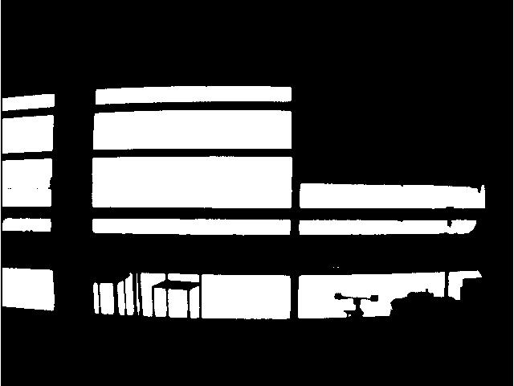
Blob Detection
1
2
3
4
5
6
7

Slide 15
Blob Detection
1
2
3
4
5
$$θ_{y}=0 \left(°\right)$$
6
7

Slide 16
Blob Detection
1
2
3
4
5
$$θ_{y}=55 \left(°\right)$$
6
7

Slide 17
Blob Detection
1
2
3
4
5
6
Advantages
7
Direct measure of angular position;
Not dependent of previous measures.
Disadvantages
Lack of robustness

Slide 18
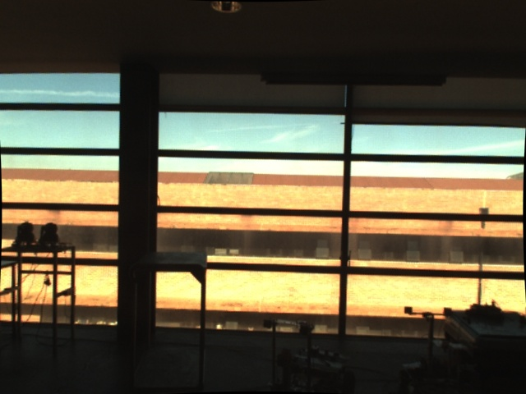
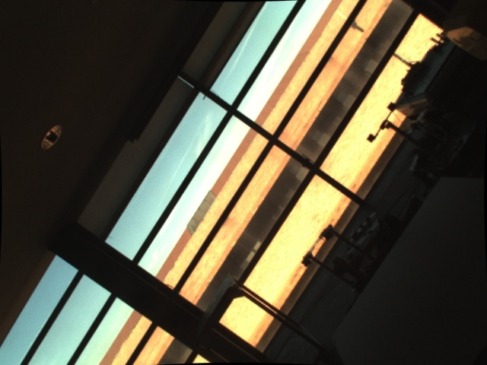
Feature Extraction
1
2
3
4
5
6
7

Slide 19
Feature Extraction
1
2
3
4
5
6
7

Slide 20
Feature Extraction
1
2
3
4
5
6
7
$$\left[T\right]$$

Slide 21
Feature Extraction
1
2
3
4
5
$${θ_{T}}_{k}−θ_{T_{k−1}}=Δ{θ_{T}}_{k}$$
6
$$\left[T\right]=\left[\begin{aligned}cosθ_{T} −sinθ_{T} { d}_{z} \\ senθ_{T} cosθ_{T} d_{x} \\ 0 0 1\end{aligned}\right]$$
7
$${θ_{y}}_{k}={{Δθ}_{T}}_{k}+{θ_{y}}_{k−1}$$
$${{\dot{θ}}_{y}}_{k}=\frac{Δ{θ_{T}}_{k}}{Δt_{k}}+{{\dot{θ}}_{y}}_{k−1}$$

Slide 22
1
2
Feature Extraction
3
4
5
6
Advantages
7
More robust method, which can operate in several environments;
Can be used for various tasks, like mapping or scene recognition.
Disadvantages
Relies on previous measurements

Slide 23
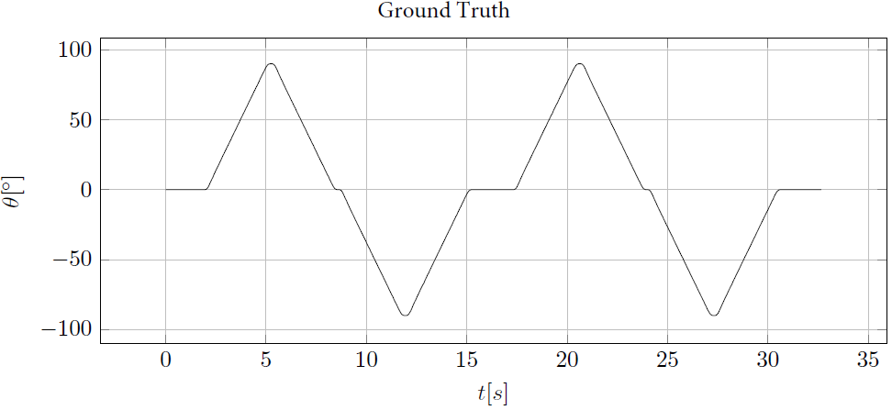
Visual Tracking
1
2
3
4
5
6
7

Slide 24
Visual Tracking
1
2
3
4
5
6
7

Slide 25
Results
1
2
3
4
5
6
7

Slide 26
Kalman Filter
1
2
3
4
5
6
7
$$x_{k}={A.x}_{k−1}+B.u_{k−1}+w_{k}$$
$$y_{k}=C.x_{k}+v_{k}$$

Slide 27
Data Merging Using Kalman Filter
1
2
3
4
5
6
$$State Variables:$$
$$x_{k}=\left[\begin{aligned}θ_{x} \\ θ_{y} \\ θ_{z} \\ {\dot{θ}}_{x} \\ {\dot{θ}}_{y} \\ {\dot{θ}}_{z}\end{aligned}\right]$$
7
$$x_{k}={A.x}_{k−1}+B.u_{k−1}+w_{k}$$
$$y_{k}=C.x_{k}+v_{k}$$

Slide 28
Data Merging Using Kalman Filter
1
2
3
4
5
$$Model Definition:$$
$$θ_{k}=θ_{k−1}+ {\dot{θ}}_{k−1}.∆_{t}+0,5.{\ddot{θ}}_{k−1}.{∆t}^{2}$$
$${\dot{θ}}_{k}={\dot{θ}}_{k−1}+{\ddot{θ}}_{k−1}.∆t$$
$${\ddot{θ}}_{k−1}=u_{k}=\left\{\begin{aligned}0 \\ {({\dot{θ}}_{k−1}−{\dot{θ}}_{k−2})}/{∆t_{k}}\end{aligned}\right.$$
6
7
$$x_{k}={A.x}_{k−1}+B.u_{k−1}+w_{k}$$
$$y_{k}=C.x_{k}+v_{k}$$

Slide 29
Data Merging Using Kalman Filter
1
2
3
4
5
$$Model Definition:$$
$$θ_{k}=θ_{k−1}+ {\dot{θ}}_{k−1}.∆_{t}+0,5.{\ddot{θ}}_{k−1}.{∆t}^{2}$$
$${\dot{θ}}_{k}={\dot{θ}}_{k−1}+{\ddot{θ}}_{k−1}.∆t$$
6
7
$$x_{k}={A.x}_{k−1}+B.u_{k−1}+w_{k}$$
$$y_{k}=C.x_{k}+v_{k}$$
$$A=\left[\begin{aligned}1 0 0 Δ_{t} 0 0 \\ 0 1 0 0 Δ_{t}0 \\ 0 0 1 0 0 Δ_{t} \\ 0 0 0 1 0 0 \\ 0 0 0 0 1 0 \\ 0 0 0 0 0 1\end{aligned}\right]$$
$$B=\left[\begin{aligned}0,5{∆t}^{2} \\ 0,5{∆t}^{2} \\ 0,5{∆t}^{2}\end{aligned}\right]$$

Slide 30
Data Merging Using Kalman Filter
1
2
3
4
5
6
$\left[\begin{aligned}θ_{x_{i}} \\ θ_{y_{i}} \\ θ_{z_{i}} \\ {\dot{θ}}_{x_{i}} \\ {\dot{θ}}_{y_{i}} \\ {\dot{θ}}_{z_{i}}\end{aligned}\right]$=$\left[\begin{aligned}1 0 0 Δ_{t} 0 0 \\ 0 1 0 0 Δ_{t}0 \\ 0 0 1 0 0 Δ_{t} \\ 0 0 0 1 0 0 \\ 0 0 0 0 1 0 \\ 0 0 0 0 0 1\end{aligned}\right]$. $\left[\begin{aligned}θ_{x_{i−1}} \\ θ_{y_{i−1}} \\ θ_{z_{i−1}} \\ {\dot{θ}}_{x_{i−1}} \\ {\dot{θ}}_{y_{i−1}} \\ {\dot{θ}}_{z_{i−1}}\end{aligned}\right]$
7
+$\left[\begin{aligned}0,5{∆t}^{2} \\ 0,5{∆t}^{2} \\ 0,5{∆t}^{2}\end{aligned}\right]\left[\begin{aligned}{\ddot{θ}}_{x_{i−1}} \\ {\ddot{θ}}_{y_{i−1}} \\ {\ddot{θ}}_{z_{i−1}}\end{aligned}\right]$
$$x_{k}={A.x}_{k−1}+B.u_{k−1}+w_{k}$$
$$y_{k}=C.x_{k}+v_{k}$$

Slide 31
Data Merging Using Kalman Filter
1
2
3
4
$${\dot{θ}}_{z_{k}}$$
5
6
$$y_{k}=\left[\begin{aligned} \\ \\ \\ \\ \\ \\ \\ \\ …\end{aligned}\right]$$
7
$${\dot{θ}}_{y_{k}}$$
$${\dot{θ}}_{x_{k}}$$
$$x_{k}={A.x}_{k−1}+B.u_{k−1}+w_{k}$$
$$y_{k}=C.x_{k}+v_{k}$$

Slide 32
Data Merging Using Kalman Filter
1
2
3
4
$${\dot{θ}}_{z_{k}}$$
5
$$y_{k}=\left[\begin{aligned} \\ \\ \\ {\dot{θ}}_{x} \\ {\dot{θ}}_{y} \\ {\dot{θ}}_{z} \\ \\ \\ \end{aligned}\right]$$
6
7
$${\dot{θ}}_{y_{k}}$$
$$x_{k}={A.x}_{k−1}+B.u_{k−1}+w_{k}$$
$$y_{k}=C.x_{k}+v_{k}$$
$${\dot{θ}}_{x_{k}}$$

Slide 33
Data Merging Using Kalman Filter
1
2
3
4
5
$$y_{k}=\left[\begin{aligned}θ_{x} \\ θ_{y} \\ θ_{z} \\ {\dot{θ}}_{x} \\ {\dot{θ}}_{y} \\ {\dot{θ}}_{z} \\ \\ \\ …\end{aligned}\right]$$
6
7
$$x_{k}={A.x}_{k−1}+B.u_{k−1}+w_{k}$$
$$y_{k}=C.x_{k}+v_{k}$$

Slide 34
Data Merging Using Kalman Filter
1
2
3
4
5
$$y_{k}=\left[\begin{aligned}θ_{x} \\ θ_{y} \\ θ_{z} \\ {\dot{θ}}_{x} \\ {\dot{θ}}_{y} \\ {\dot{θ}}_{z} \\ {θ_{C}}_{y} \\ {{\dot{θ}}_{C}}_{y} \\ …\end{aligned}\right]$$
6
7
$$x_{k}={A.x}_{k−1}+B.u_{k−1}+w_{k}$$
$$y_{k}=C.x_{k}+v_{k}$$

Slide 35
Data Merging Using Kalman Filter
1
2
3
4
$$y_{k}=\left[\begin{aligned}θ_{x} \\ θ_{y} \\ θ_{z} \\ {\dot{θ}}_{x} \\ {\dot{θ}}_{y} \\ {\dot{θ}}_{z} \\ {θ_{C}}_{y} \\ {{\dot{θ}}_{C}}_{y} \\ …\end{aligned}\right]$$
5
$$C=\left[\begin{aligned}1 0 0 0 0 0 \\ 0 1 0 0 0 0 \\ 0 0 1 0 0 0 \\ 0 0 0 1 0 0 \\ 0 0 0 0 1 0 \\ 0 0 0 0 0 1 \\ 0 1 0 0 0 0 \\ 0 0 0 0 1 0 \\ …\end{aligned}\right]$$
6
$$x_{k}=\left[\begin{aligned}θ_{x} \\ θ_{y} \\ θ_{z} \\ {\dot{θ}}_{x} \\ {\dot{θ}}_{y} \\ {\dot{θ}}_{z}\end{aligned}\right]$$
7
$$x_{k}={A.x}_{k−1}+B.u_{k−1}+w_{k}$$
$$y_{k}=C.x_{k}+v_{k}$$

Slide 36
Data Merging Using Kalman Filter
1
2
3
4
5
I
I
I
I
I
I
I
I
I
I
I
I
I
I
I
6
V
V
V
*1
V
V
7
*1
$$G_{k}=\left[\begin{aligned}……………… \\ ……………… \\ ……………… \\ ……………… \\ ……………… \\ ……………… \\ 0 0 0 0 0 0 \\ 0 0 0 0 0 0\end{aligned}\right]$$
Kalman Filter
MD
MD
MD
MD
MD
MD

Slide 37
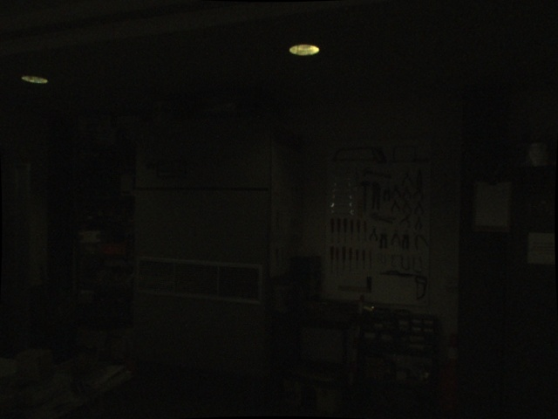
Results
1
2
3
4
5
6
7

Slide 38
Results
1
2
3
4
5
6
7

Slide 39
Results
1
2
3
4
5
6
Kalman Filter
$$u_{k}={({\dot{θ}}_{k−1}−{\dot{θ}}_{k−2})}/{∆t_{k}}$$
Kalman Filter
$$u_{k}=0$$
No Treatment
7
Inertial Data
Visual Data
Merged Data
Ground Truth

Slide 40
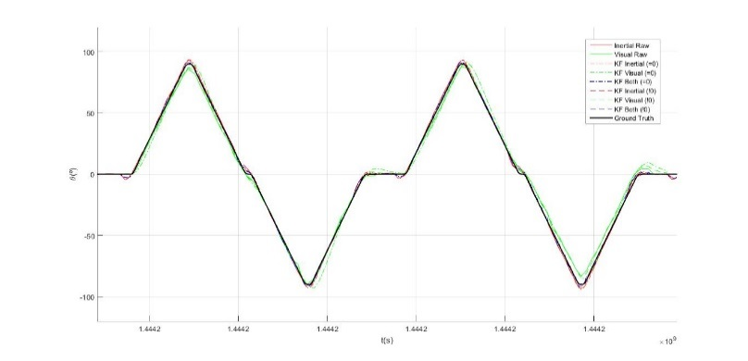
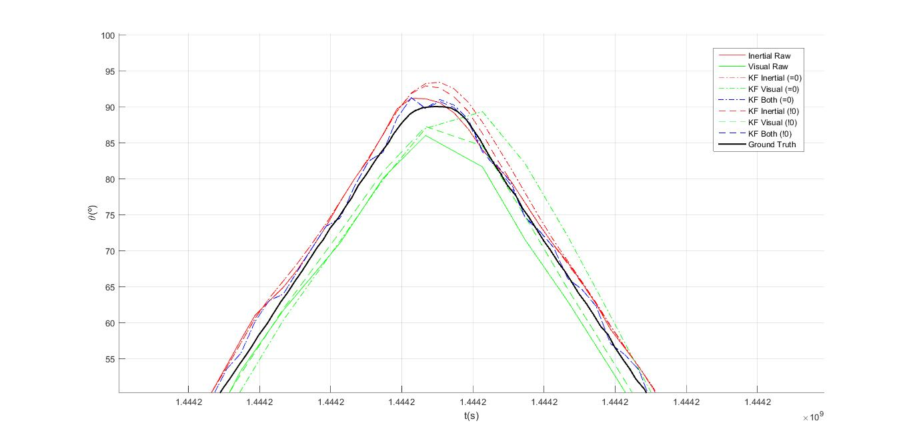
Experiment 1

Slide 41
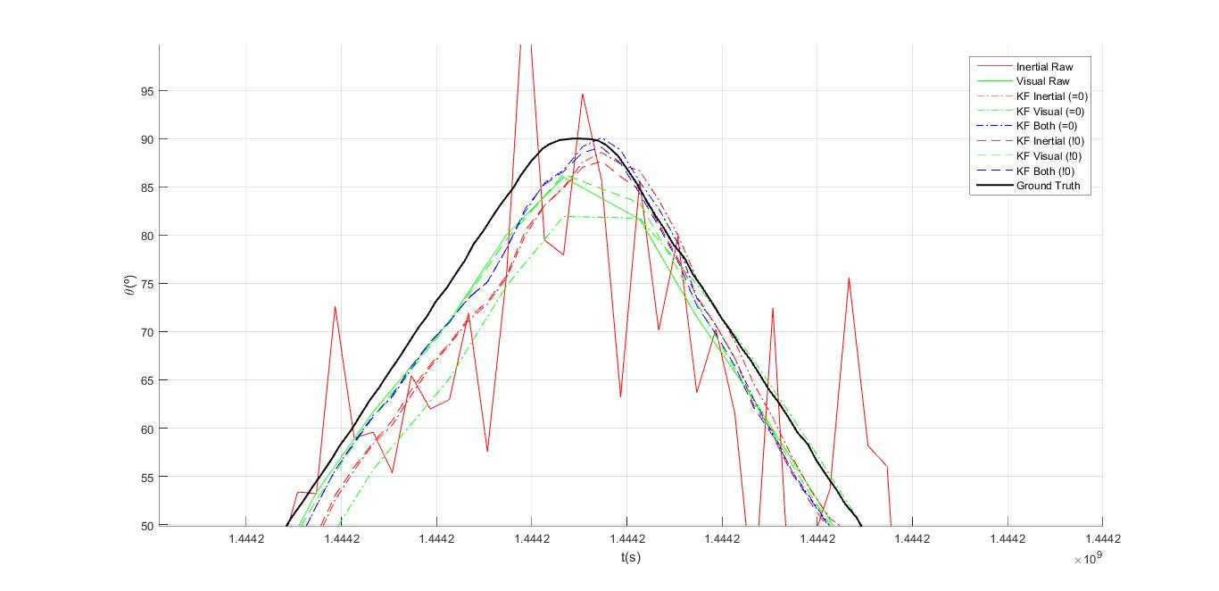
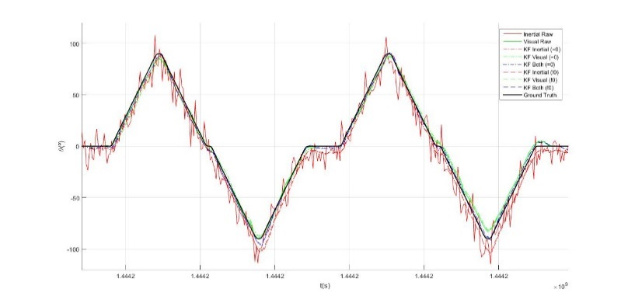
Experiment 1 (Error)

Slide 42
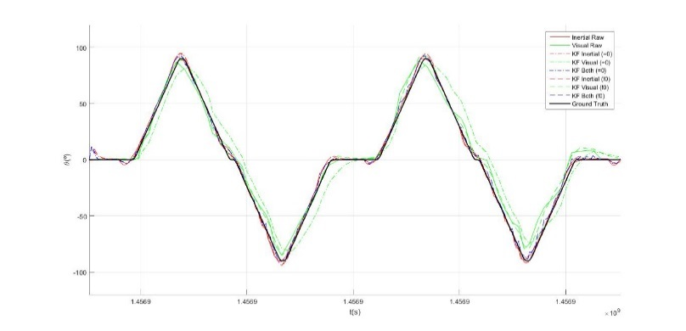
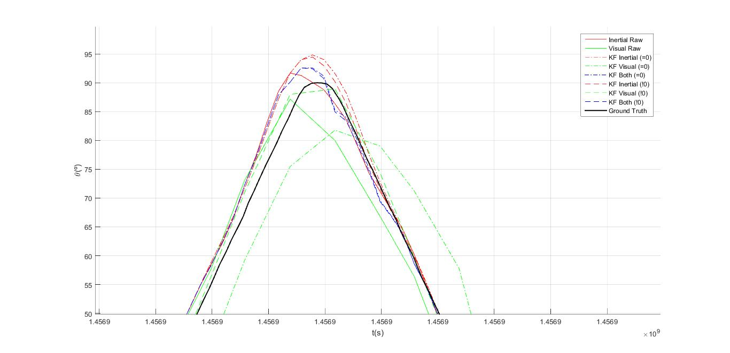
Experiment 2

Slide 43
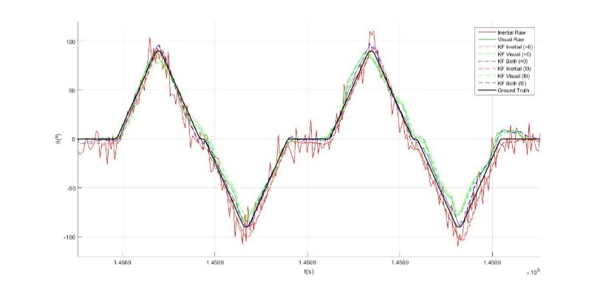
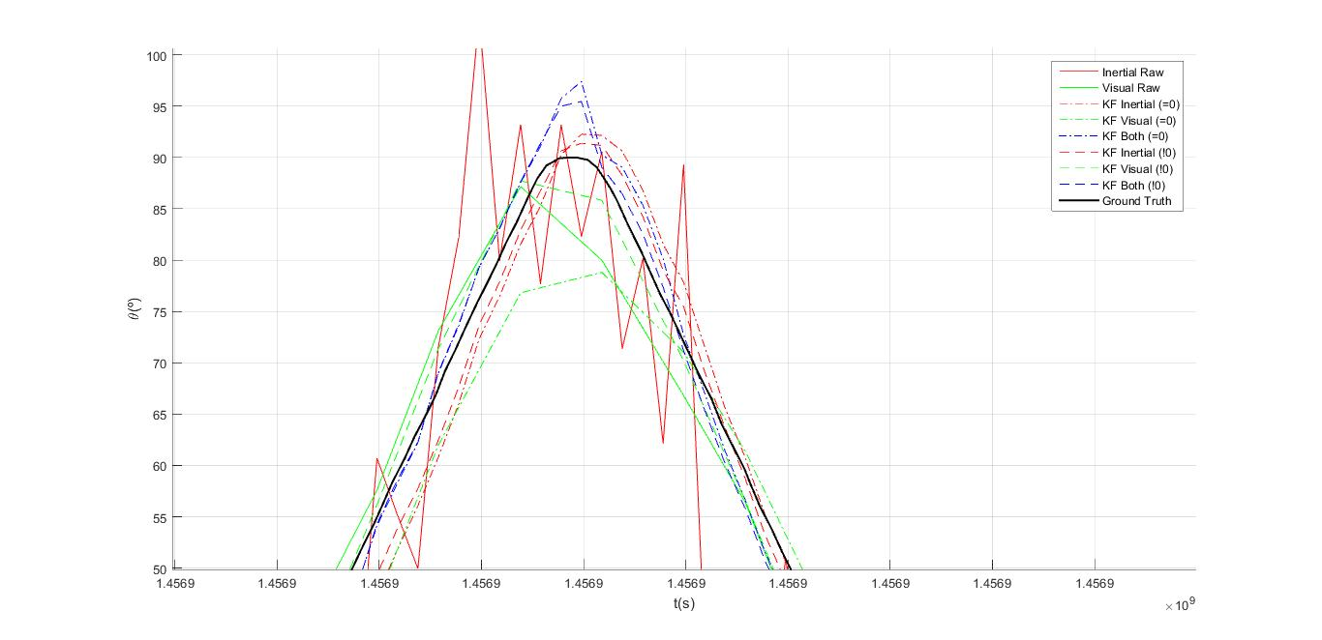
Experiment 2 (Error)

Slide 44
Conclusions
FANUC 200iB provides accurate and reliable ground truth;
Merging inertial and visual data will wield better results than the original data by itself;
Kalman Filter is robust to noise;
Worst cases will have better improvement;
Extensible tool/approach.

