Slide 1

Servo-pilot for autonomous driving
universidade de aveiro
theoria poiesis praxis
Emanuel Avila
Scientific advisors:
Ph.D. Vitor Santos
Ph.D. Jorge Ferreira

Slide 2
Summary
Introduction
Sensor network
Actuation system
Tests and results
Conclusions
Future work

Slide 3
introduction

Slide 4
Motivation
Atlas project success;
AtlasCar1 acquisition;
Software interface necessity.
Notes:
Atlas project 3rd stage;

Slide 5
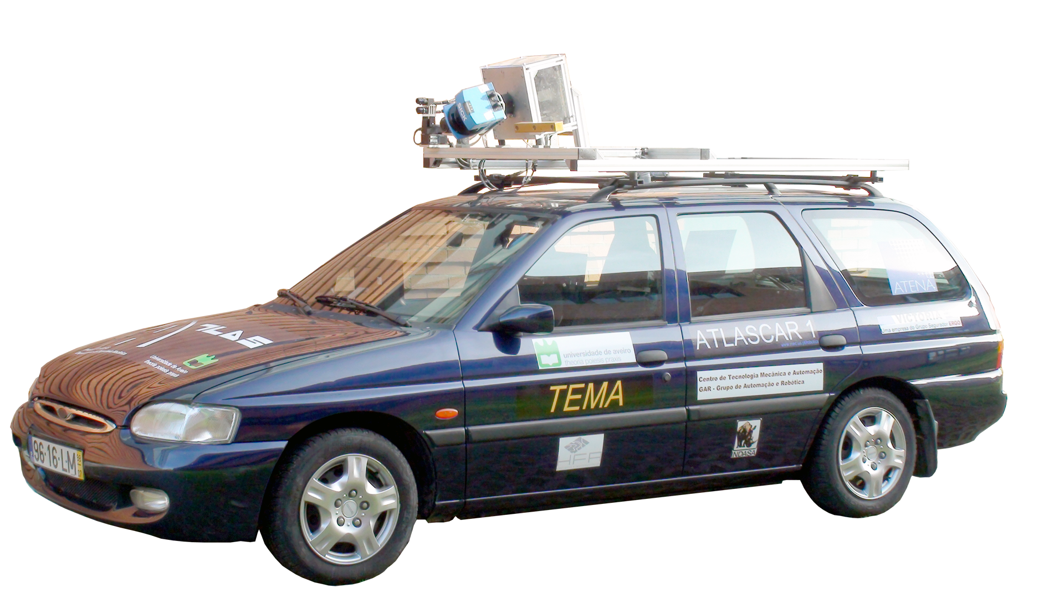


Atlas project
Notes:
Autonomous navigation projects;
5 years consecutive national champion;

Slide 6
Brief description
Monitor driver’s actions;
Update vehicle to drive-by-wire;

Slide 7
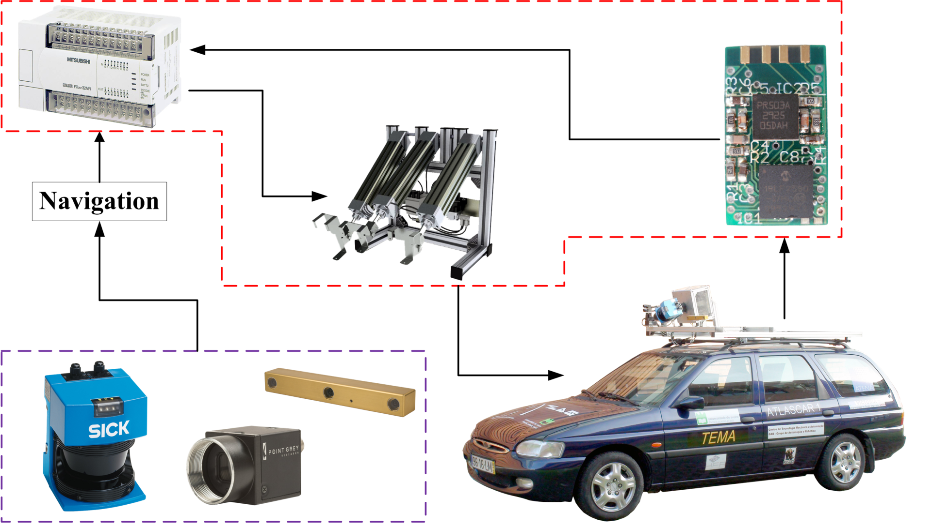
AtlasCAR1
Notes:
What is a servo pilot;
My work, actuation project, sensor development.

Slide 8
Actuation system

Slide 9
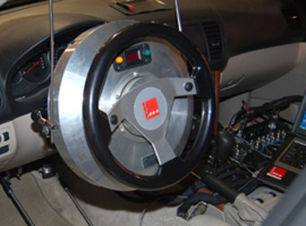
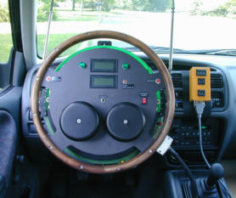
State-of-the-Art
SEA, Ltd. ASC
ATI/Heitz Sprint 3
Notes:
Only can preform open loop actuation;
Replace the vehicle steering wheel;
Take long time to install;

Slide 10
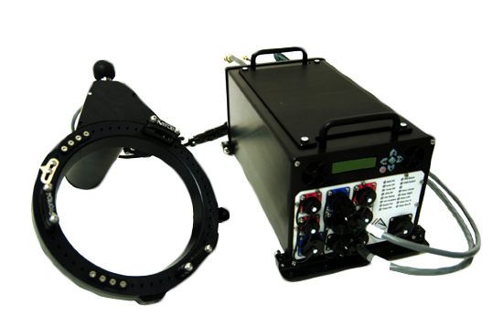
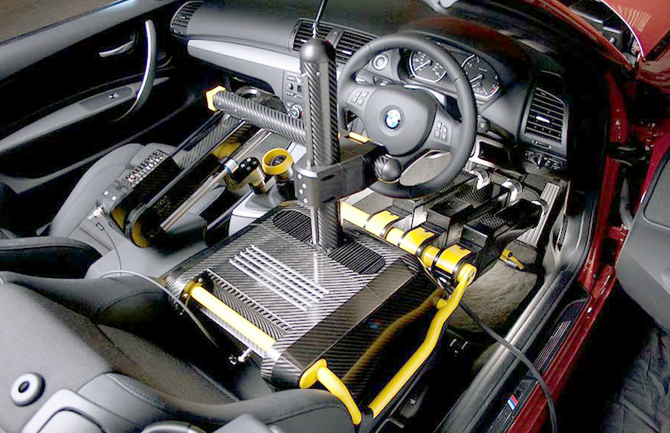
State-of-the-Art
Kairos Autonomi® Pronto4™
Froude Hofmann Robot Driver
Notes:
Pronto4 Requires vehicle modifications and takes 4H to install;
Froude is only suitable for Dynamometer tests;

Slide 11
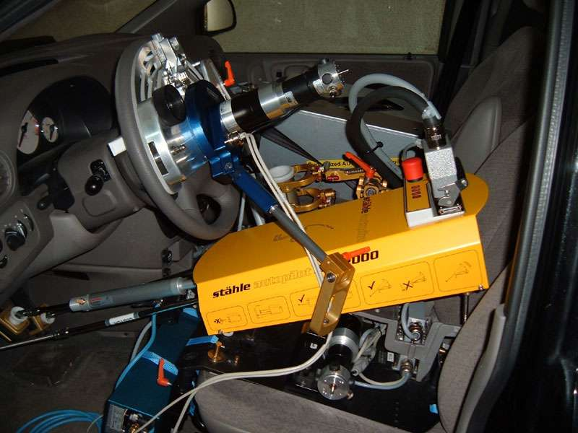
State-of-the-Art
Stähle SPF2000FF
Does not require vehicle modifications;
Relatively easy and quick to install;
Prices start at 135.000€
Notes:
Controls steering, pedals and gear lever;
Very complete system;

Slide 12
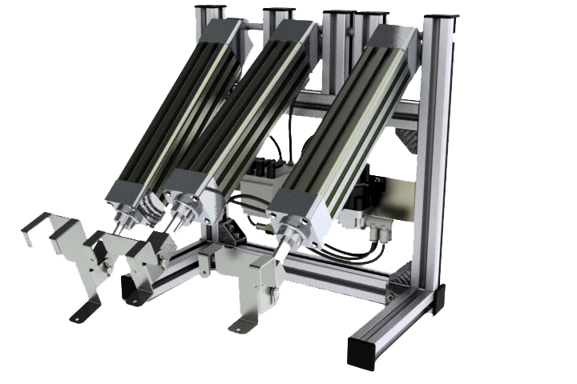
Project
Light and compact;
Does not require vehicle modifications;
Very quick to install;
Force actuated;
Notes:
Standard parts built;
Electric pressure regulators allow PID control;
Low friction cylinders;
Control preformed by PLC;

Slide 13
Sensor network
Notes:
Responsible for feedback;

Slide 14
Servo-feedback
Potentiometers;
Encoders;
Inertial systems.
Notes:
Anchorage points;
Contact wear;

Slide 15
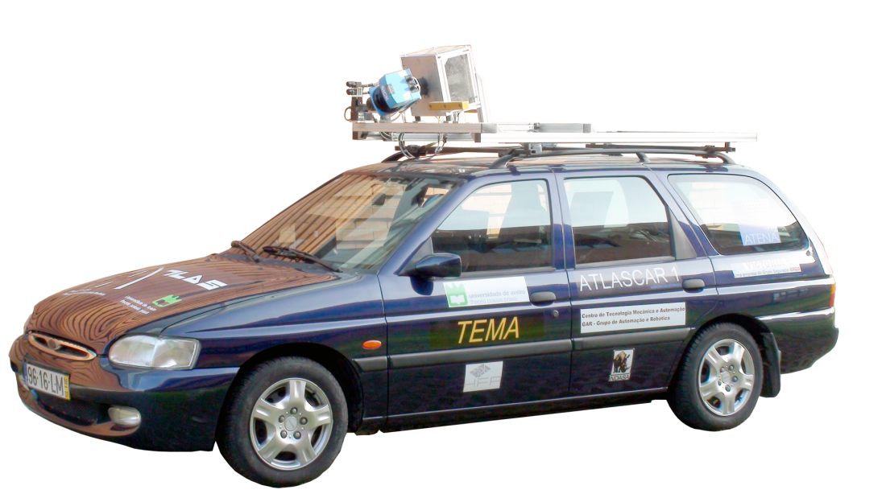
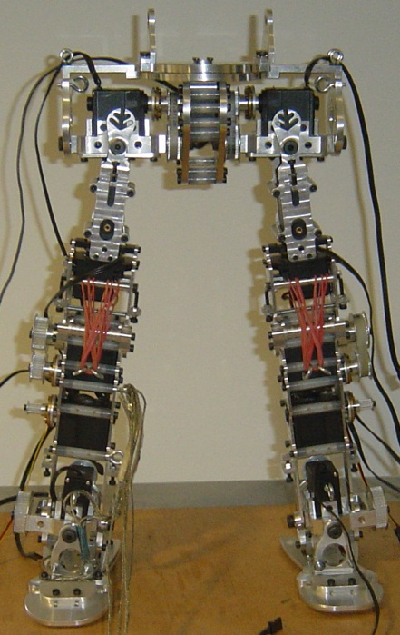
Inertial systems
AtlasCar1;
Humanoid Robots;
Anthropometry.
Notes:
Monitor Driver’s actions;
Inertial measurement and balance for humanoid robots;
Anthropometry for handicapped rehabilitation;
Highlight the other applications;

Slide 16
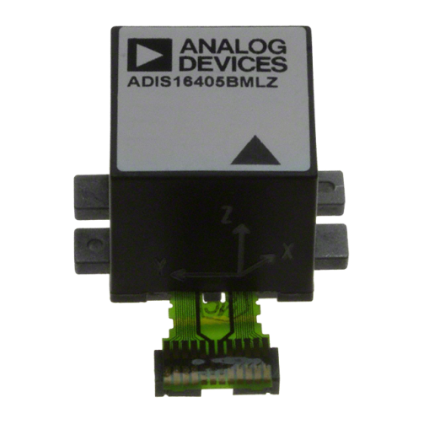
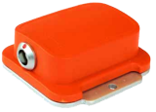
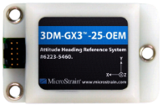

State-of-the-Art
Notes:
DSP in Xsens and MicroStrain;
Transformation matrix;
3D orientations;
Raw data in the others;

Slide 17
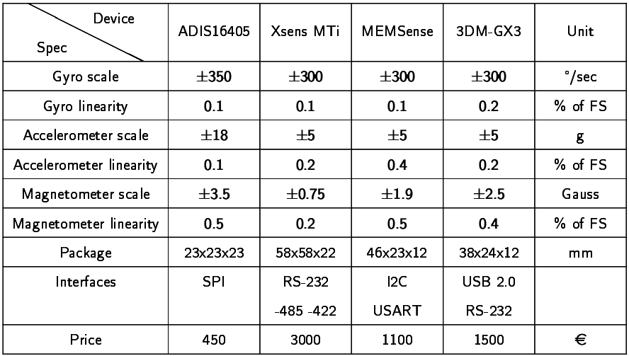
State-of-the-Art
Notes:
Price tags;
Dimensions;
This devices are based on MEMS;
Microelectromechanical systems;

Slide 18
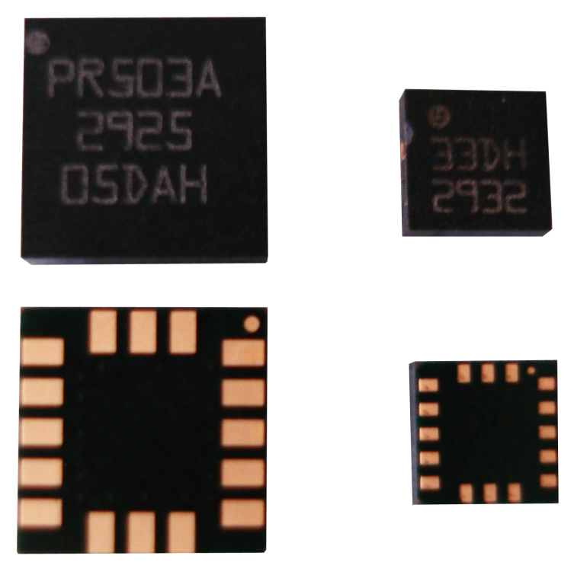
MEMS
ST LPR503AL dual axis pitch and roll analog gyroscope;
ST LIS331DLH ultra low-power high performance 3-axes “nano” accelerometer.

Slide 19
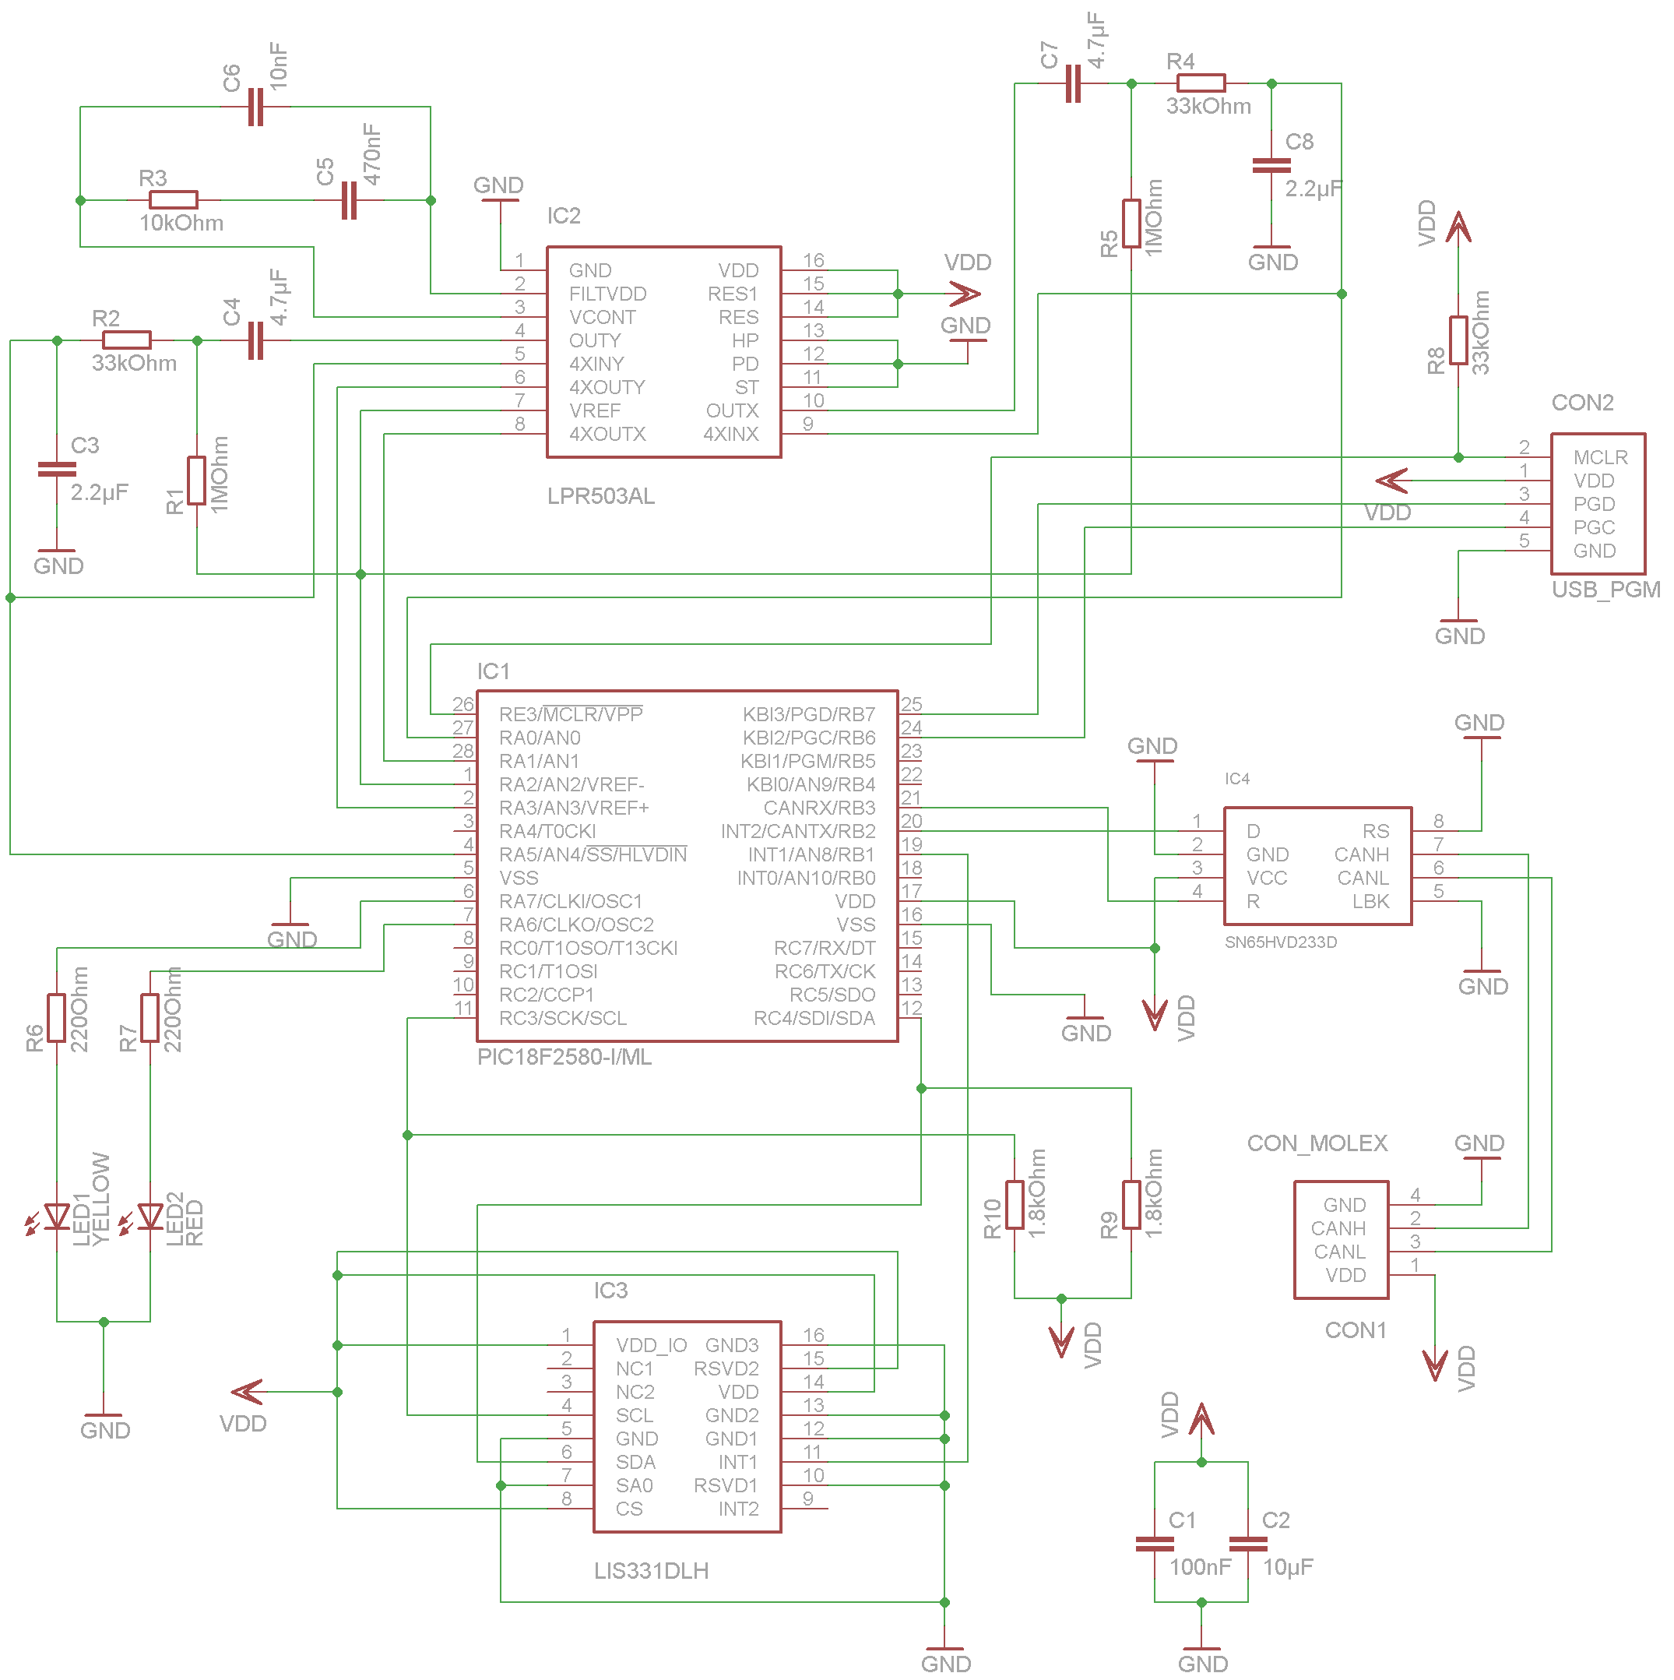
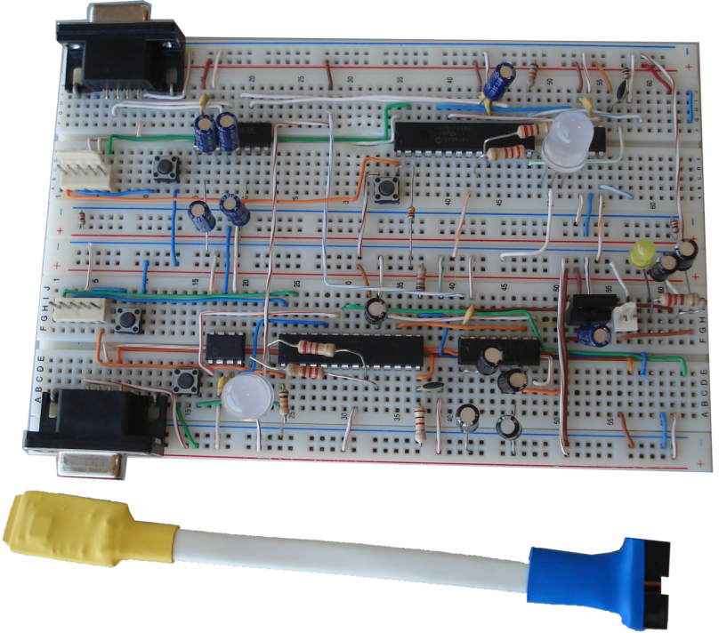
Prototype
Notes:
Proof of concept;
Software debug;
Learning and debugging communications;
Interface boards for surface mount MEMS;

Slide 20
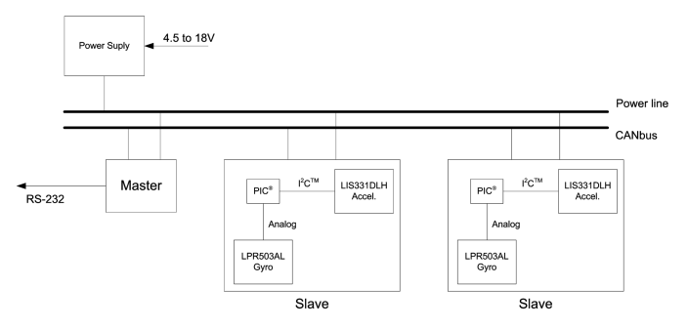
Architecture
Notes:
I²C bus failure;
Expandability;
CANbus tolerance to noise;

Slide 21
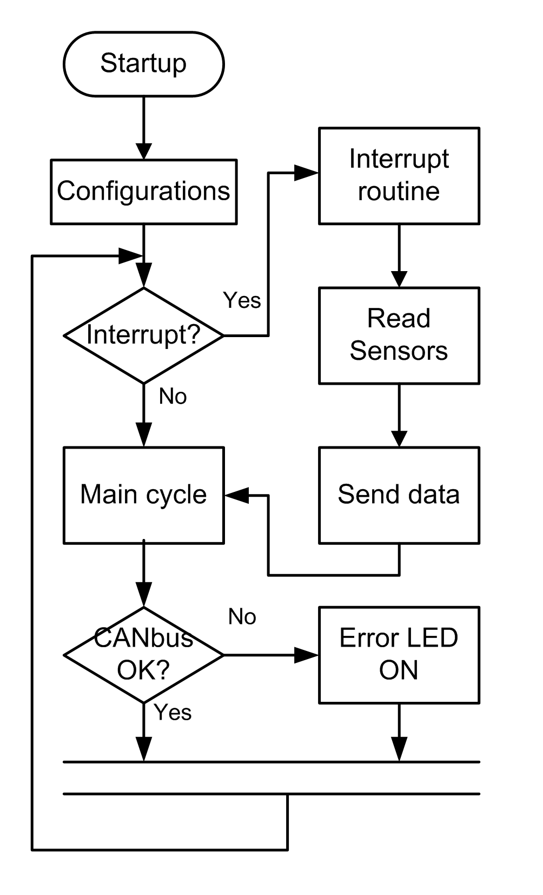
Slave software
Simple routines;
Interrupt driven;
Use of MPLAB® peripheral and CAN libraries.
Notes:
Interrupt driven to reduce data lag;
Interrupt triggered by accelerometer;
Watchdogs to detect error status;
ID defined in EEPROM;
MPLAB® libraries to handle peripheral and CAN functions for software robustness;

Slide 22
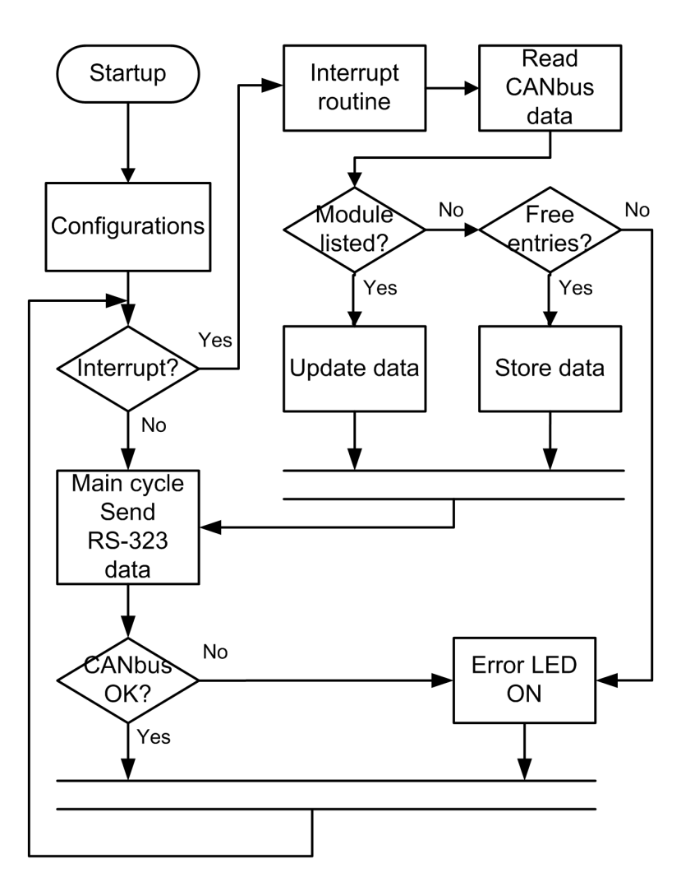
Master software
Interrupt driven;
Use of MPLAB® peripheral and CAN libraries;
Database handling.
Notes:
Interrupt driven to reduce data lag;
Interrupt triggered by CANbus reception;
Watchdogs to detect error status;
Newest data is stored in database, inactive sensors are removed from database;
USART rate set in EEPROM.

Slide 23
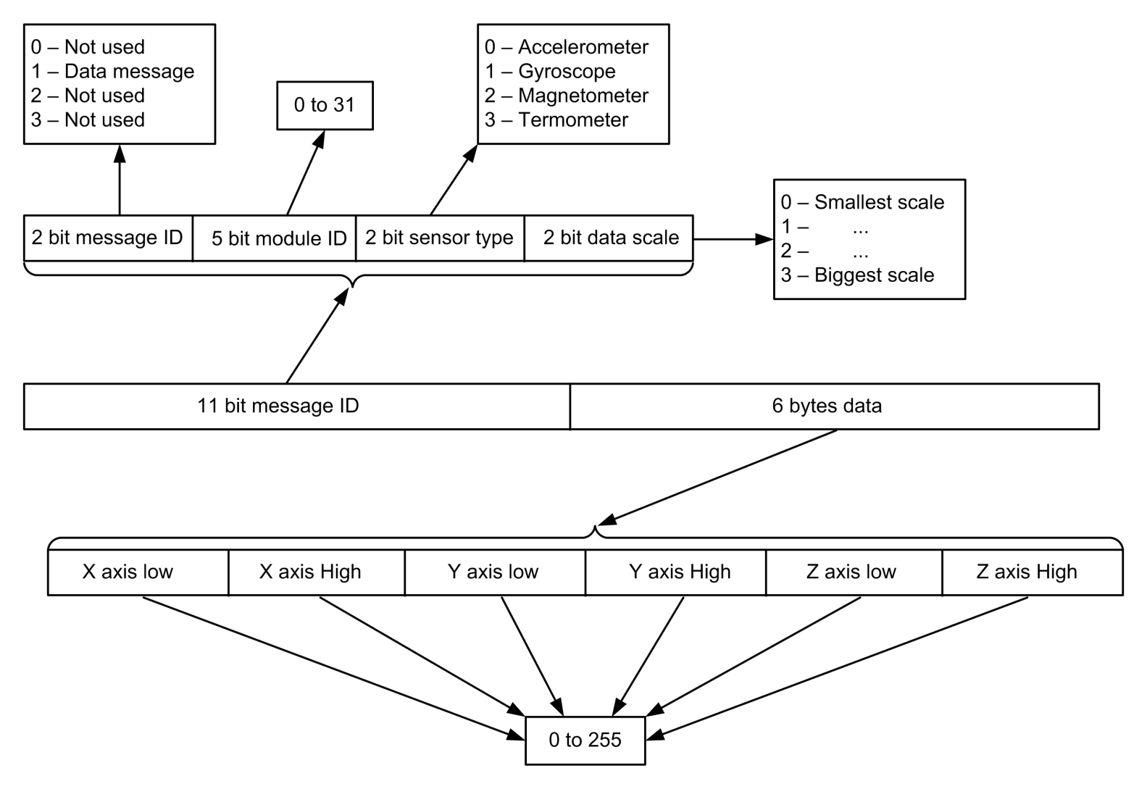
CANbus protocol
Notes:
Use of message ID mandatory bytes to transmit data, reducing message length;
Protocol can be updated to carry more message types, sync data etc..;

Slide 24
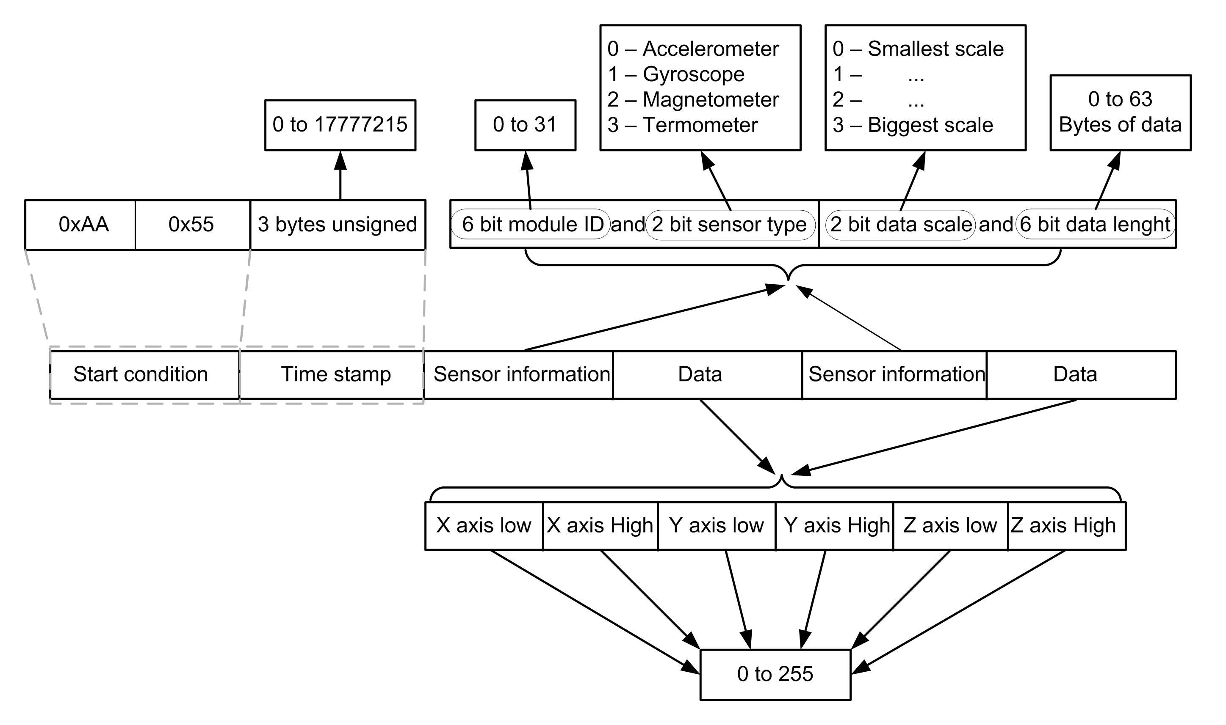
RS-232 protocol
Notes:
Variable data length;
Protocol can be updated for more sensors, and different messages.

Slide 25
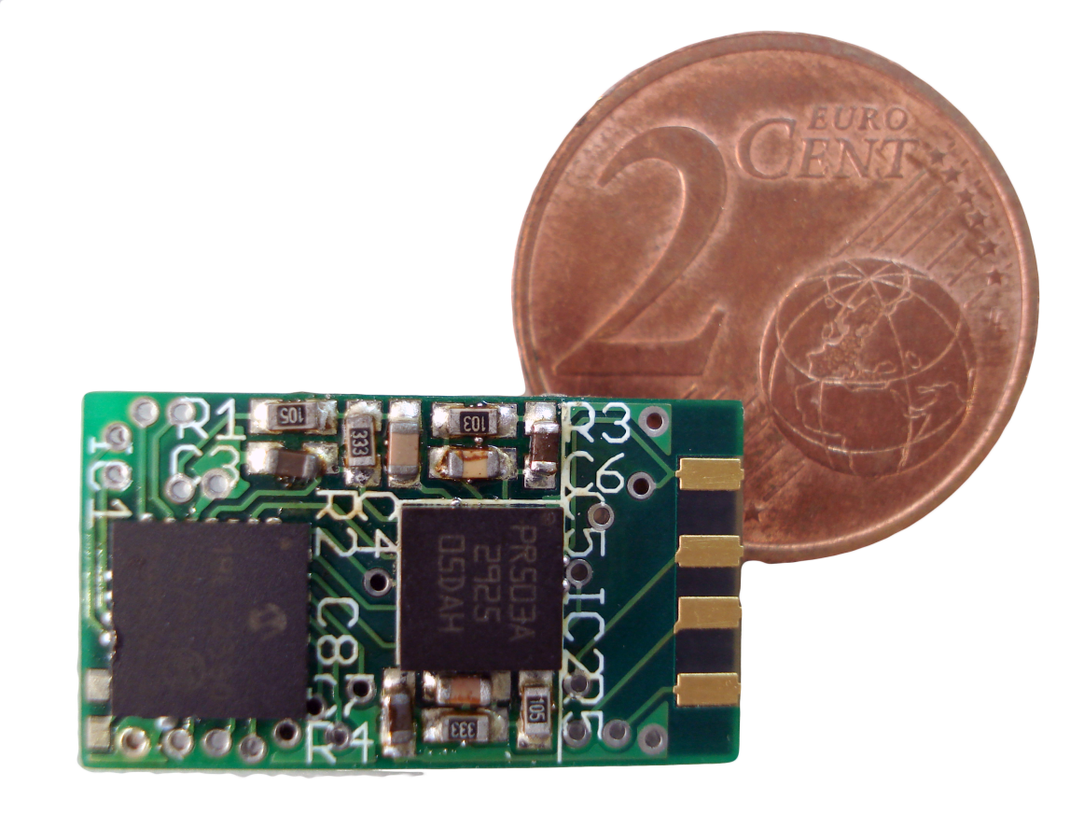
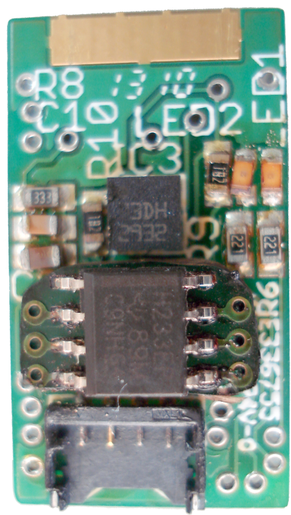
Base PCB
Notes:
Most of components are SMT;
3 layers;
Smaller than all the market available solutions 21x12x7 mm;
Programming port integrated in the PCB to reduce connectors;
Some problems with soldering, very delicate process, failed attempts, PCB pre hearing;
Master lacks of MEMS and filters;

Slide 26
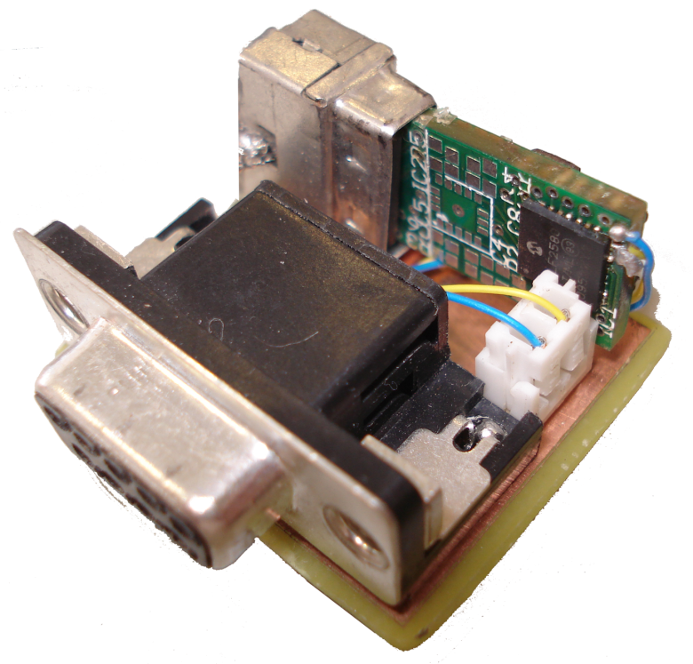
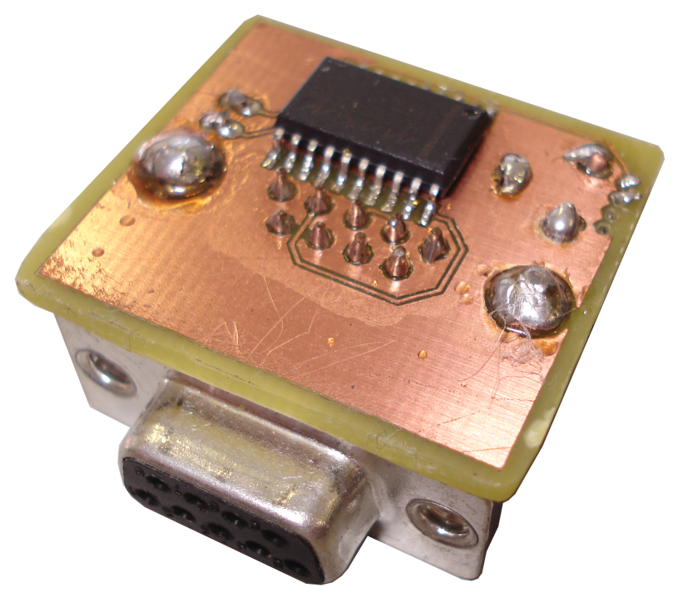
TTL-RS232 bridge
Notes:
Base PCB supplies power to the MAX IC;

Slide 27
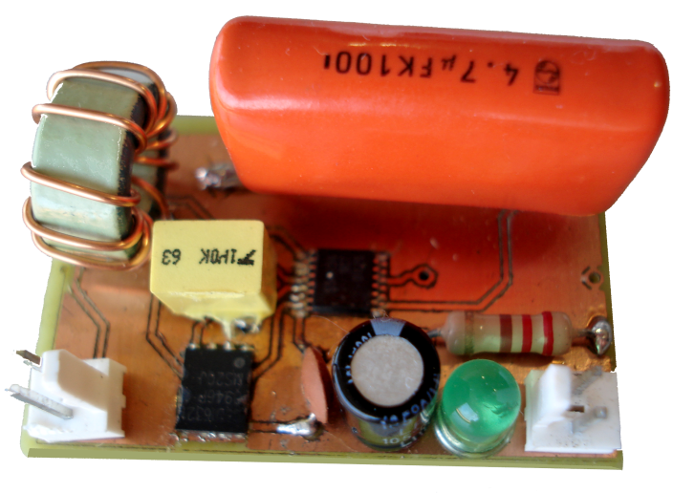
Power supply
Buck regulator;
Input from 4.5 to 18V;
3.3V up to 3A output.

Slide 28
Tests and results

Slide 29
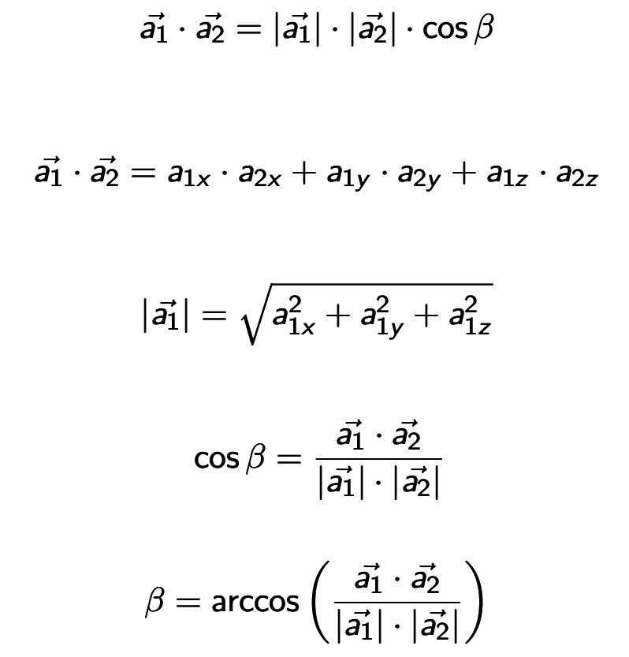
Math
Notes:
a is the acceleration vector;
a_{x} a_{y} and a_{z} are the three axis accelerations!

Slide 30
Static
Tests and results

Slide 31
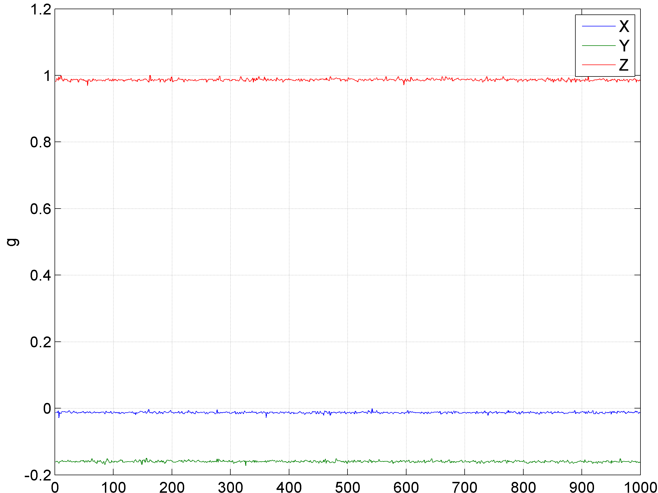
Raw data
Accelerometer
Gyroscope
Notes:
Explain the data!!

Slide 32
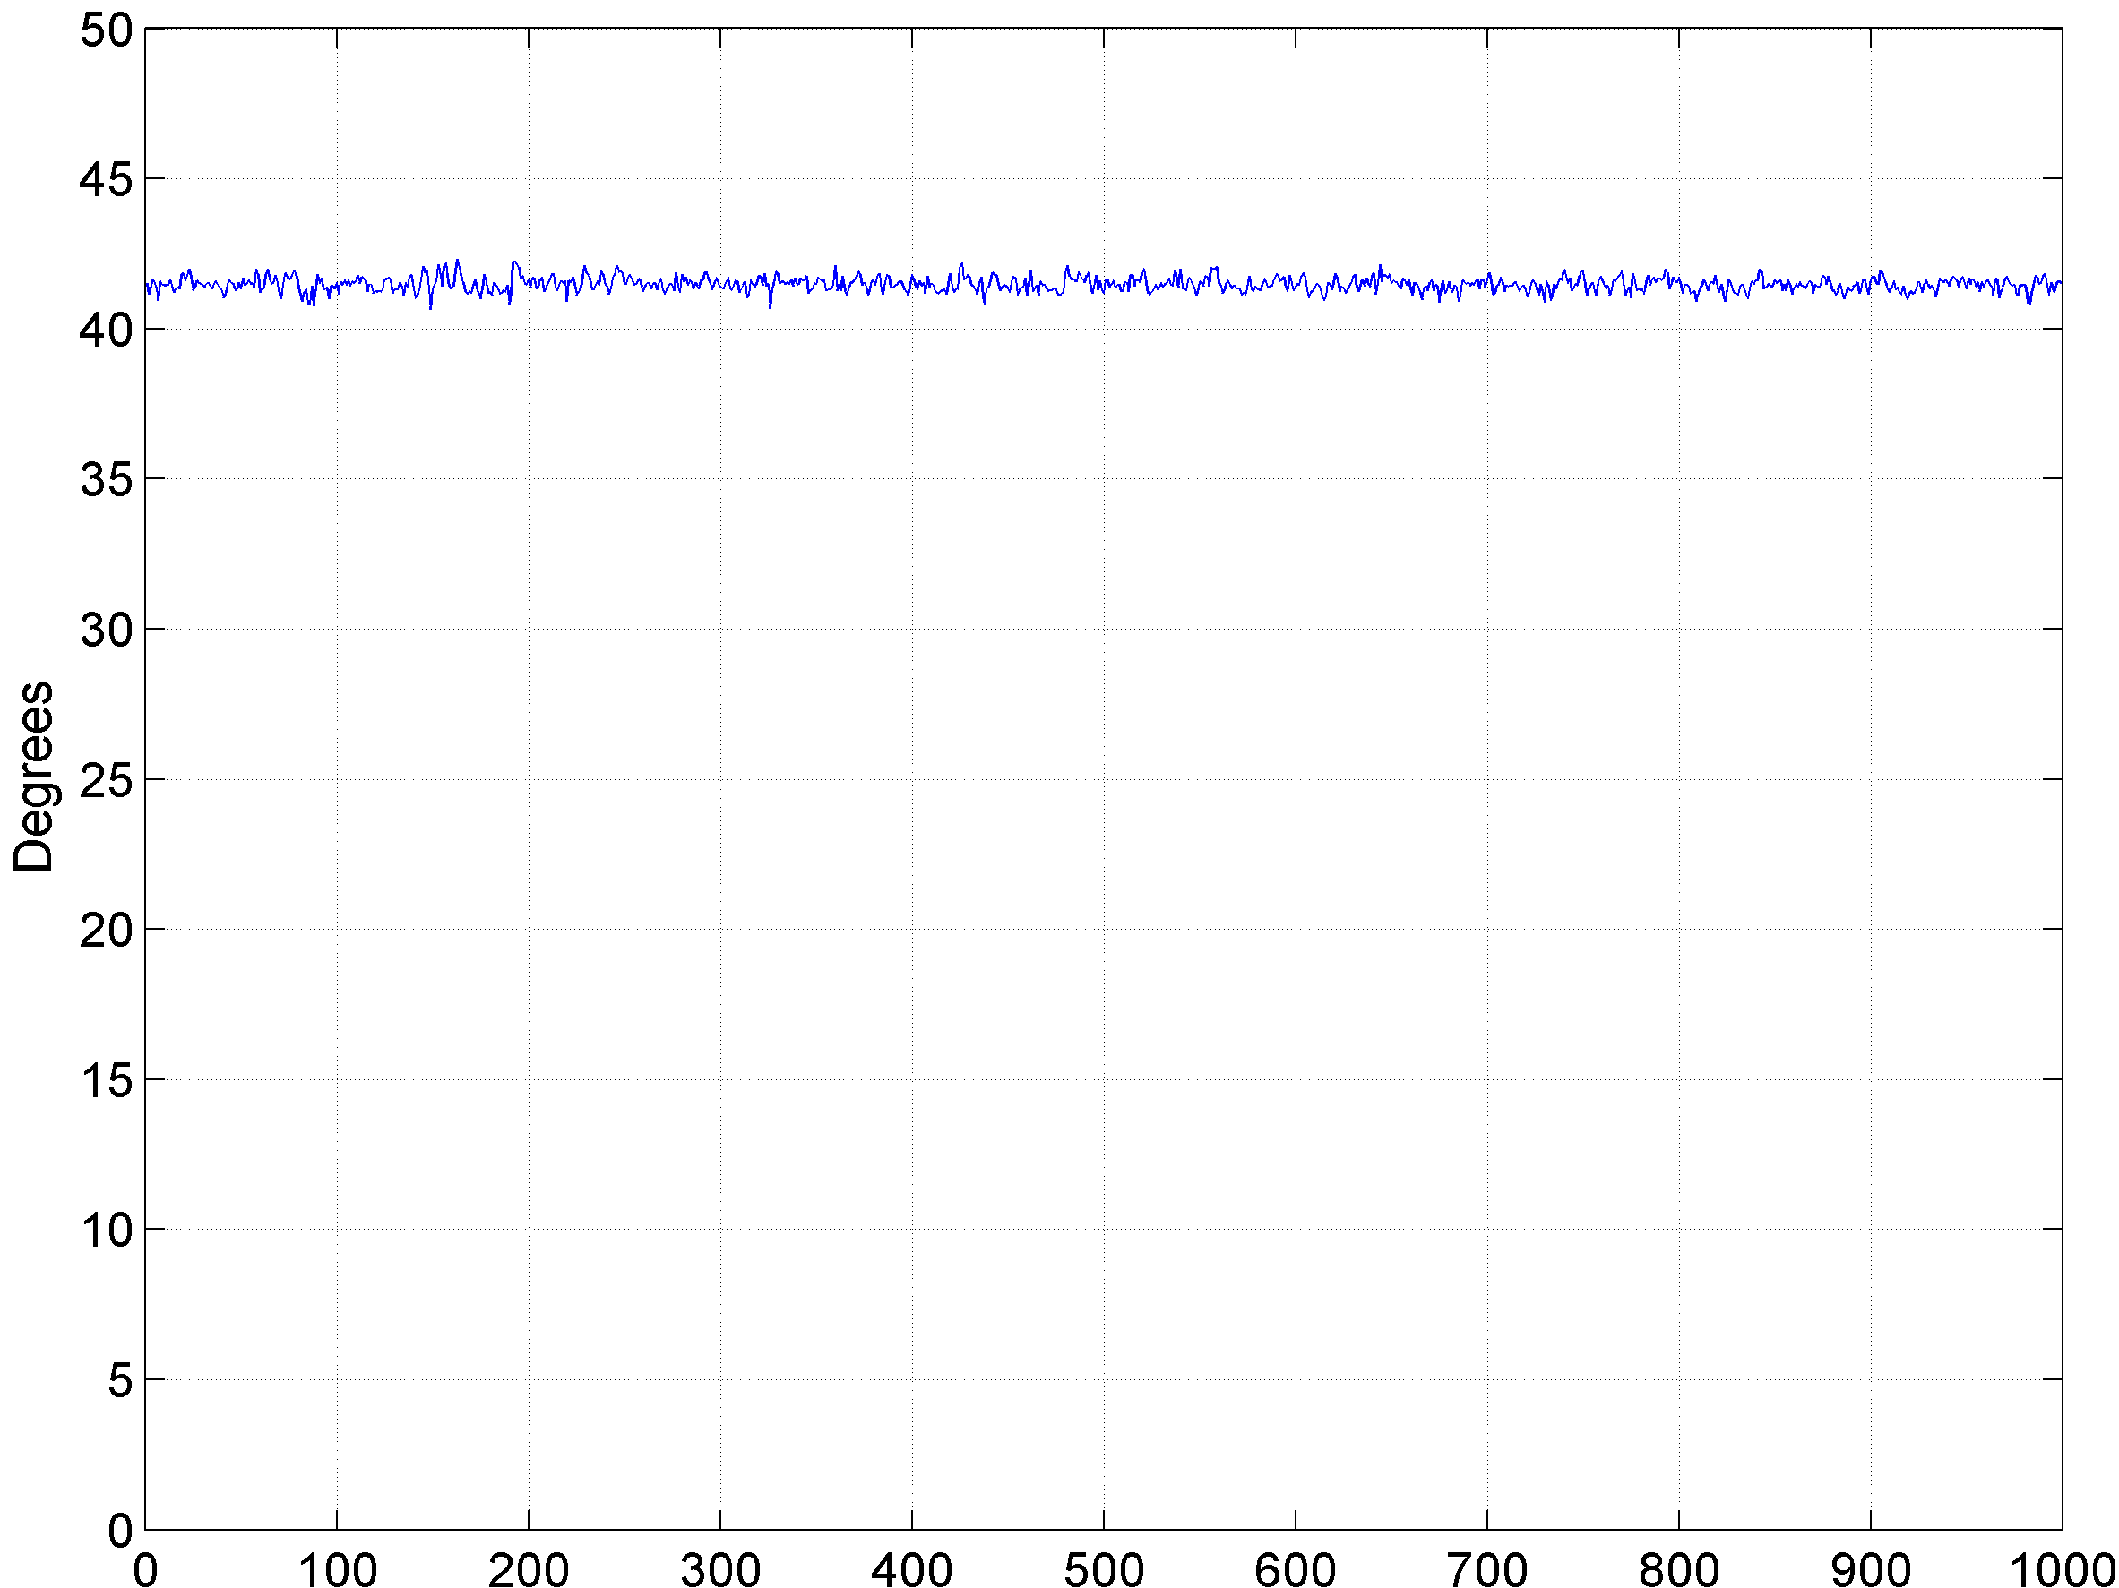
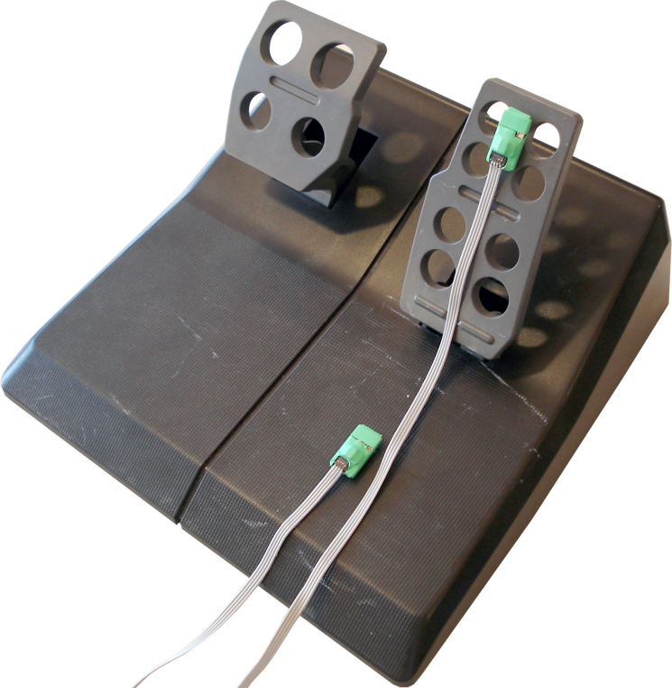
Home position

Slide 33
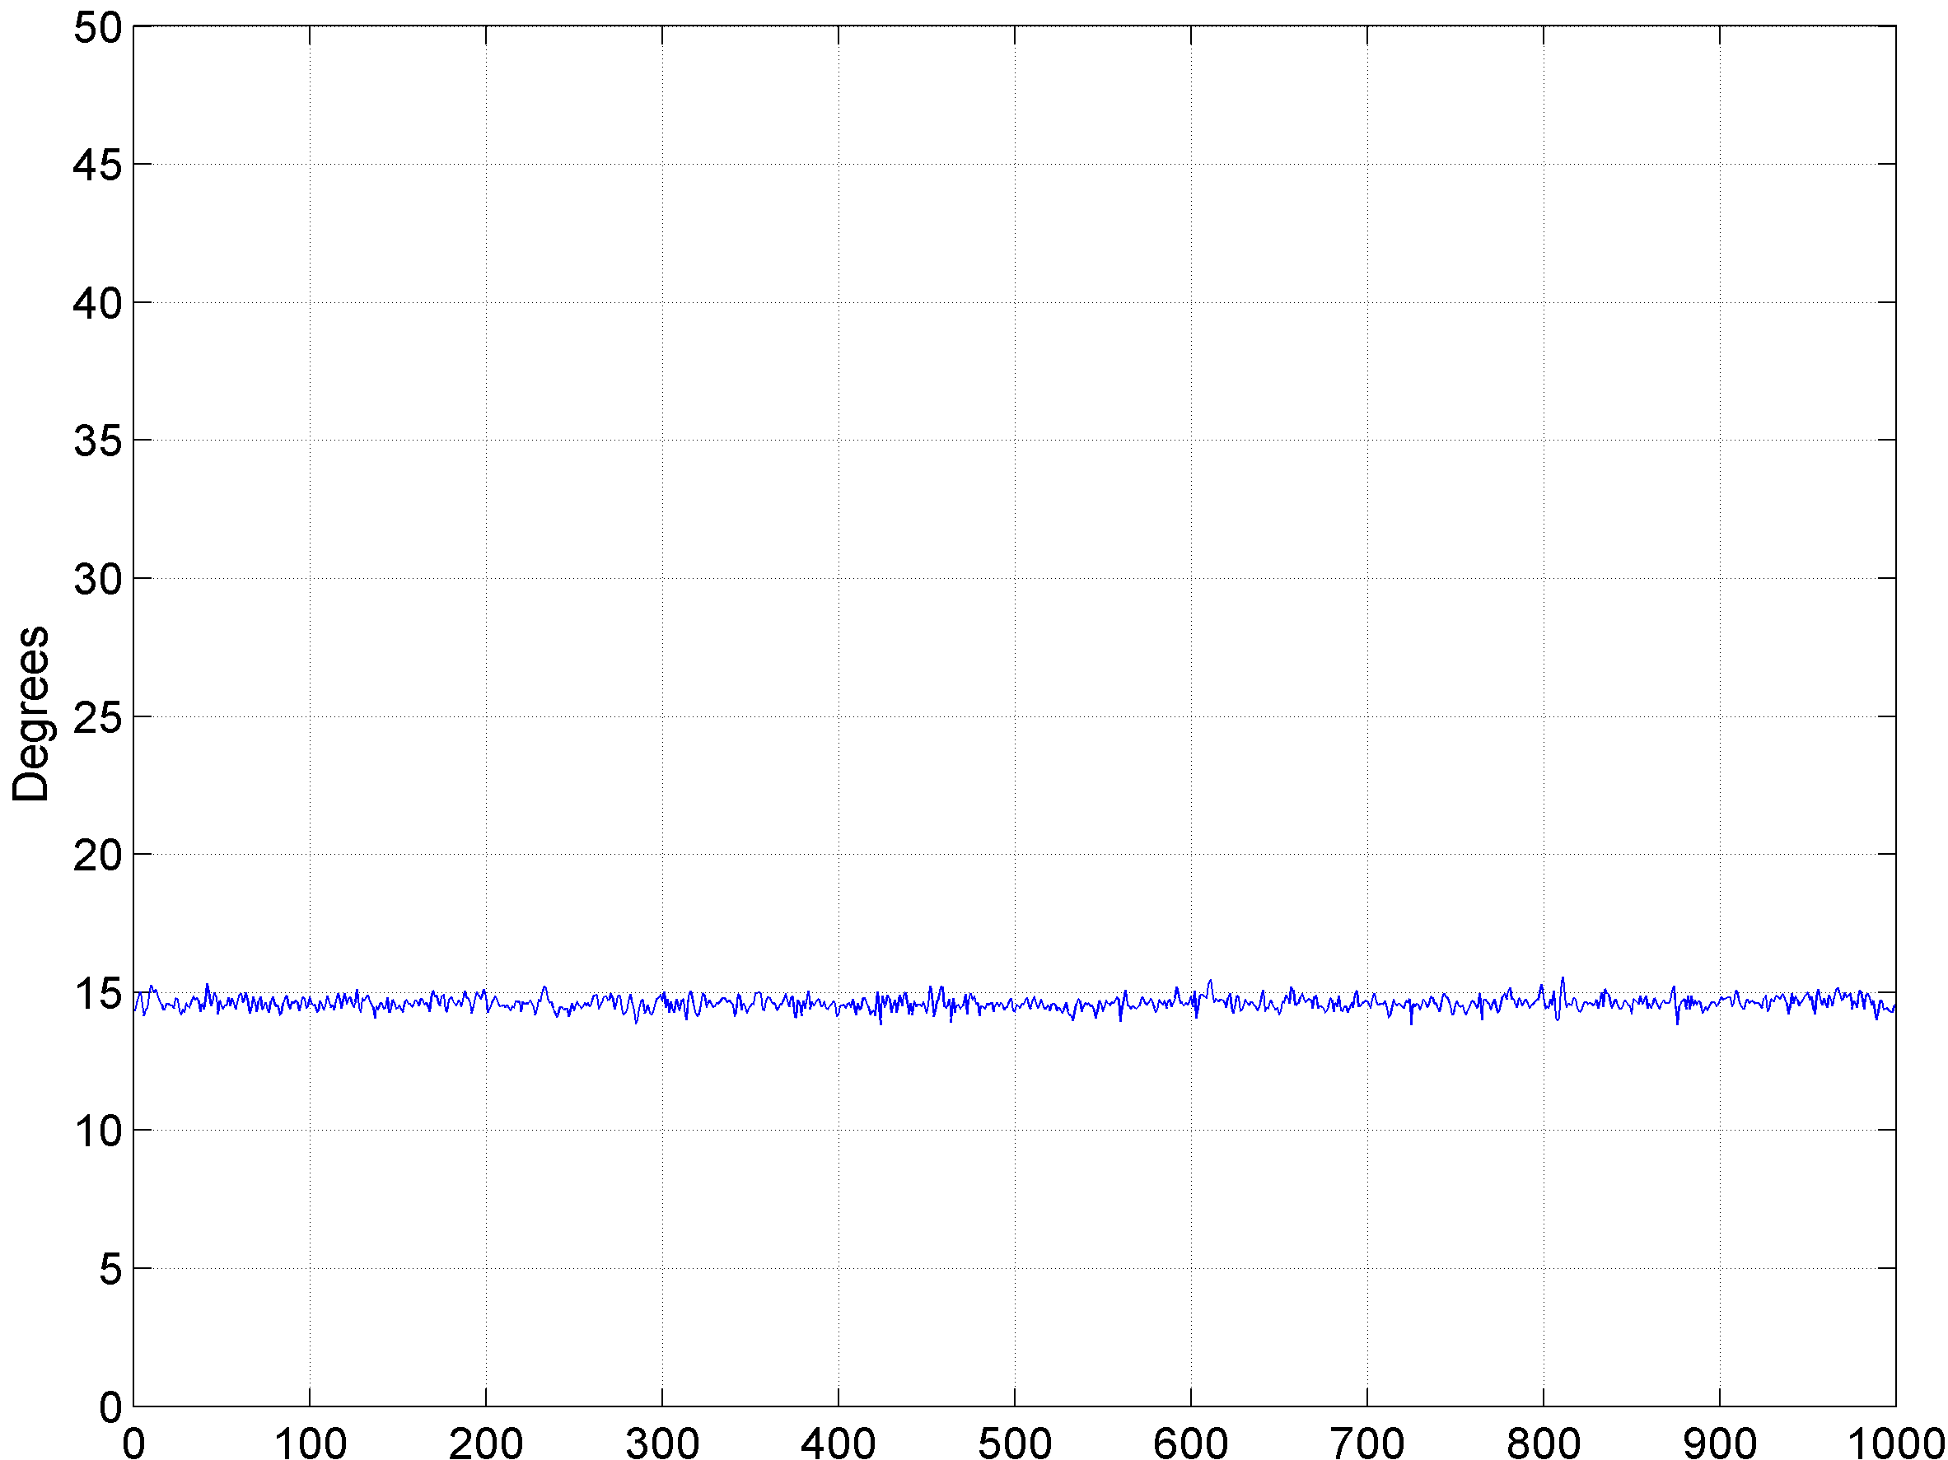
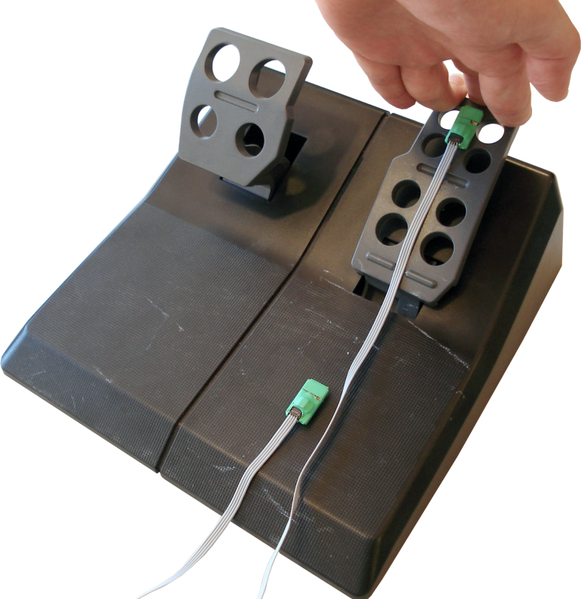
Pressed position

Slide 34
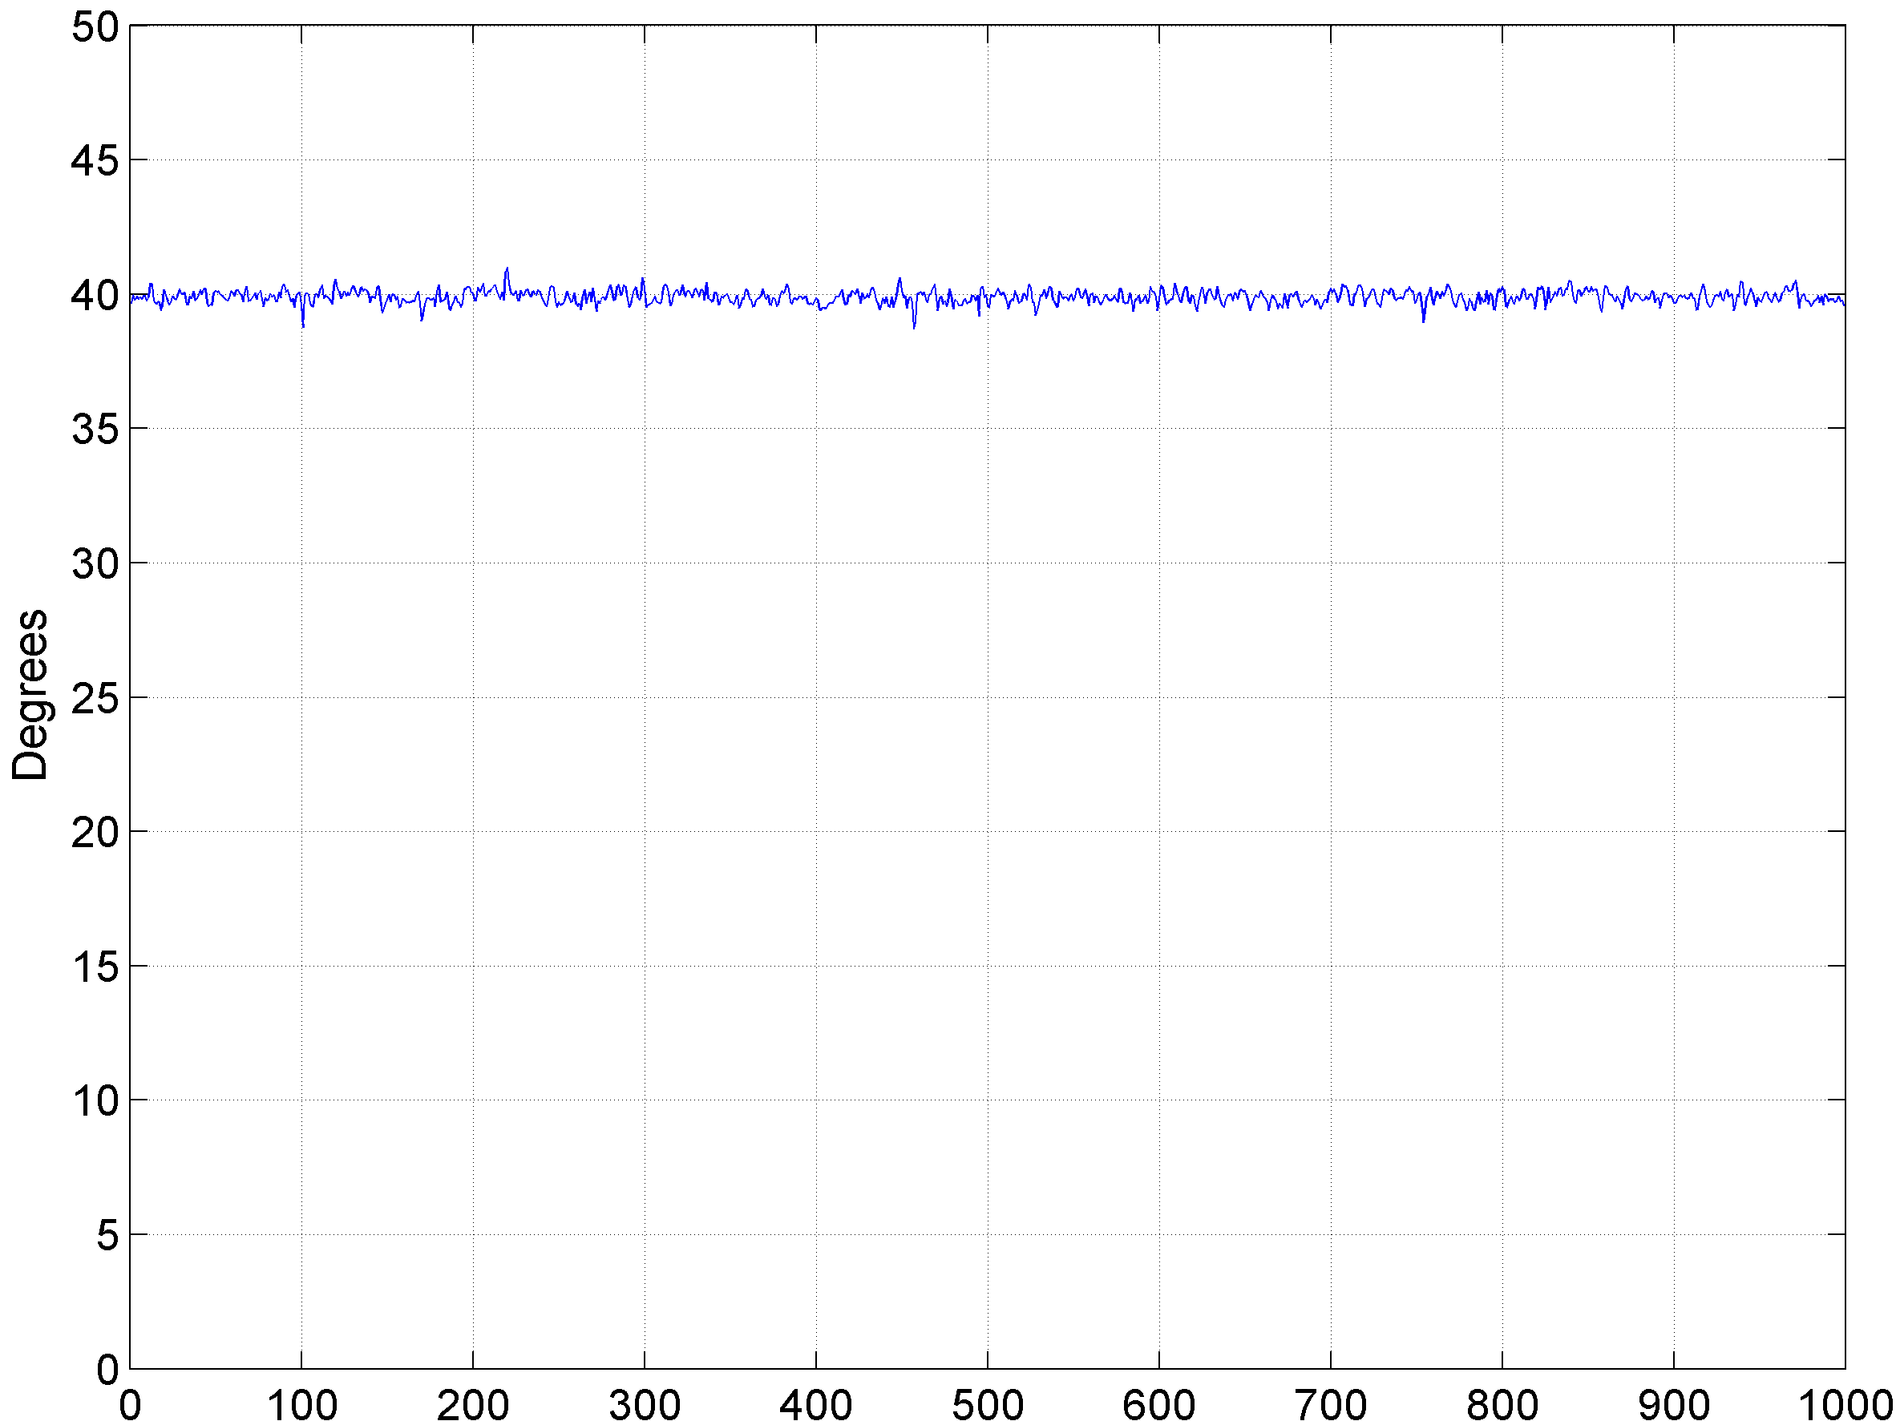
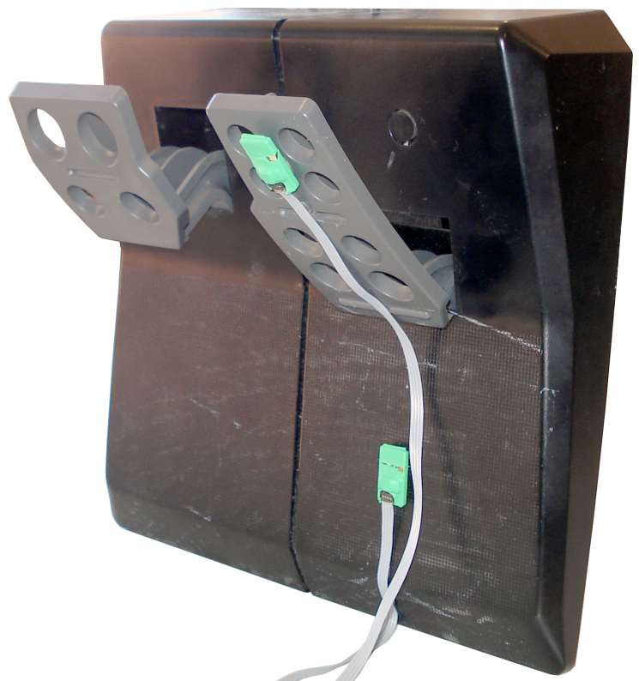
Vertical position

Slide 35
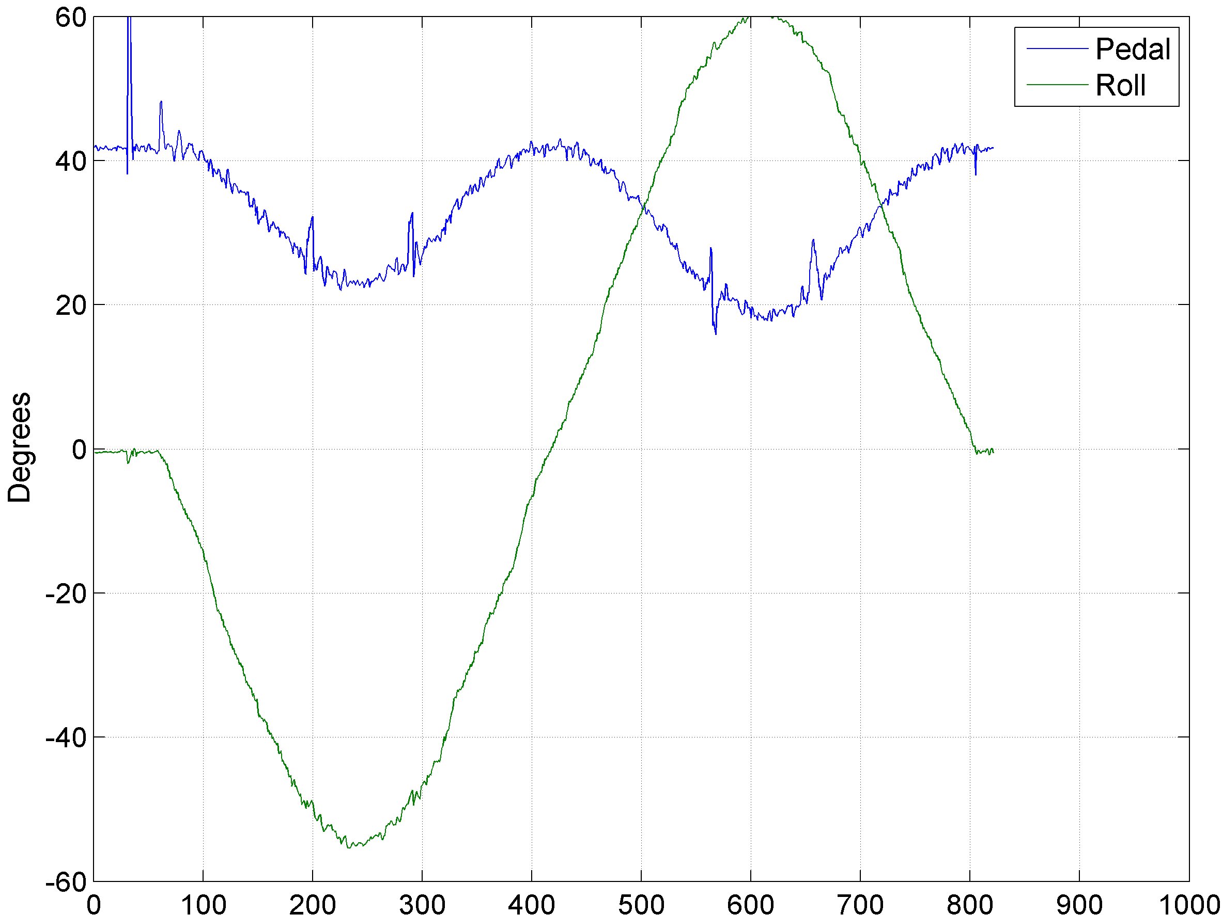
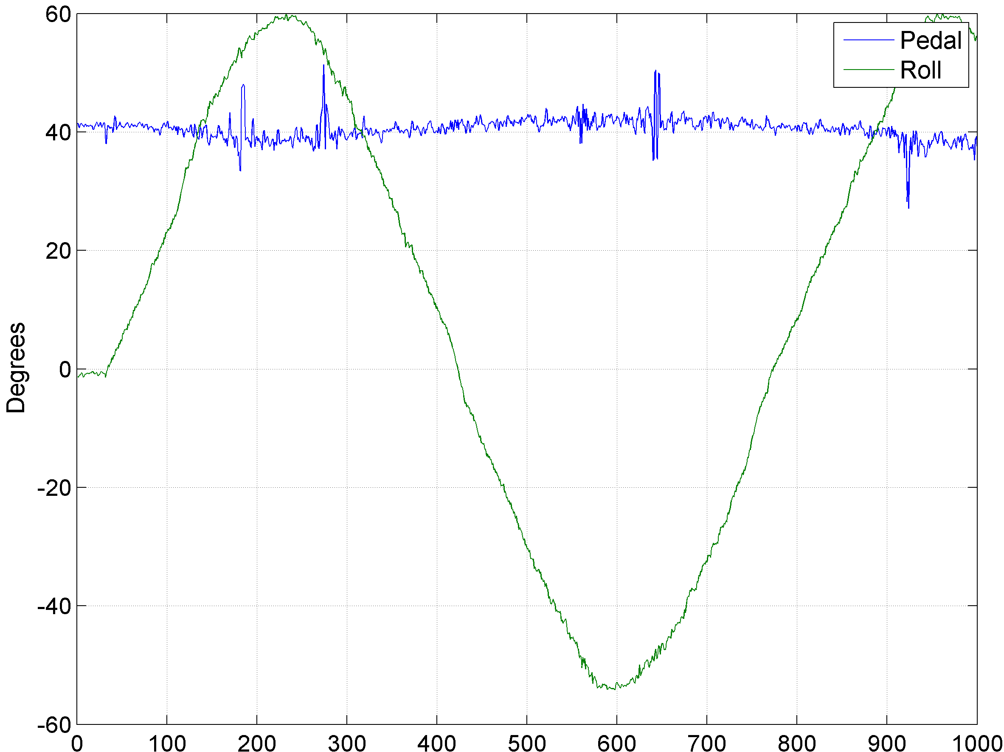
Measurement vs. roll
Three dimensional vectors
Two dimensional vectors
Notes:
Use only 2D vectors;

Slide 36
dynamic
Tests and results

Slide 37
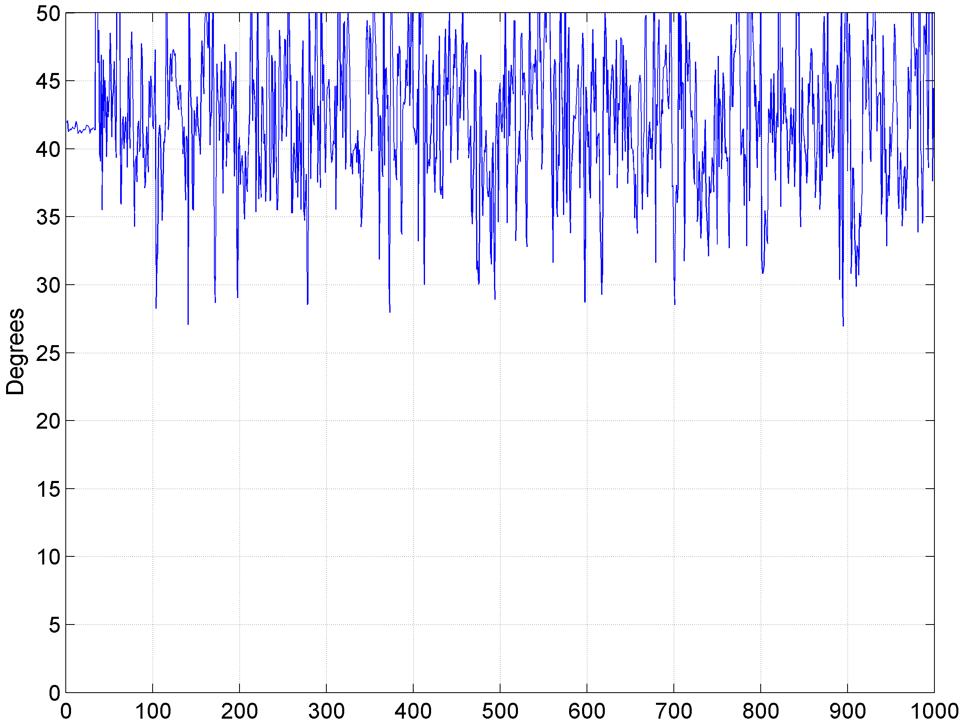
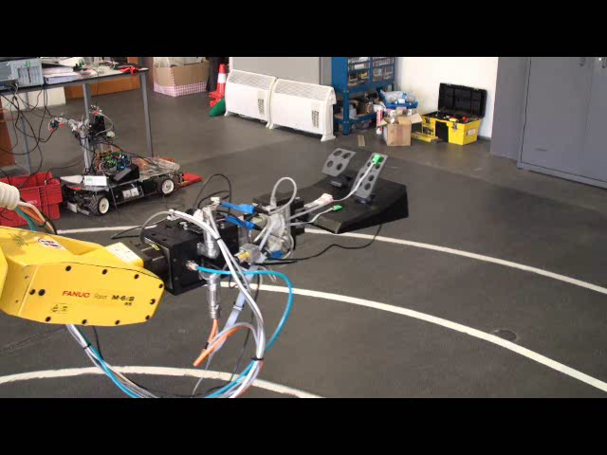
Elliptical

Slide 38
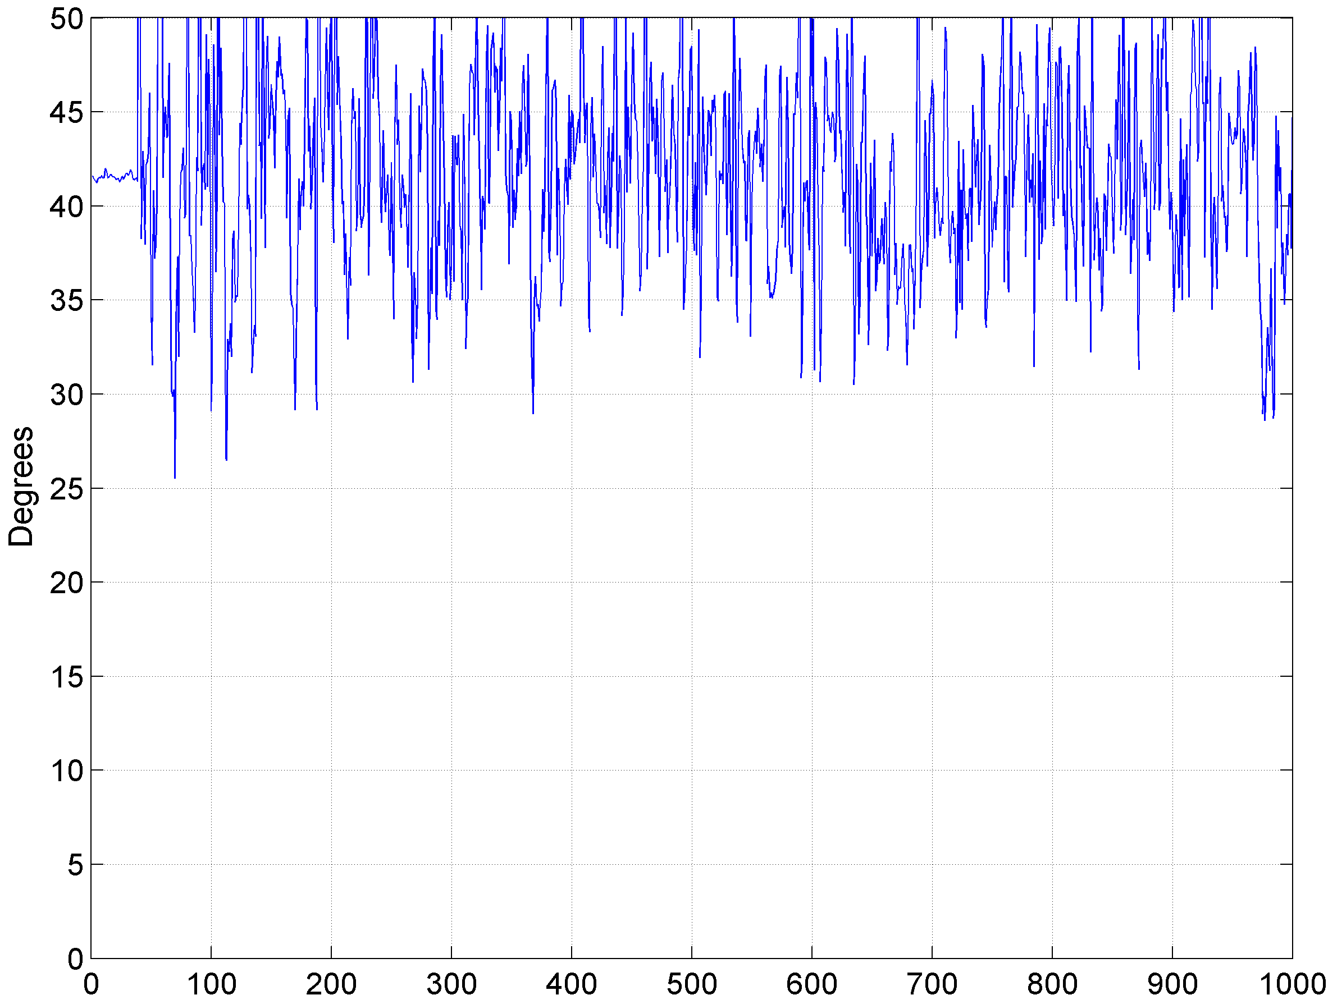
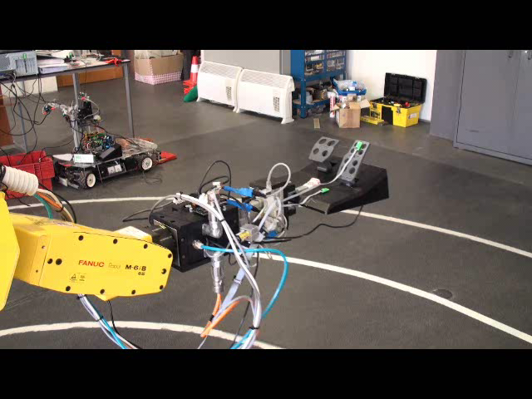
Elliptical + roll

Slide 39
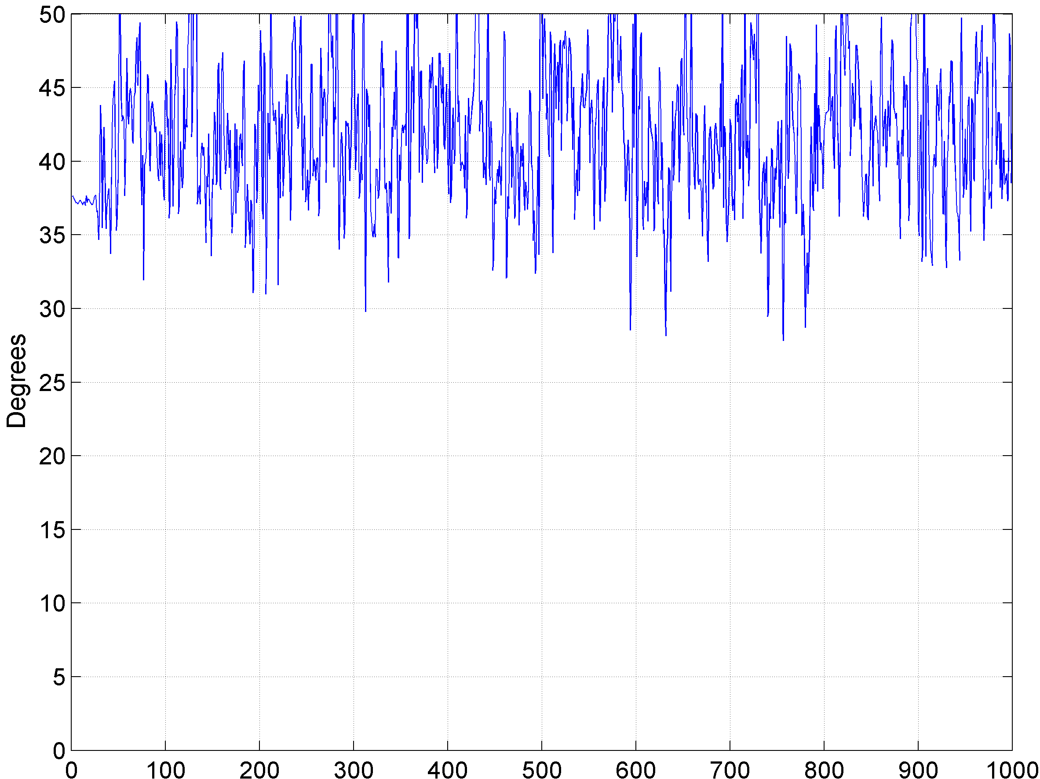
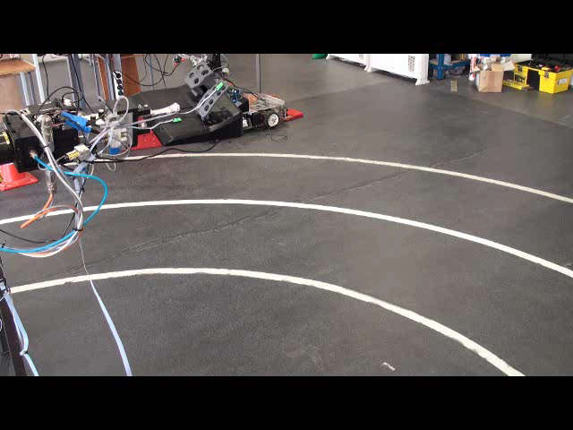
Linear + roll

Slide 40
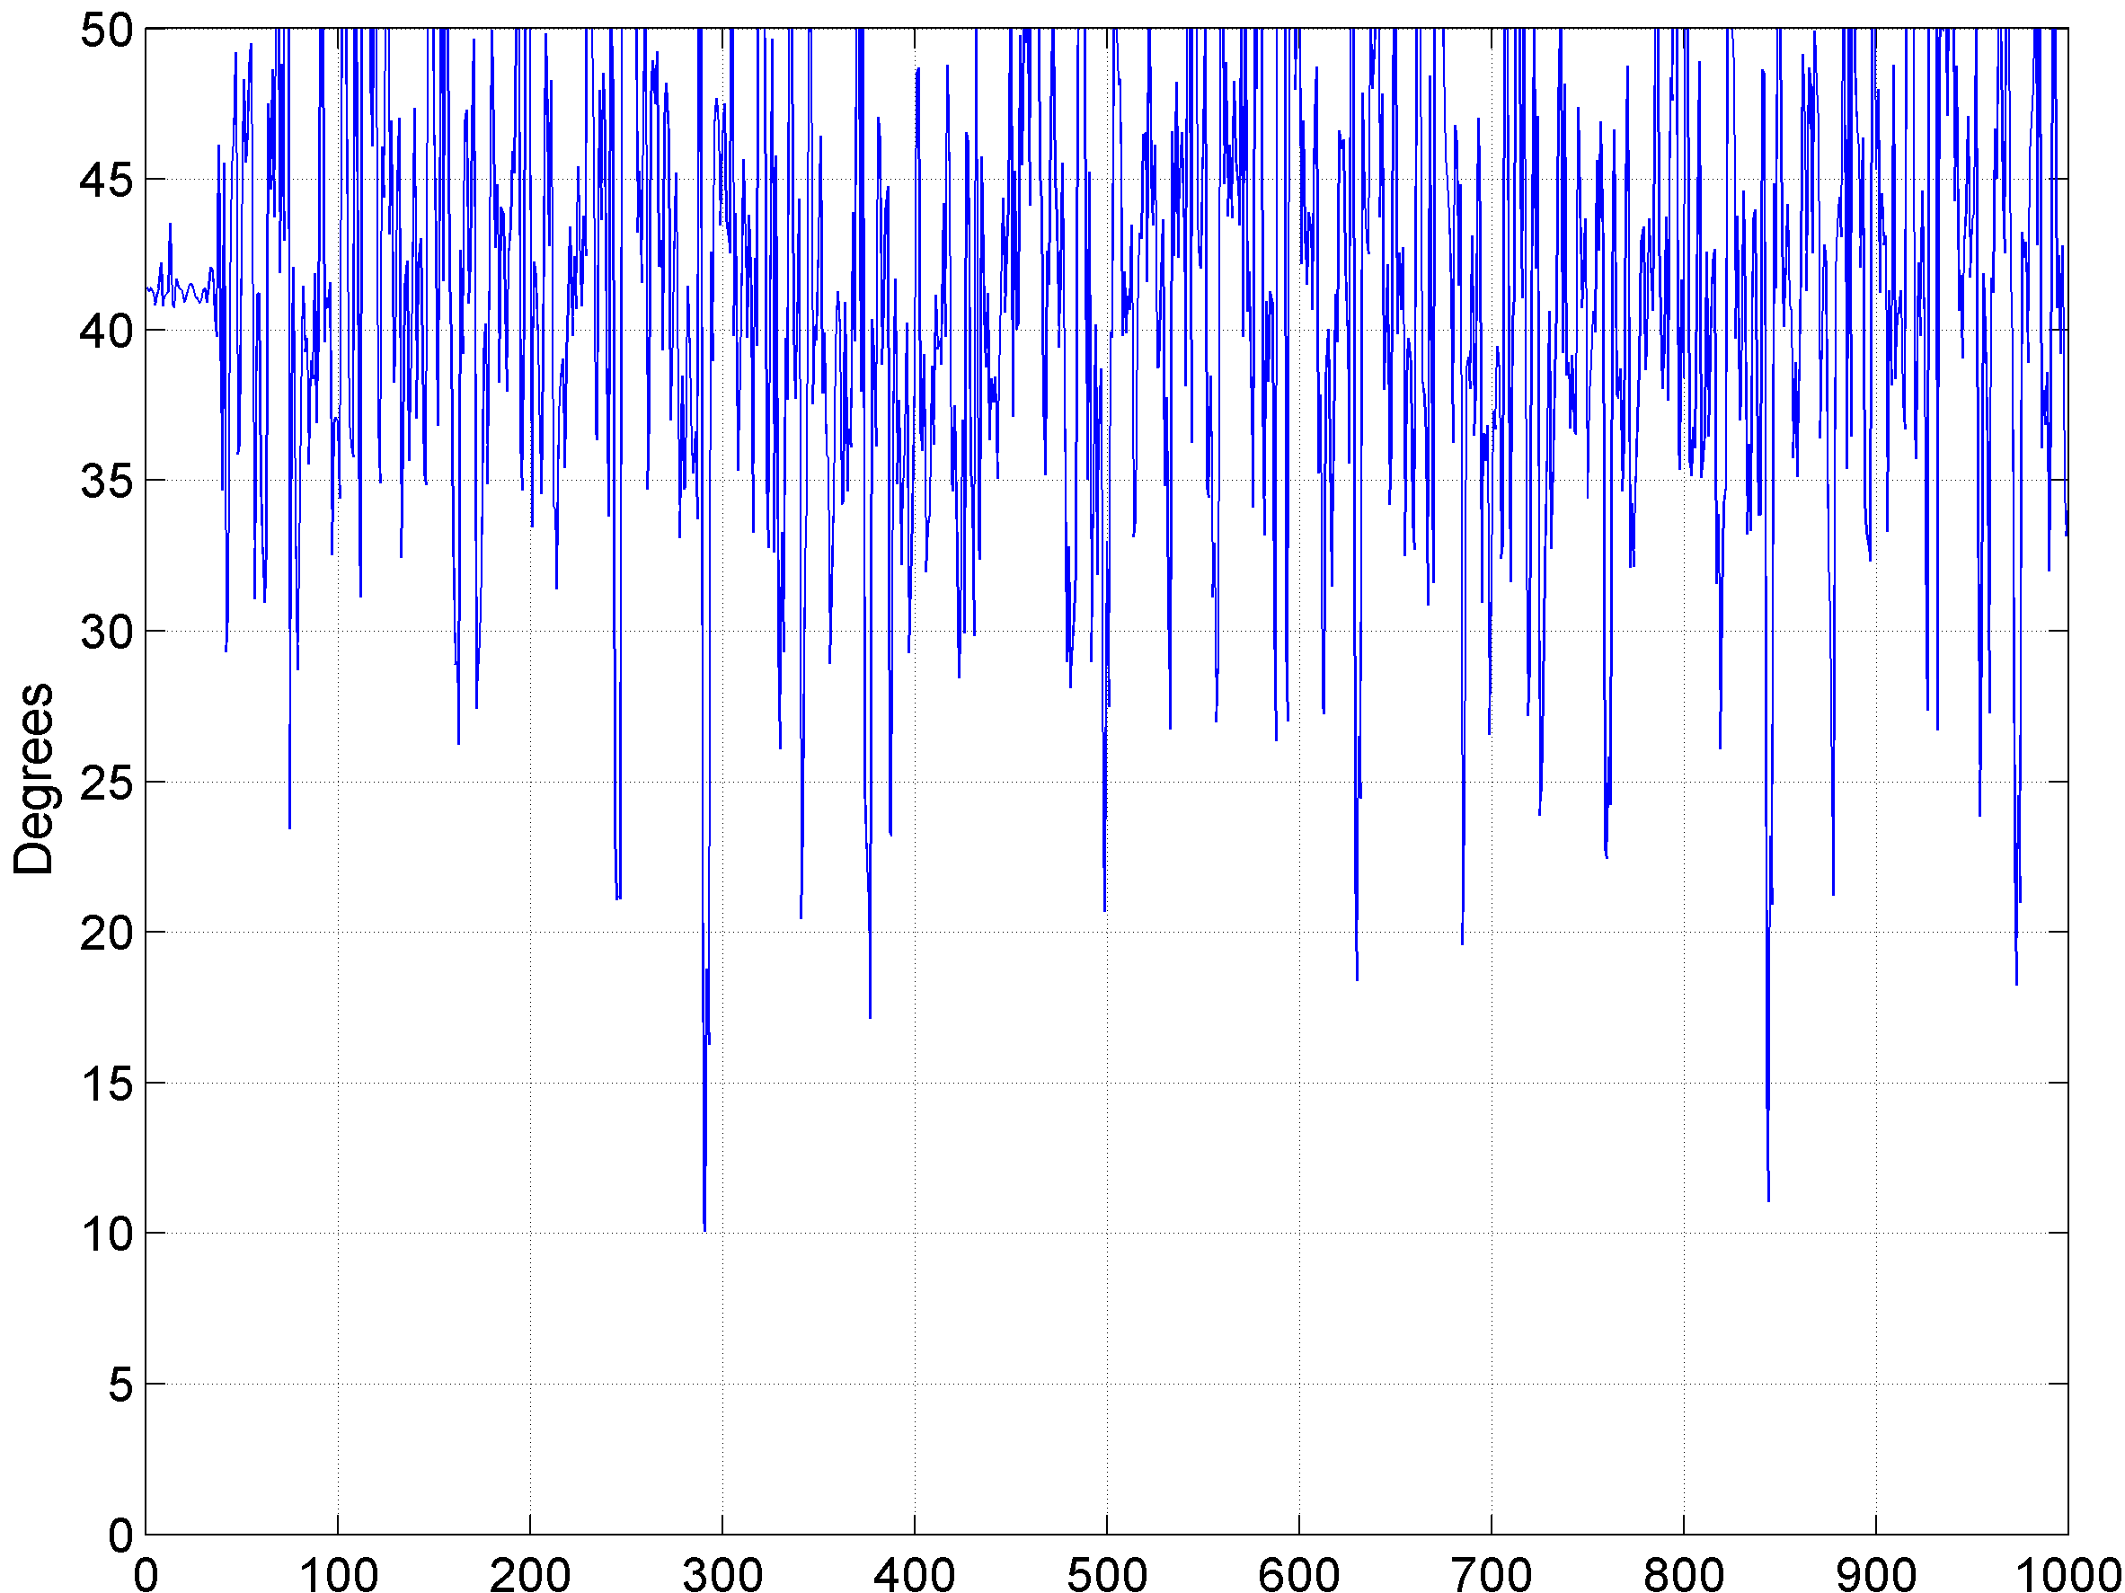
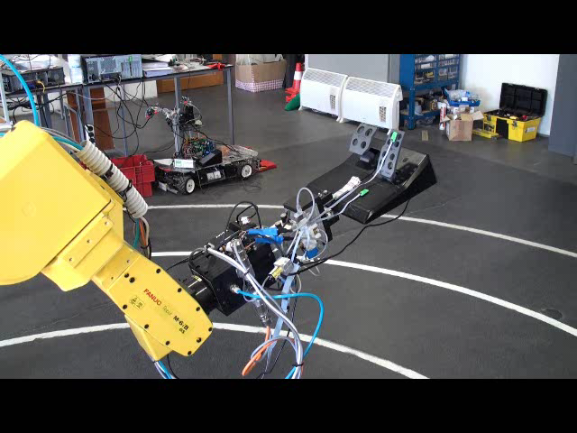
Pitch

Slide 41
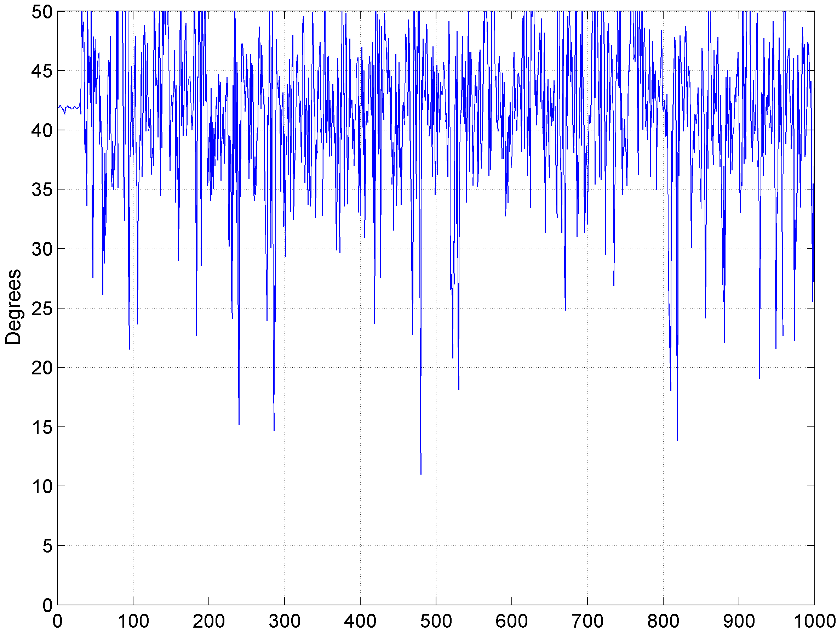
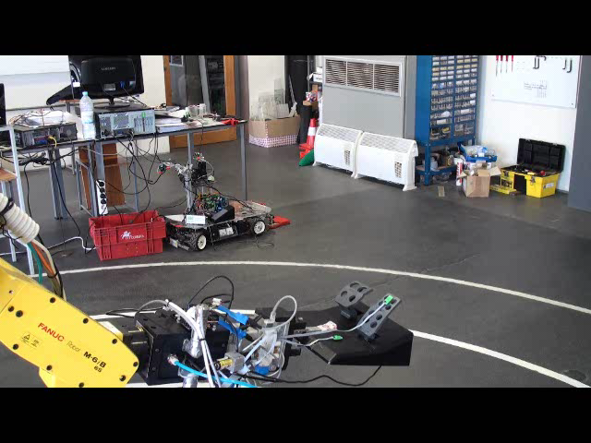
Linear + pitch

Slide 42
Conclusions

Slide 43
Sensor specification
Specification | Value | Units
Sample rate | 0.5 – 1000 | Hz
Accelerometer scale | ±2; ±4; ±8 | g
Accelerometer accuracy | ±4 | mg
Gyroscope scale | ±120 | °/s
Gyroscope accuracy | ±0.5 | °/s
Differential accuracy (static) | ±0.25 | °
Maximum bus length* | 100 | m
Dimensions | 21x12x7 | mm
Prototype cost | 30 | €/unit
* According to CAN specification

Slide 44
Conclusions
With 21x12x7mm overall dimensions, the solution is smaller than all market devices;
Cheap to build;
More units can be easily attached;
Sensors feed reliable raw data;
Literature validates this approach;
Further mathematical improvement is needed for differential measurements;

Slide 45
Future work

Slide 46
Future work
Improve mathematical algorithm;
Continue the actuation unit design and construction;
Update to new MEMS as they are released in the market;
Implement CANbus boot-loader;

Slide 47
END
Thanks for your attention

Slide 48
More applications
Monitor vehicle behavior;
Movement capture;
Human-machine interface;
Guidance systems;
Movement stabilization;
Motion and vibration alarms;

