Slide 1
Recognition of Human Grasping Patterns for Intention Prediction in Collaborative Tasks
93283 - Pedro Miguel Loureiro Amaral
Master in Robotics and Intelligent Systems
Advisor: Filipe Silva
Co-advisor: Vítor Santos
11/12/2023
DETI-UA

Slide 2
OUTLINE
01
02
03
04
PROBLEM INTRODUCTION
HUMAN-ROBOT COLLABORATION SYSTEM
RECOGNITION OF HUMAN GRASPED OBJECTS
CONCLUSIONS

Slide 3
01
PROBLEM INTRODUCTION

Slide 4
INTRODUCTION
Human-Robot Collaboration is a research topic increasingly important in the industry to enhance productivity, efficiency, and safety.
This dissertation aims at the development of an anticipatory system to enhance human-robot collaboration in industrial settings.
This work was developed in the context of the AUGMANITY mobilizing project.

Slide 5
OBJECTIVES
Review important concepts in HRC and, in this context, study the current research direction of action anticipation and object recognition.
Develop an infrastructure in ROS to support a practical implementation of action anticipation in the context of HRC.
Develop a learning framework capable of recognizing the objects being grasped by the human operator to infer his/her intention or needs.

Slide 6
02
HUMAN-ROBOT COLLABORATION SYSTEM

Slide 7
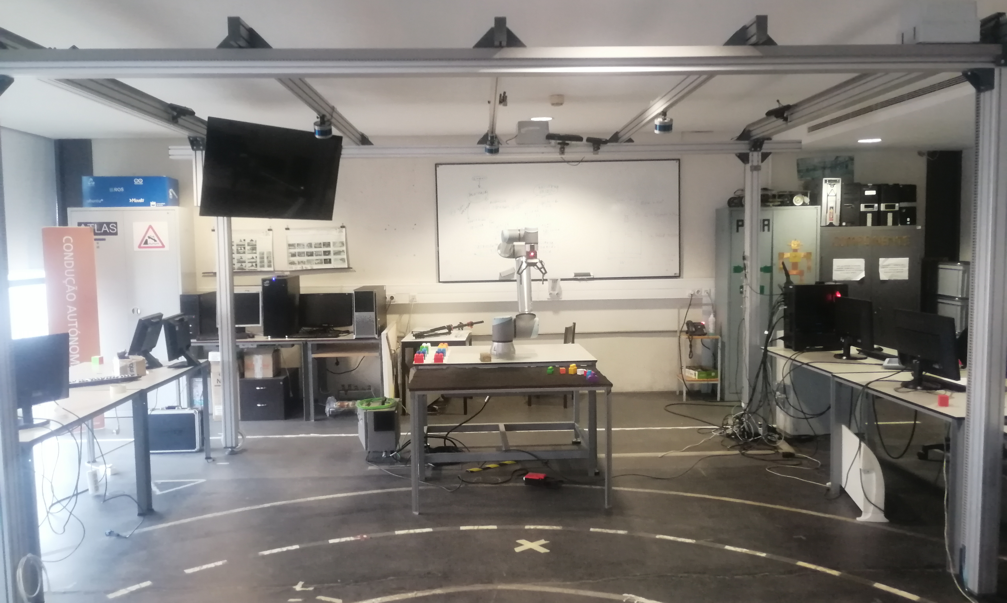
EXPERIMENTAL SETUP
The experimental setup is part of the collaborative cell (LARCC) at the Laboratory for Automation and Robotics (LAR-DEM-UA).

Slide 8
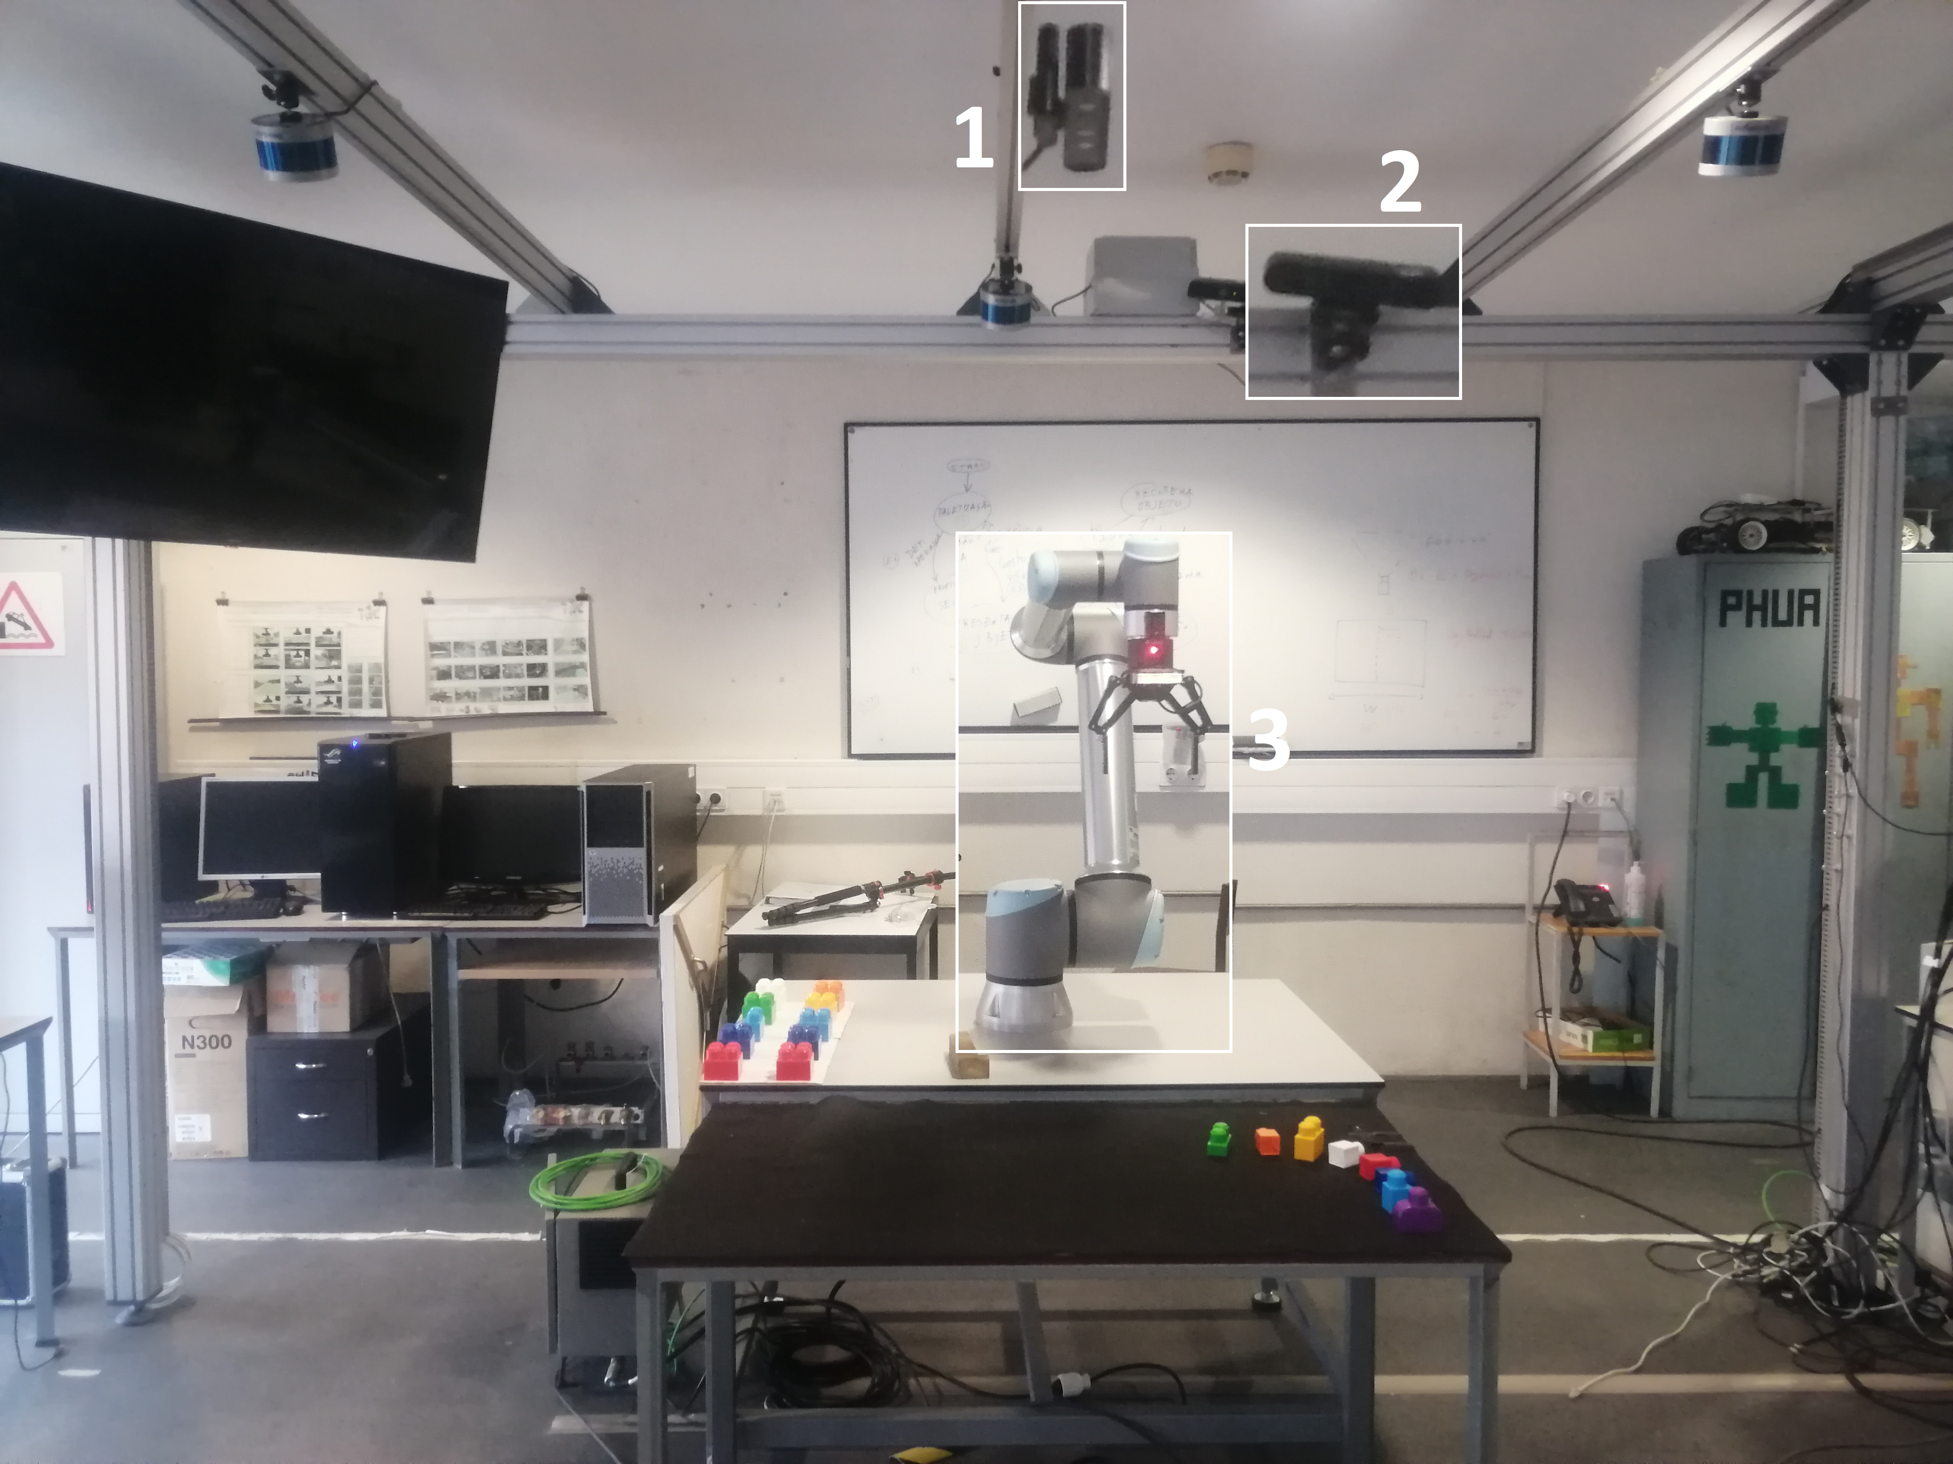
EXPERIMENTAL SETUP
Orbbec Astra Pro recording the objects in the table
Orbbec Astra Pro recording the human operator
UR10e cobot with 6-DOF equipped with a Robotiq 2F-140 gripper

Slide 9
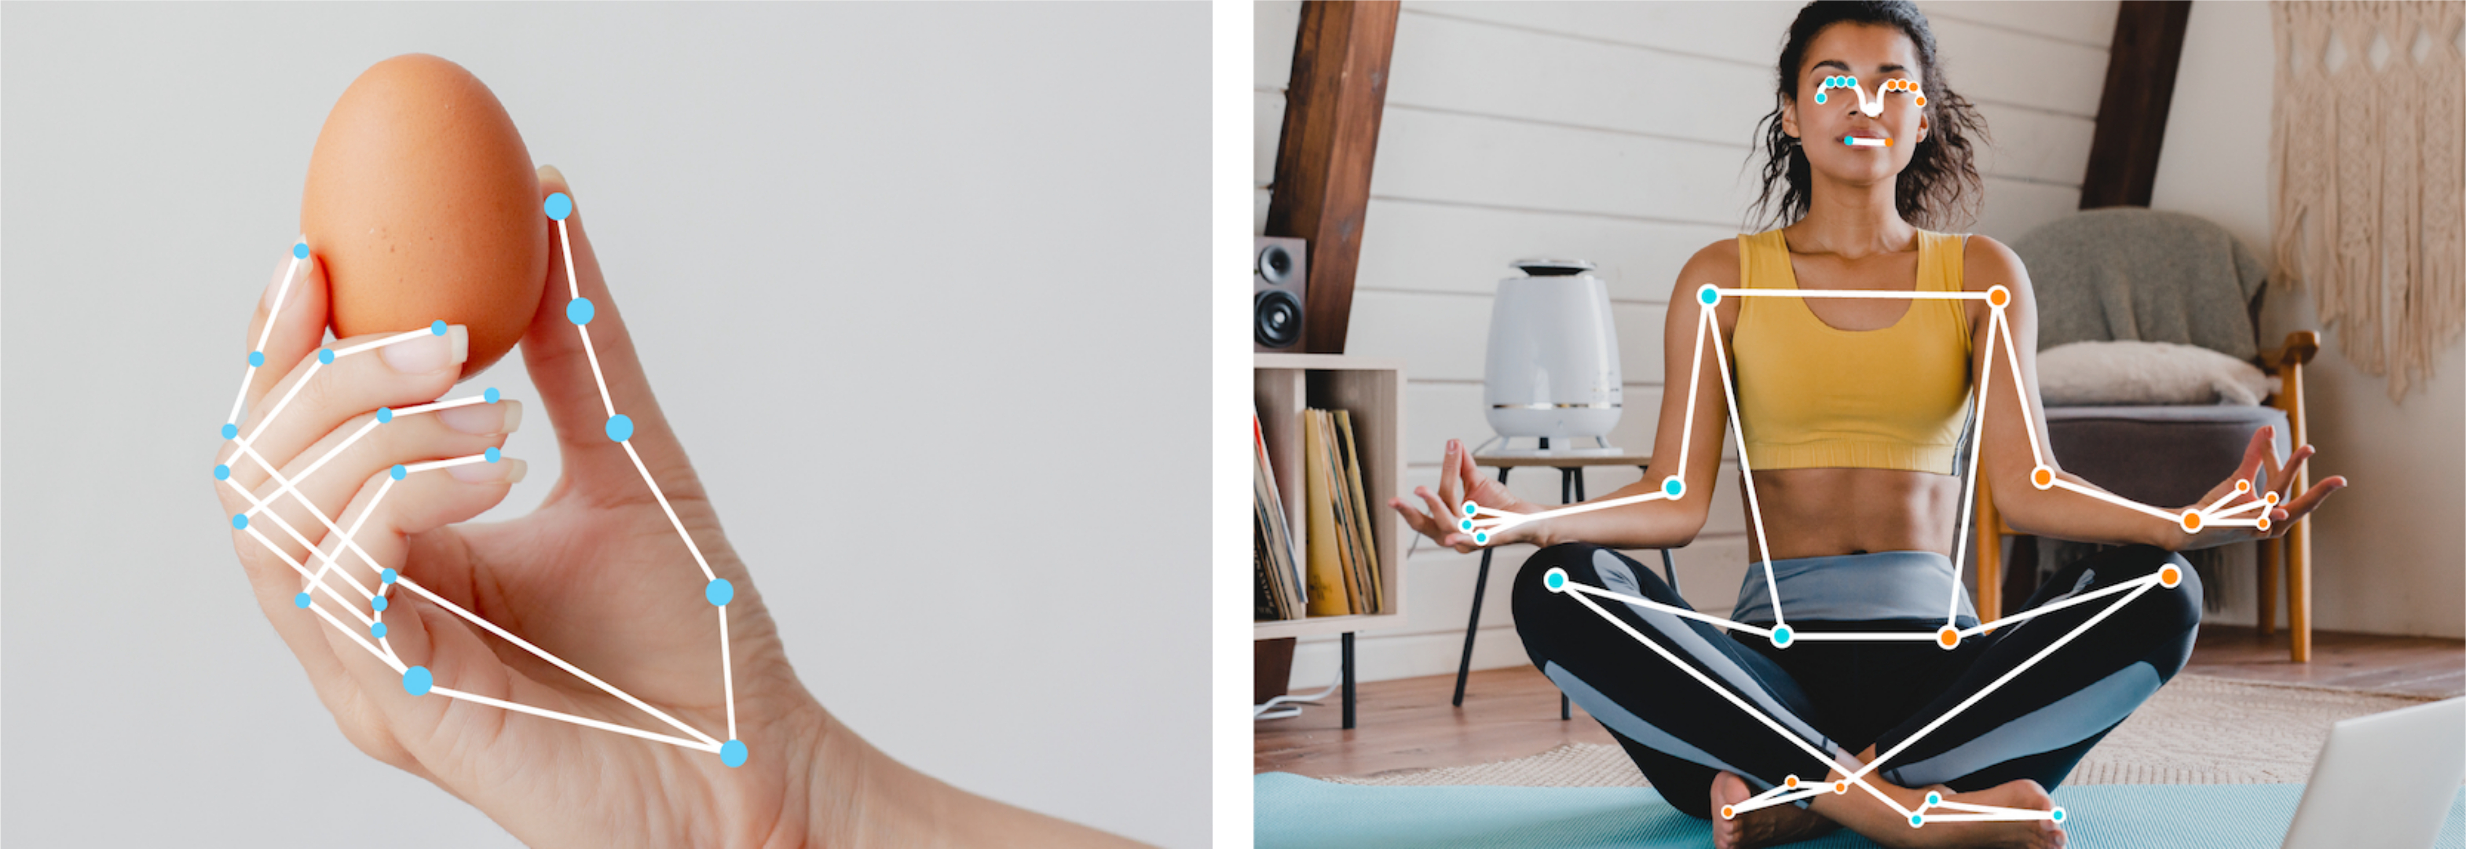
SOFTWARE
ROS – integration and communication among the various components
MoveIt – planning and execution of robot movements
OpenCV – image processing
MediaPipe – keypoint detection

Slide 10
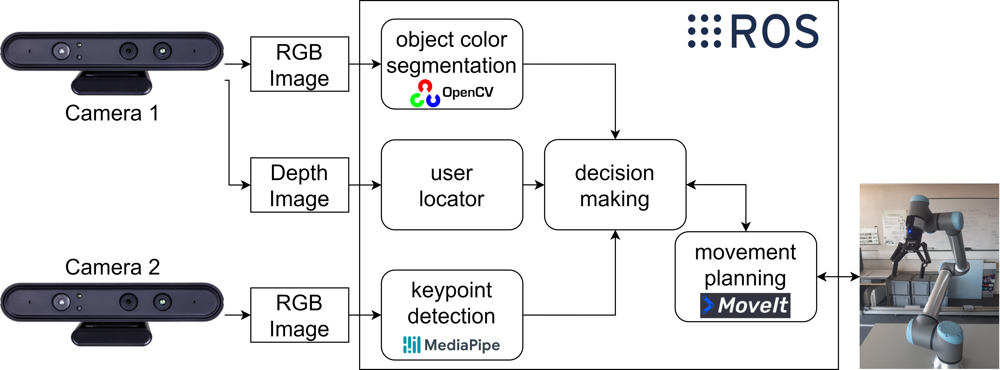
ARCHITECTURE

Slide 11
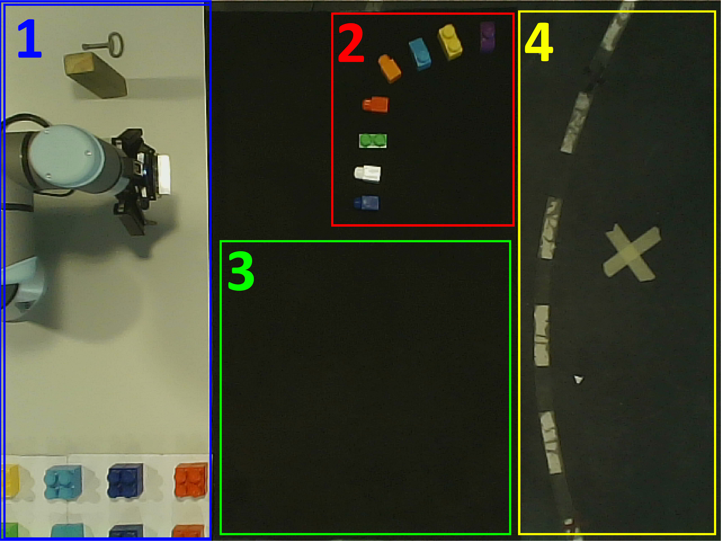
COLLABORATIVE TASK: WORKSPACE
Robot area where the big blocks are stored
Small blocks that can be hovered by the user to interact with the robot
Free space where the robot places the blocks
User space
Notes:
Tarefa Colaborativa

Slide 12
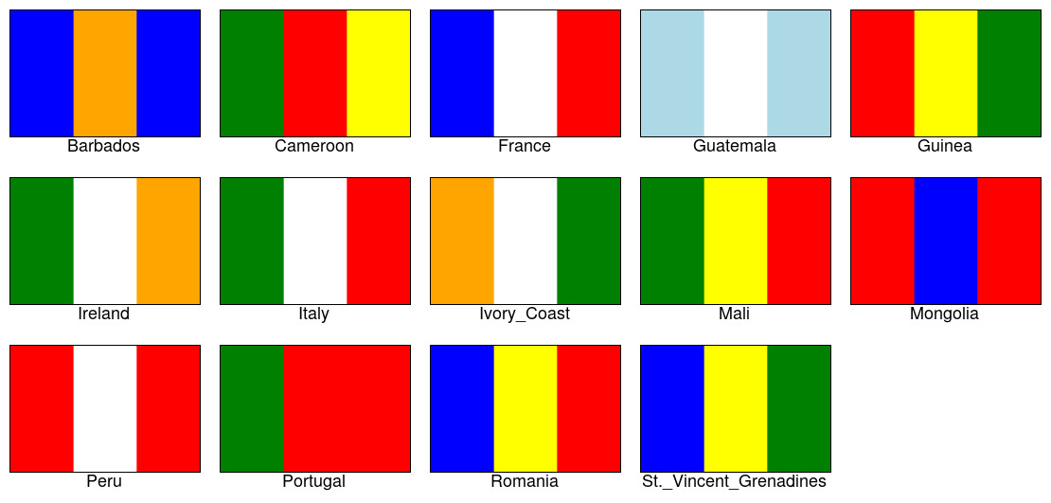
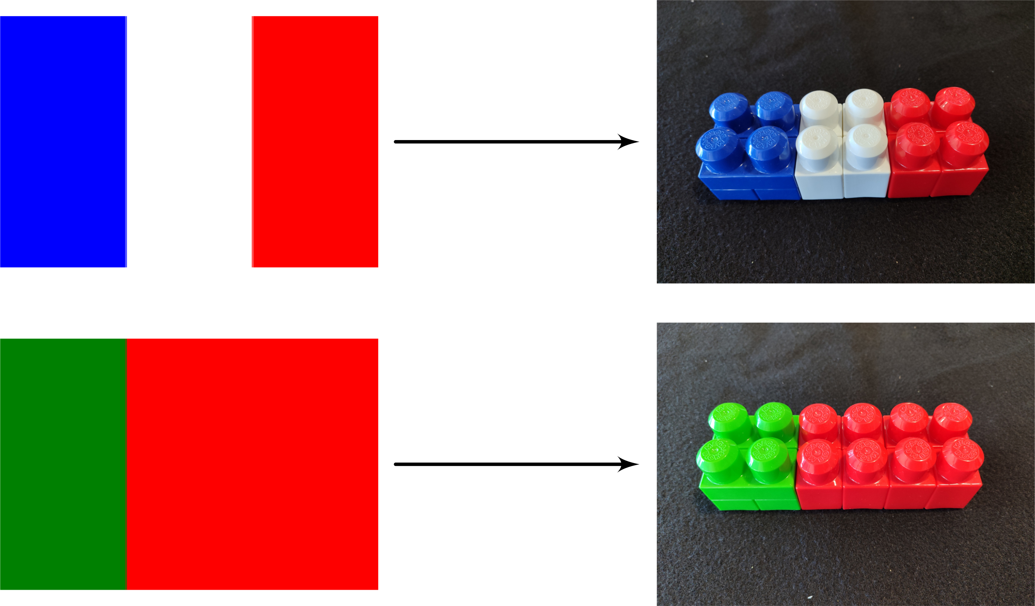
COLLABORATIVE TASK: BUILD A FLAG
The experiment involves the shared task of building a striped flag using Lego bricks (14 pre-selected flags).
The human operator selects the first block by interacting with the small blocks.
The robot completes the sequence trying to anticipate the human intention.
The operator can reject a block using the small violet block.
Notes:
Tarefa colaborativa

Slide 13
PROBABILITY BASED
First block based on a small block interaction
Next blocks based on a probability table
P(yellow | dark blue) = 50%
P(white | dark blue) = 25%
P(orange | dark blue) = 25%
P(red | dark blue & white) = 100%

Slide 14
RULE BASED
First block based on a small block interaction
Next blocks decided from a set of rules from a configuration file
The rules are managed by the Experta library
green -> red
green & red -> red

Slide 15
RULE BASED + MEDIAPIPE
Rules are still used to decide the following blocks.
The first block is now picked up by the user.
MediaPipe is used to detect the right-hand (the zone of interest) and the object is detected with color segmentation.
green -> red
green & red -> red
Notes:
Estas primeiras experiências permitiram validar o pipeline criado em ROS e mostrar alguns exemplos simples da aplicação de antecipação em tarefas colaborativas

Slide 16
03
RECOGNITION OF HUMAN GRASPED OBJECTS

Slide 17
APPROACH
This work proposes a learning-based framework to enable an assistive robot to recognize the object grasped by the human operator.
This framework combines MediaPipe and a deep muti-class classifier.

Slide 18
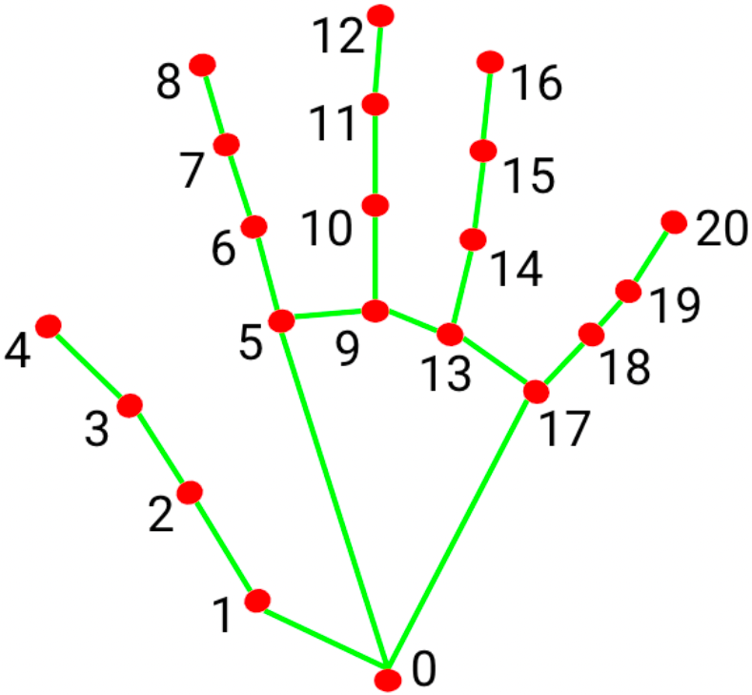
MEDIAPIPE EVALUATION
The MediaPipe models either extract all 21 right-hand (x, y, z) keypoints or none.
Previous studies in the literature show trust in its tracking accuracy.
Experiences with and without occlusions were made showing acceptable results.
 | Hand Open | Hand Closed
No Movement | 100% | 99.6%
In Movement | 93.2% | 98.4%

Slide 19
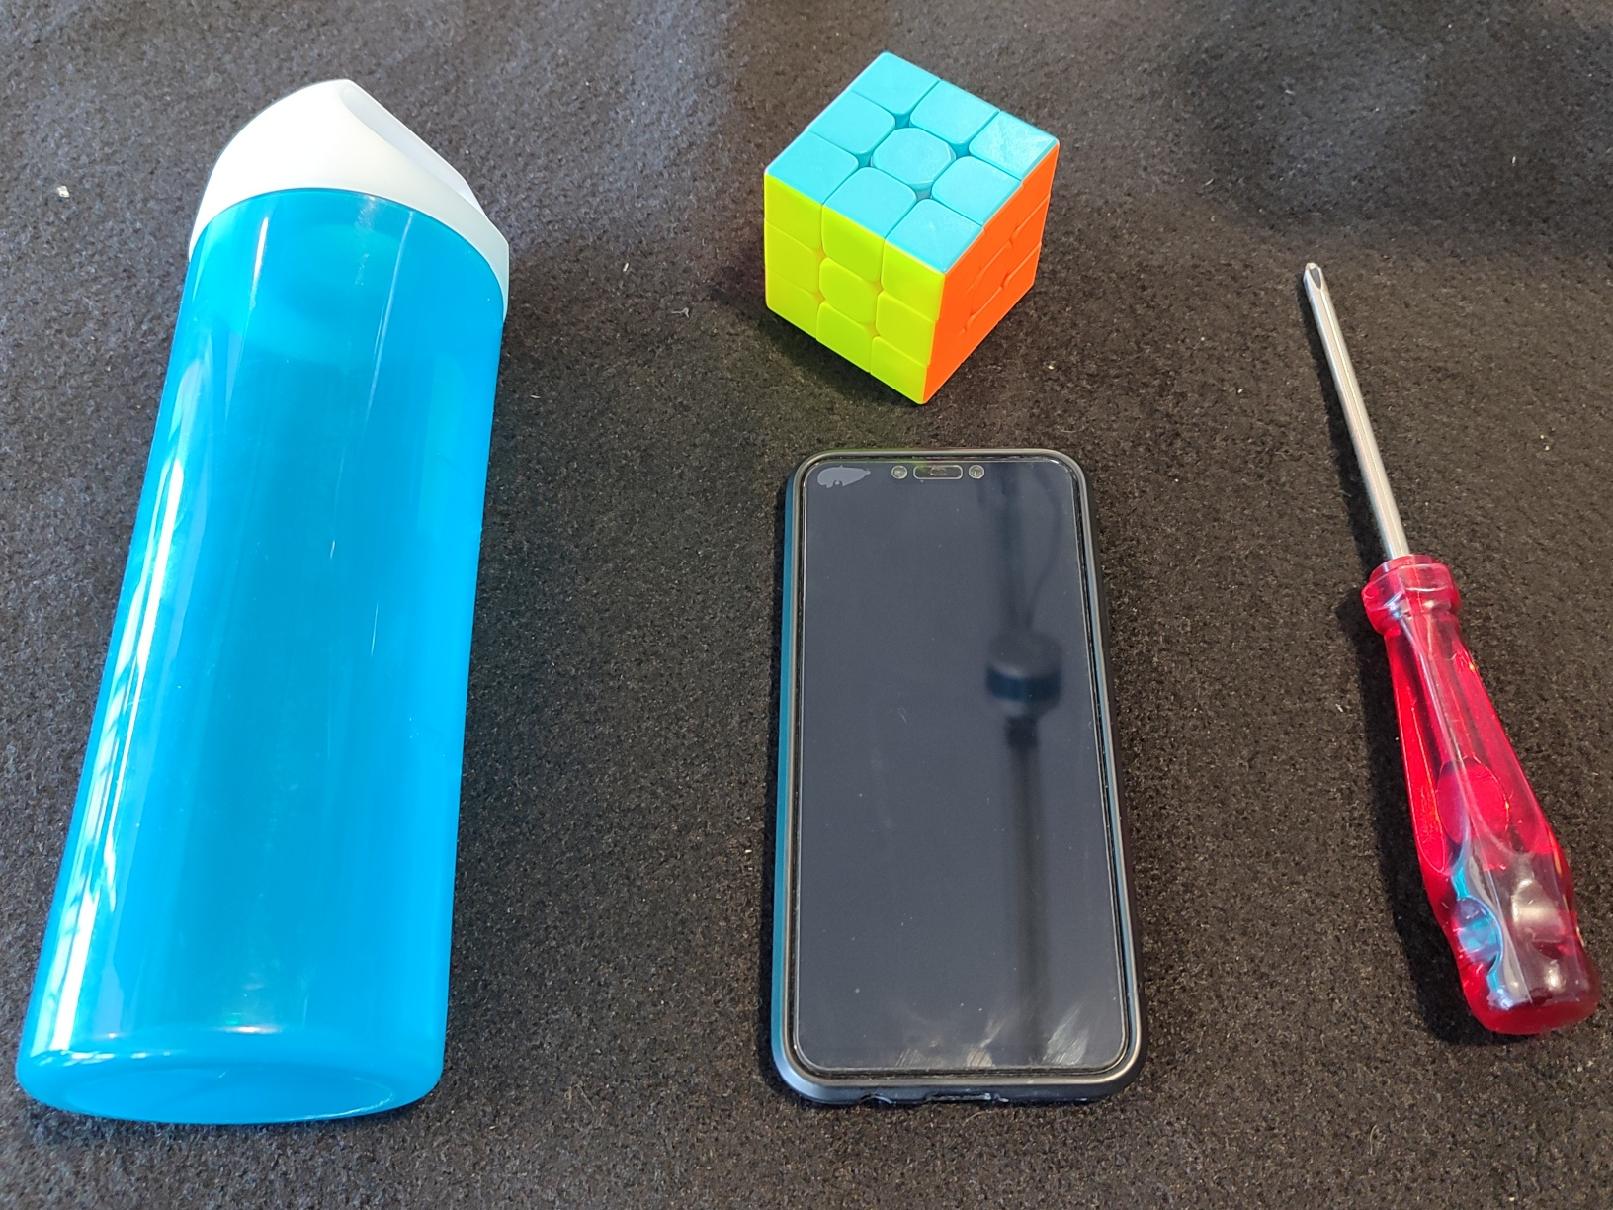
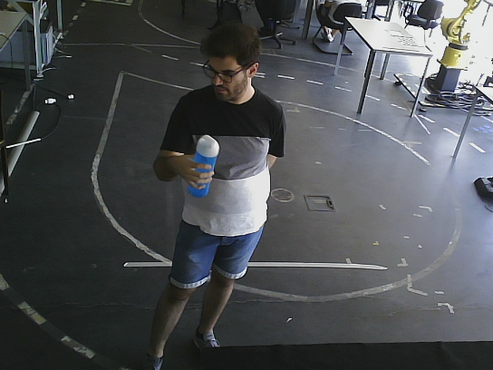
DATASET ACQUISITION
The objects used include a water bottle, a Rubik’s cube, a smartphone, and a screwdriver.
The acquisition involved the participation of three volunteers, who were asked to naturally grab an object and execute small movements.
A tool was developed in ROS to ease the creation of a new dataset.
Notes:
Referir que a tool é importante para criar datasets para utilizadores especificos e para depois poder ter mais objetos

Slide 20
DATASET ACQUISITION
The dataset is distributed almost equally between the 3 participants and the 4 objects in the acquisition.
For each participant and object, 4 sessions were recorded to ensure variability within the same human-object interaction.
Dataset | Bottle | Cube | Phone | Screwdriver | Total
User1 | 828 | 928 | 950 | 957 | 3663
User2 | 886 | 926 | 939 | 946 | 3697
User3 | 904 | 907 | 937 | 946 | 3694
Total | 2618 | 2761 | 2826 | 2849 | 11 054

Slide 21
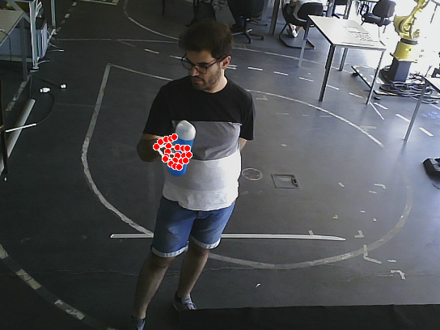
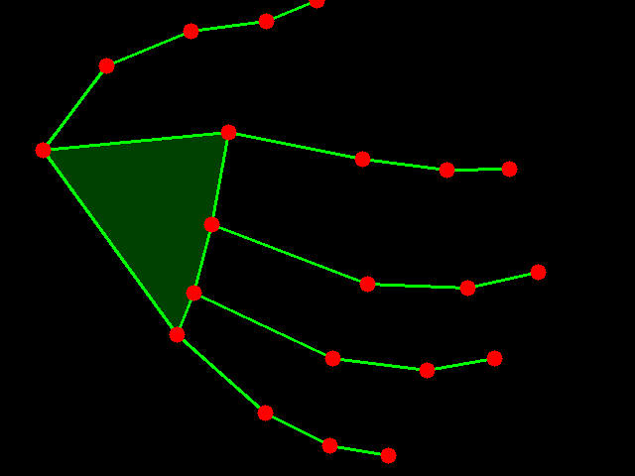
DATASET PREPROCESSING
The keypoints generated by MediaPipe corresponding to the right hand suffer further transformations and normalization.
This ensures maximum separation between keypoints helping the data be more consistent and invariable to hand position, size or scale.

Slide 22
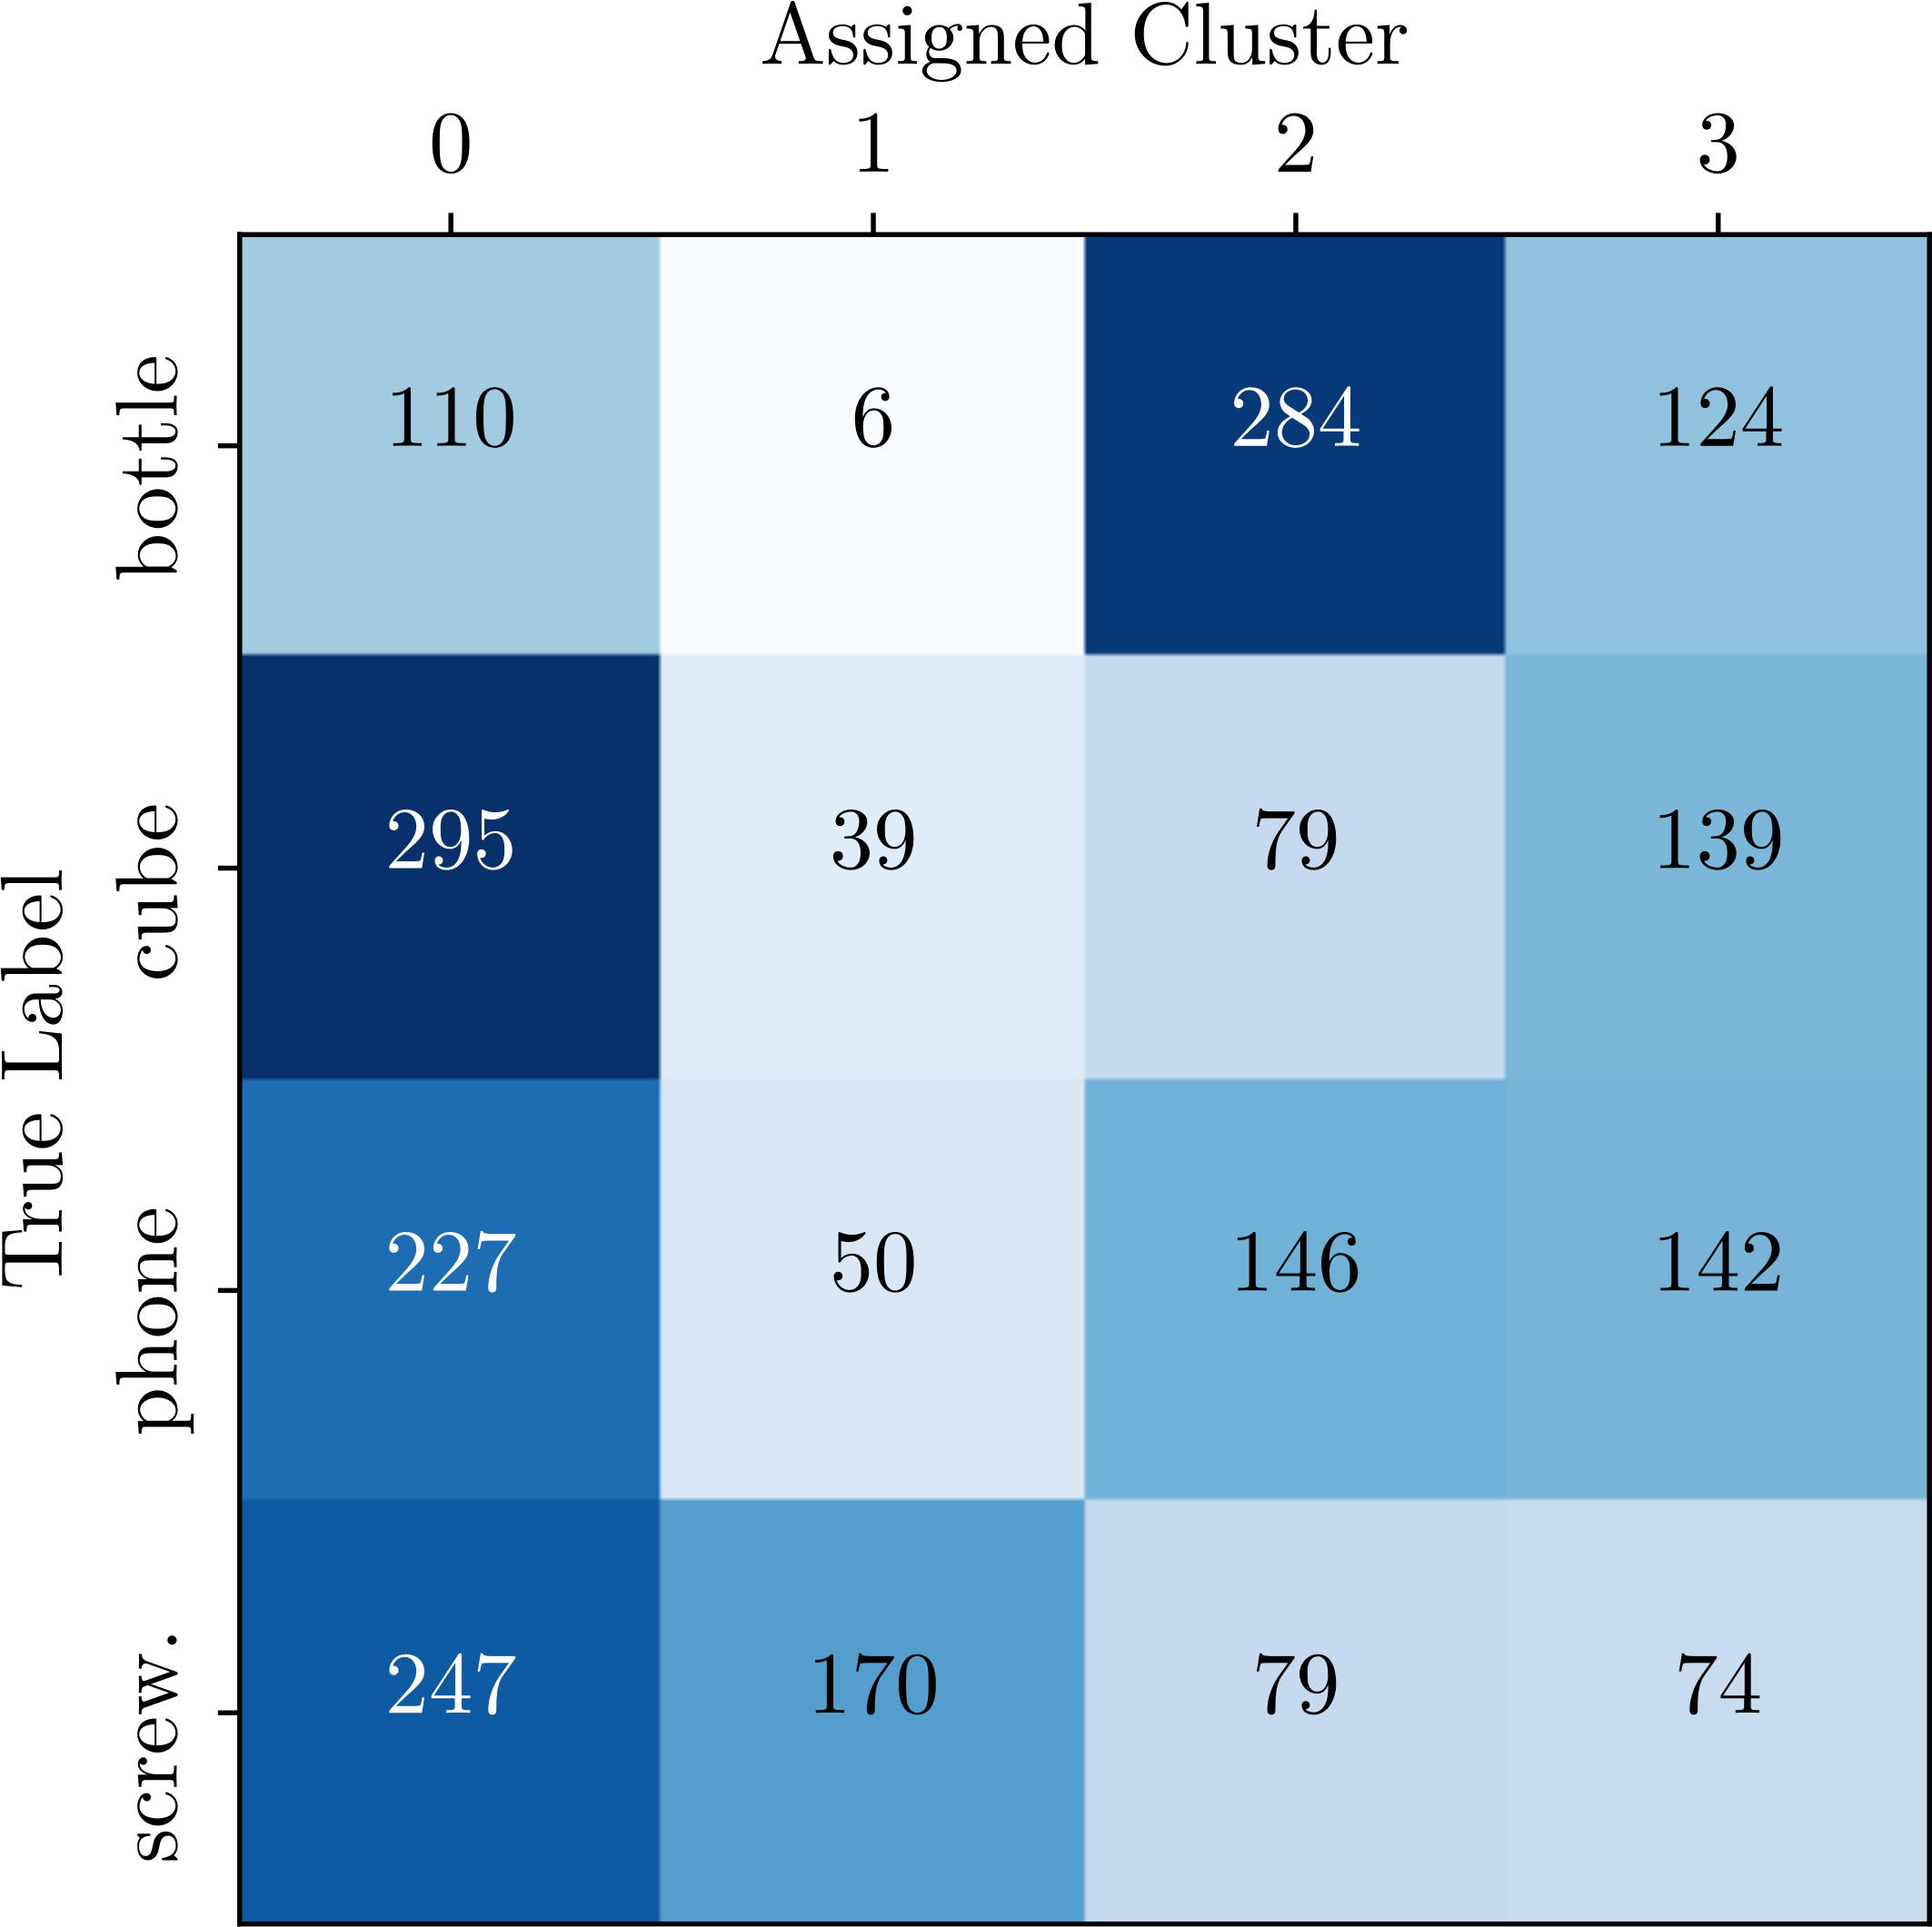
DATASET STATISTICAL ANALYSIS
K-Means clustering was used on the normalized keypoints as a statistical analysis of the complexity of this problem.
Clusters 0 and 3 exhibit a mix of all classes.
Cluster 0 encompasses 39.8% of all data.
Clusters do not align with classes.
Given the results, deep learning models were used showing a more robust generalization.

Slide 23
DEEP ARCHITECTURES
CNN – 156 644 trainable parameters & 127s training time
Transformer – 16 384 trainable parameters & 1351s training time

Slide 24
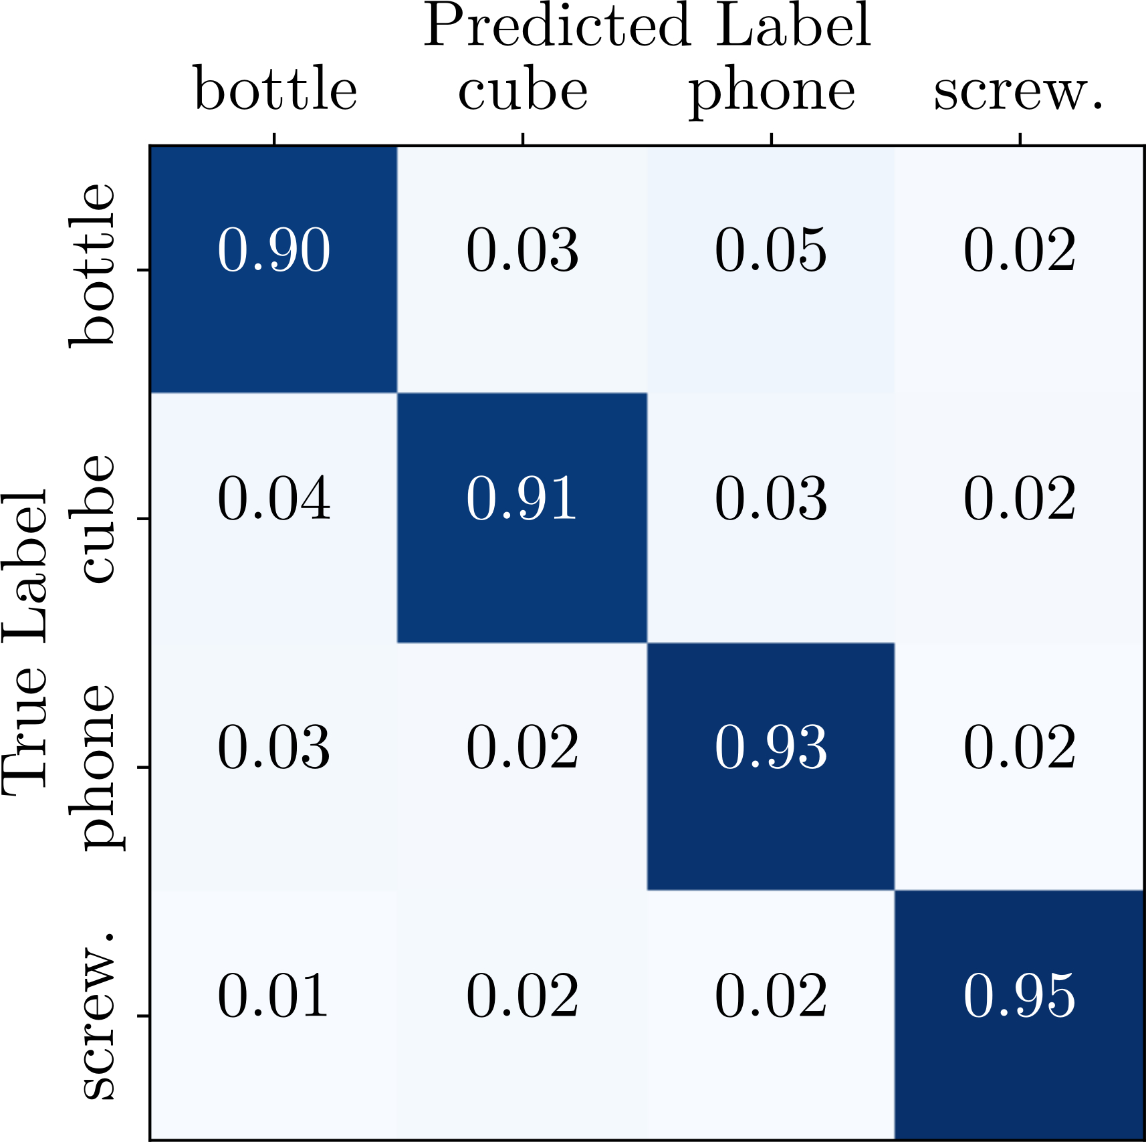
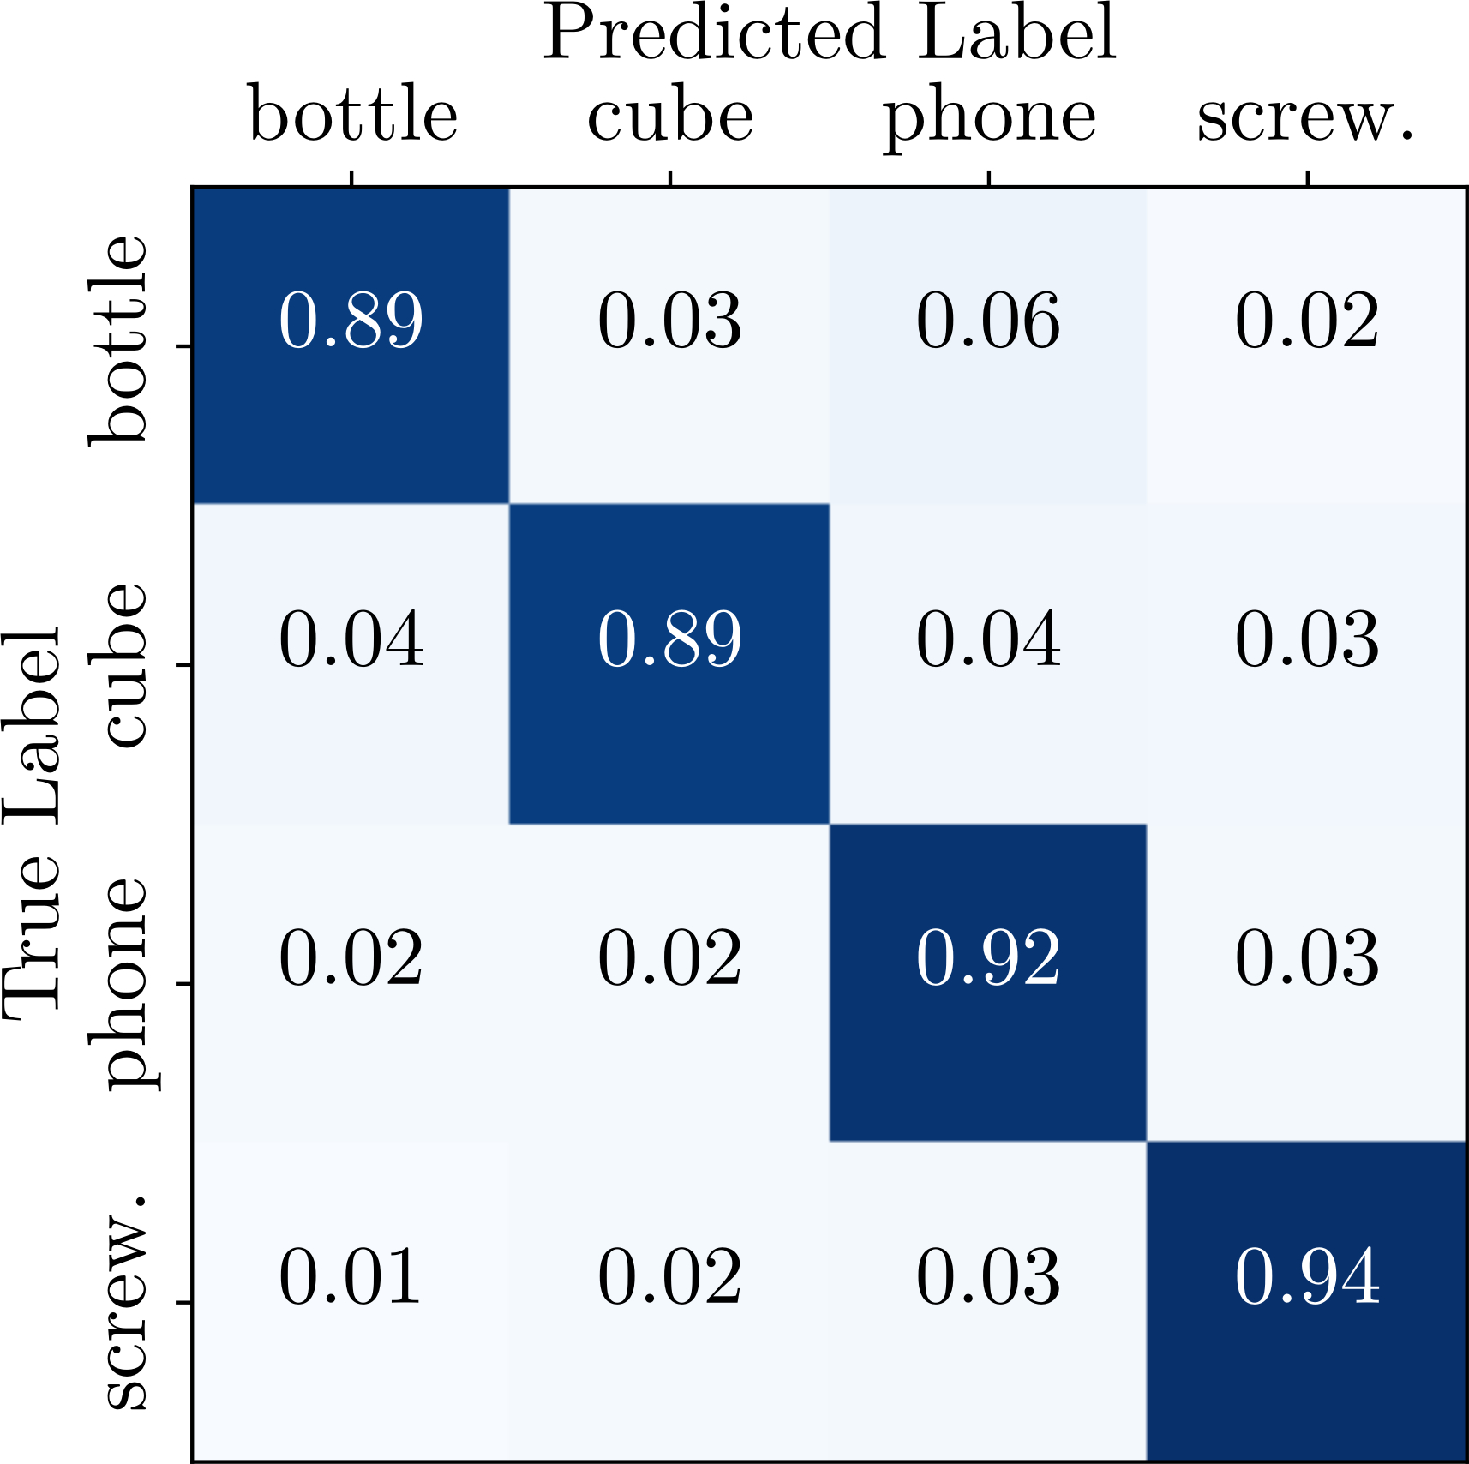
PERFORMANCE EVALUATION
CNN
Transformer
Accuracy | Precision | Recall | F1-Score
0.9240 | 0.9242 | 0.9240 | 0.9240
Accuracy | Precision | Recall | F1-Score
0.9109 | 0.9115 | 0.9109 | 0.9109
Notes:
Aqui temos resultados promissores mas não são realistas em uma aplicação prática
o padrão varia de aquisição para aquisição, e aqui usavam-se todos os utilizadores tanto em treino como em teste

Slide 25
PRACTICAL CHALLENGES
SESSION
BASED
USER
SPECIFIC
LEAVE ONE
USER OUT
Acess the impact of the sessions on the classifier’s performance.
Provide insights into the classifier’s performance on data from a single user.
Evaluate the performance on data from a user not included in the training data.
Notes:
50 simulations

Slide 26
SESSION BASED TESTING
Access the impact of session-specific data on the classifier’s performance.
“Full Dataset” – trained and tested on all users and all sessions
“Session-Based Testing” – tested on a session not used for training
Model | Accuracy | Precision | Recall | F1-Score
CNN | 0.9210 | 0.9214 | 0.9211 | 0.9211
Transformer | 0.9017 | 0.902 | 0.9016 | 0.9017
Metric | Model | Session 1 | Session 2 | Session 3 | Session 4
Accuracy | CNN | 0.8493 | 0.8138 | 0.7844 | 0.7718
 | Transformer | 0.8458 | 0.8027 | 0.7902 | 0.7613
Notes:
Primeiros resultados mostram que o modelo consegue generalizar entre as várias classes
Os segundos resultados mostram o impacto que os dados especificos de cada sessão afetam o classificador dado que em cada sessão o utilizador acaba por segurar num objeto de forma ligeiramente diferente

Slide 27
USER SPECIFIC TESTING
Provide insights into the classifier’s performance on data from a single user.
“Full User Dataset” – trained and tested on all sessions from one user
“Session-Based User1 Testing” – using only user1’s data, tested on a session not used for training
Metric | Model | User1 | User2 | User3
Accuracy | CNN | 0.9674 | 0.9100 | 0.9163
 | Transformer | 0.9423 | 0.8929 | 0.8730
Metric | Model | Session 1 | Session 2 | Session 3 | Session 4
Accuracy | CNN | 0.9257 | 0.8364 | 0.9053 | 0.7883
 | Transformer | 0.9078 | 0.8171 | 0.8742 | 0.7636
Notes:
A melhoria de performance que advém de usar apenas um utilizador mostra a importância de personalizar um modelo a um utilizador específico.
Foi também aplicada a idea do teste anterior de usar uma sessão para teste para os dados do user1 e os resultados em geral foram superiores aos obtidos usando todos os utilizadores.

Slide 28
LEAVE ONE USER OUT
Evaluate the performance on data from a user not included in the training data.
“Leave-One-User-Out Test” – tested on all sessions from one user not used in training
Metric | Model | User1 | User2 | User3
Accuracy | CNN | 0.7969 | 0.5827 | 0.5488
 | Transformer | 0.8006 | 0.5730 | 0.5350
Notes:
Esta experiência mostra as dificuldades para generalizar para outros utilizadores com os quais o modelo não foi treinado.
Embora sem usar o User1 no treino, os resultados ainda foram aceitáveis mas para os outros utilizadores, os resultados foram muito inferiores reforçando a necessidade para personalizar os modelos

Slide 29
04
CONCLUSIONS

Slide 30
CONCLUSIONS
The collaborative workspace and infrastructure was validated and allowed for preliminary anticipation experiments.
The approach adopted in this work was to perform action anticipation by recognizing the object being grasped by the user.
The object recognition framework was tested in different cases and showed promising results for a practical implementation.

Slide 31
FUTURE WORK
More Data - test the current architectures with a bigger dataset.
Adaptability Strategies - explore advanced techniques to further enhance the adaptability and generalization capabilities of the system.
Real-Time Integration – test the integration of the object recognition pipeline into a real-time collaborative application.

Slide 32
CONTRIBUTIONS
Article - P. Amaral, F. Silva, V. Santos, «Recognition of Grasping Patterns using Deep Learning for Human-Robot Collaboration», Sensors, https://www.mdpi.com/1424-8220/23/21/8989.
Github Repository - Pedro Amaral, Recognition of Human Grasping Patterns for Intention Prediction in Collaborative Tasks, https://github.com/pedromiglou/MRSI_Thesis_Action_Anticipation.
Kaggle Dataset - Pedro Amaral, Human Grasping Patterns for Object Recognition, https://www.kaggle.com/datasets/pedromiglou/human-grasping-patterns-for-object-recognition.

Slide 33
THANK YOU
Do you have any questions?

