Slide 1
Aveiro, October 04 2024
End-to-End Reinforcement Learning for Autonomous Driving in Urban Environments
Thesis Defense
^{Ph.D. candidate: Daniel Coelho}
^{Supervisor: Miguel Oliveira}
^{Co-supervisor: Vítor Santos}

Slide 2
Outline
Aveiro, October 04 2024
Introduction
RLAD: Reinforcement Learning from Pixels for Autonomous Driving in Urban Environments
RLfOLD: Reinforcement Learning from Online Demonstrations in Urban Autonomous Driving
PRIBOOT: A New Data-Driven Expert for Improved Driving Simulations
Conclusions

Slide 3
1.
Introduction
Coelho, Daniel, and Miguel Oliveira. "A review of end-to-end autonomous driving in urban environments." IEEE Access (2022): 75296-75311, doi: 10.1109/ACCESS.2022.3192019.

Slide 4
Autonomous Driving
1. Introduction Aveiro, October 04 2024
Modular [1]
End-to-End [2]
[1] C. Urmson et al., ‘‘Autonomous driving in urban environments: Boss and the urban challenge,’’ J. Field Robot., vol. 25, pp. 425–466, 2009.
[2] M. Bojarski et al., ‘‘End to end learning for self-driving cars,’’ 2016, arXiv:160407316.

Slide 5
End-to-End Autonomous Driving
1. Introduction Aveiro, October 04 2024
Imitation Learning (IL) [2]
Reinforcement Learning (RL) [3]
[2] K. Chitta et al., “Transfuser: Imitation with transformer-based sensor fusion for autonomous driving”, in IEEE TPAMI, 2022, 45(11), 12878-12895.
[3] A. Kendall et al., ‘‘Learning to drive in a day,’’ in Proc. Int. Conf. Robot. Autom. (ICRA), 2019, pp. 8248–8254.

Slide 6
Simulation Framework
1. Introduction Aveiro, October 04 2024
Real-world research in AD is costly, risky, and presents ethical dilemmas, making it impractical to rely solely on real-world testing
Simulations provide a controlled, safe, and cost-effective environment for testing diverse driving scenarios that would be difficult or unsafe to replicate in real life
In this research, the CARLA simulator [4], a leading open-source platform, was used for developing, training, and evaluating AD systems
[4] A. Dosovitskiy, G. Ros, F. Codevilla, A. Lopez, and V. Koltun, ‘‘CARLA:An open urban driving simulator,’’ in Proc. CoRL, 2017, pp. 1–16.

Slide 7
Research Objectives
1. Introduction Aveiro, October 04 2024
Development of End-to-End RL Architectures for AD Systems in Urban Environments
Integration of Expert Demonstrations in an End-to-End RL Architecture for AD Systems
Development of a Data-Driven Expert Agent for Improved Driving Simulations

Slide 8
2.
RLAD: Reinforcement Learning from Pixels for Autonomous Driving in Urban Environments
Daniel Coelho, Miguel Oliveira, and Vitor Santos. "RLAD: Reinforcement Learning From Pixels for Autonomous Driving in Urban Environments." IEEE Transactions on Automation Science and Engineering (2023), doi: 10.1109/TASE.2023.3342419.

Slide 9
Motivation
2. RLAD Aveiro, October 04 2024
In urban Autonomous Driving (AD), all methods that use RL train the encoder and the policy separately
This is in contrast to Reinforcement Learning from Pixels (RLfP), which trains the encoder and the policy using the same objective function
By having only one objective function, we ensure that all components are aligned with the downstream task

Slide 10
Problems of applying RLfP in AD
2. RLAD Aveiro, October 04 2024
Sample Inefficiency [5]
Catastrophic Self-overfitting [6]
[5] D. Yarats et al., “Improving sample efficiency in model-free reinforcement learning from images,” in Proc. AAAI Conf. Artif. Intell., May 2021, vol. 35, no. 12,
[6] E. Cetin et al., “Stabilizing off-policy deep reinforcement learning from pixels,” in Proc. Int. Conf. Mach. Learn., 2022, pp. 2784–2810.

Slide 11
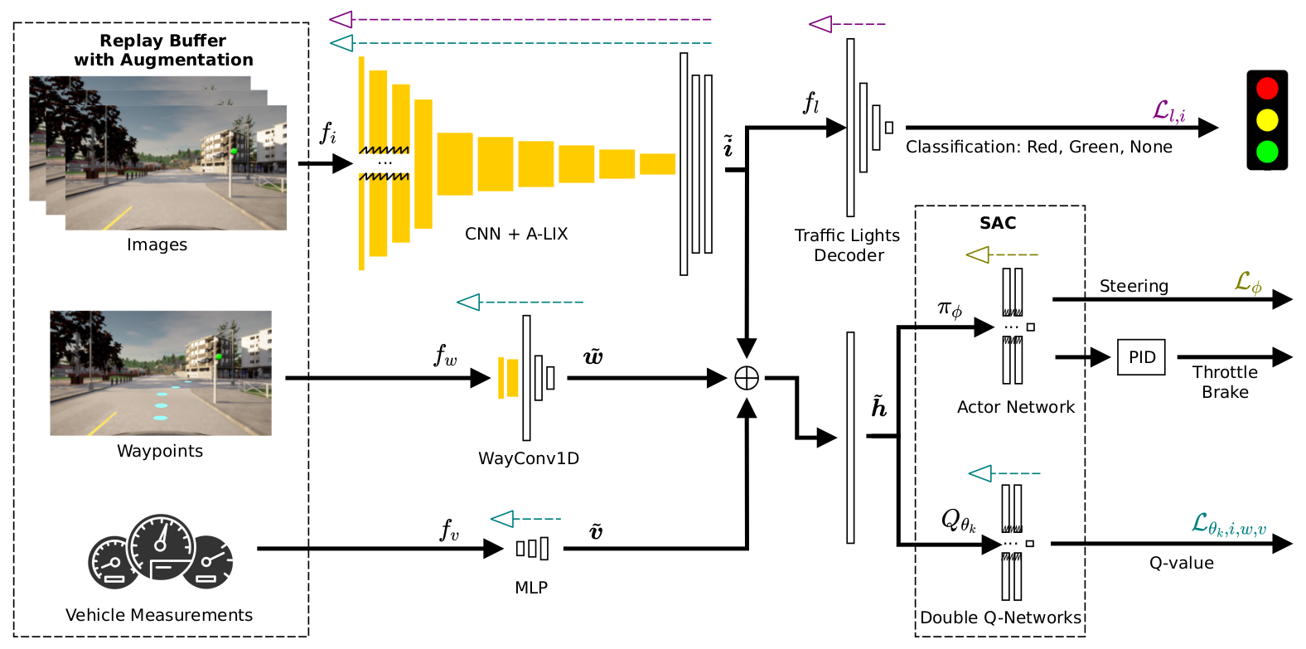
Architecture
2. RLAD Aveiro, October 04 2024

Slide 12
Architecture
2. RLAD Aveiro, October 04 2024

Slide 13
Adaptive Local Signal Mixing (A-LIX)
2. RLAD Aveiro, October 04 2024
Technique adapted from [6] , that minimizes the catastrophic self-overfitting phenomenon
A-LIX is applied to features from convolutional layers by mixing each component with its neighboring components within the same feature map, using an exponential weighting mechanism that reduces the influence of neighbors as the distance increases
Thus, the feature maps become spatially consistent, minimizing the effect of the catastrophic self-overfitting phenomenon.
[6] E. Cetin et al., “Stabilizing off-policy deep reinforcement learning from pixels,” in Proc. Int. Conf. Mach. Learn., 2022, pp. 2784–2810.

Slide 14
WayConv1D
2. RLAD Aveiro, October 04 2024
WayConv1D is a waypoint encoder that leverages the 2D geometrical structure of the input by applying 1D convolutions with a 2×2 kernel over the 2D coordinates of the next N waypoints
With WayConv1D the agent learns more efficiently to follow the trajectory without oscillating near the center of the lane.

Slide 15
Traffic Light Decoder
2. RLAD Aveiro, October 04 2024
Auxiliary loss that performs traffic light classification to strengthen the significance of traffic light information in the latent representation of the image
Inputs
Encoder
Policy
Control Commands

Slide 16
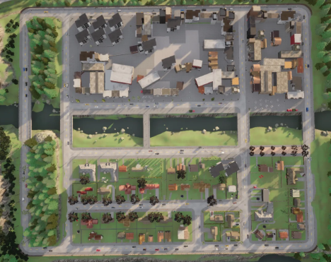
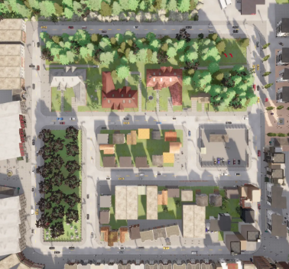
Setup of Experiments: NoCrash Benchmark
2. RLAD Aveiro, October 04 2024
Town 01
Town 02

Slide 17
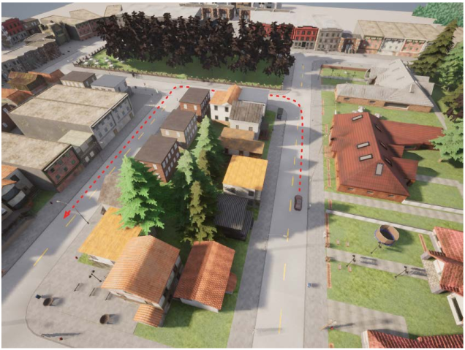
NoCrash Benchmark
2. RLAD Aveiro, October 04 2024
Empty
Regular
Dense

Slide 18
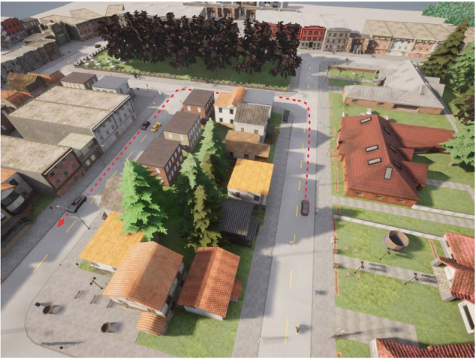
NoCrash Benchmark
2. RLAD Aveiro, October 04 2024
Empty
Regular
Dense

Slide 19
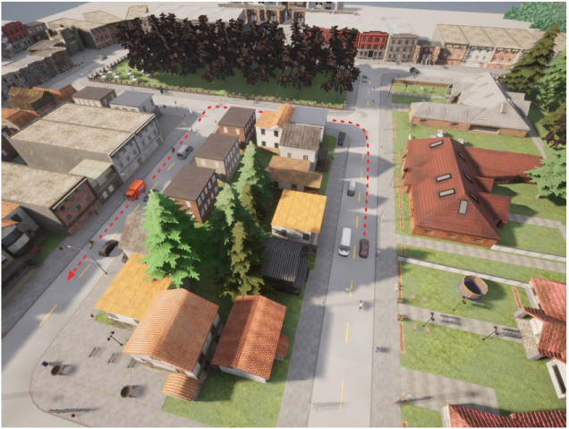
NoCrash Benchmark
2. RLAD Aveiro, October 04 2024
Empty
Regular
Dense

Slide 20
Setup of Experiments: SOTA Methods
2. RLAD Aveiro, October 04 2024
SAC+AE: AAAI 2021
CURL: ICML 2020
DrQ: ICLR 2021
DrQ-V2: ICLR 2022

Slide 21
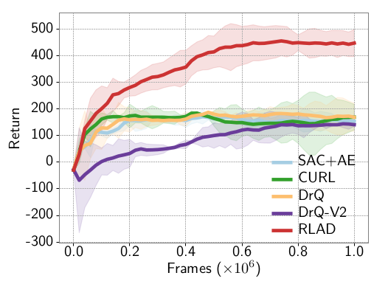
Comparison with SOTA: Return
2. RLAD Aveiro, October 04 2024

Slide 22
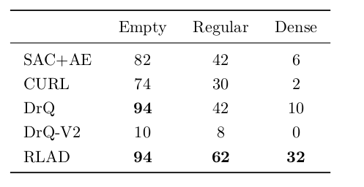
Comparison with SOTA: Success Rate (%)
2. RLAD Aveiro, October 04 2024

Slide 23
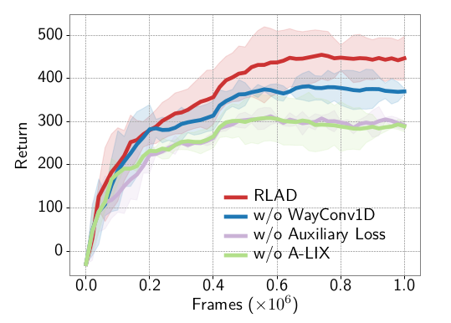
Ablation Study
2. RLAD Aveiro, October 04 2024

Slide 24
2. RLAD Aveiro, October 04 2024

Slide 25
Summary
2. RLAD Aveiro, October 04 2024
RLAD is the first algorithm that learns simultaneously the encoder and the driving policy network using RL in the domain of vision-based urban AD
Although RLAD outperforms all RLfP methods in the urban AD domain, it is not yet competitive with state-of-the-art RL methods that decouple the training of encoder and the policy network [7] or that use expert demonstrations [8]
[7] M. Toromanoff et al., “End-to-end model-free reinforcement learning for urban driving using implicit affordances,” 2020 IEEE/CVF Conference on Computer Vision and Pattern Recognition (CVPR), pp. 7151–7160, 2019.
[8] Chen et al., “Learning by Cheating”. Proceedings of the Conference on Robot Learning, volume 100 of Proceedings of Machine Learning Research, 66–75. PMLR.

Slide 26
3.
RLfOLD: Reinforcement Learning from Online Demonstrations in Urban Autonomous Driving
Daniel Coelho, Miguel Oliveira, and Vitor Santos. "RLfOLD: Reinforcement Learning from Online Demonstrations in Urban Autonomous Driving." Proceedings of the AAAI Conference on Artificial Intelligence. Vol. 38. No. 10. 2024, doi: 10.1609/aaai.v38i10.29049.

Slide 27
Motivation
3. RLfOLD Aveiro, October 04 2024
How can we improve RLAD to outperform state-of-the-art methods on the NoCrash benchmark?

Slide 28
Motivation
3. RLfOLD Aveiro, October 04 2024
How can we improve RLAD to outperform state-of-the-art methods on the NoCrash benchmark?
By Integrating Expert Demonstrations

Slide 29
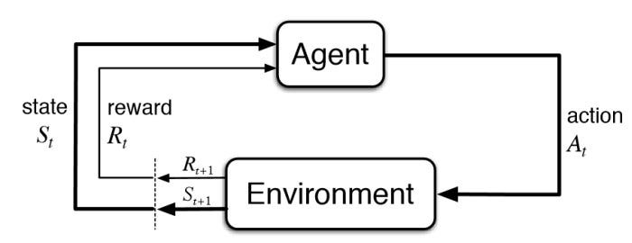
Reinforcement Learning from Demonstrations (RLfD)
3. RLfOLD Aveiro, October 04 2024
Demonstrations
High sample efficiency of IL
Generalization of RL
Distribution gap between the demonstrations and the environment
Complexity of integrating demonstrations within an RL framework

Slide 30
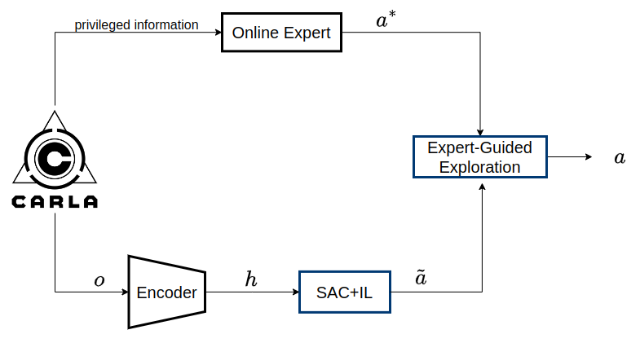
Learning Framework
3. RLfOLD Aveiro, October 04 2024
Notes:
This is a simplified architecture of our system. On the top, we have an online expert that receives privileged information from the simulator and outputs the expert actions, denoted here the a with an asterisk. In this case, we just use a rule base approach, similar to the CARLA autopilot. But in this moment we are working on improving the online expert.
In the bottom, we have an encoder to encode the observation into a latent representation, h, which is then fed into the SAC+IL block. This block is a policy that was trained using RL, more precisely Soft Actor Crtitic and Imitation Learning. This block outputs the a with tilde, which is the action sample using the SAC algorithm. In the end we have a expert guided exploration that will decide which action to use.
This simplified architecture already depicts the first contribution of our work. By using an online expert, instead of collecting an offline dataset, we are applying the expert knowledge to the same environment of the RL training, which reduces the distribution gap.

Slide 31
Soft Actor-Critic with Imitation Learning
3. RLfOLD Aveiro, October 04 2024
We propose a modified policy of the SAC algorithm that allows for the inclusion of the IL loss
Notes:
Starting with the SAC with IL, we propose a new policy for the SAC algorithm to include the IL loss.

Slide 32
Soft Actor-Critic with Imitation Learning
3. RLfOLD Aveiro, October 04 2024
We propose a modified policy of the SAC algorithm that allows for the inclusion of the IL loss
Traditional policy
Notes:
The traditional policy outputs a miu and a sigma, representing the mean and standard deviation of the gaussian distribution from which an action is sampled

Slide 33
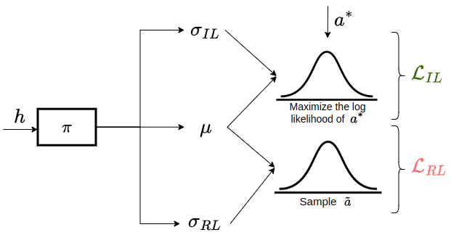
Soft Actor-Critic with Imitation Learning
3. RLfOLD Aveiro, October 04 2024
We propose a modified policy of the SAC algorithm that allows for the inclusion of the IL loss
Traditional policy
Proposed policy
Notes:
We propose in addition to the sigma of the RL component, to have an additional sigma for the IL component, sharing the same mean. This way we can simultaneously sample the action, and also maximize the log-likelihood of sampling the expert action.

Slide 34
Soft Actor-Critic with Imitation Learning
3. RLfOLD Aveiro, October 04 2024
With different standard deviations, the algorithm can adapt to the varying levels of uncertainty in RL and IL
It allows the RL component to explore the state-action space more broadly, while the IL component can focus on imitating the expert’s behavior more closely
Notes:
We found that with different standard deviations, the algorithm can adapt to the varying levels of uncertainty in RL and IL. Because it allows the RL component to explore the state-action space more broadly, while the IL component can focus on imitating the expert’s behavior more closely

Slide 35
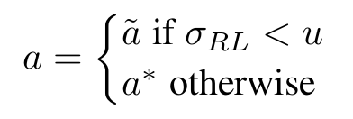
Expert-Guided Exploration Based on Uncertainty
3. RLfOLD Aveiro, October 04 2024
Rather than limiting the online expert's role to the IL loss, we also employ it to assist the exploration
The idea is to use σ_{RL}as the uncertainty of the decision taken by the current policy
Notes:
Addressing now the expert guided exploration…
Instead of using the online expert role only to the IL loss, as is common, we also use the expert to assist the exploration process
We use the sigma of the RL as the uncertainty of the decision taken by the current policy, and then use this equation.
If the uncertainty is below a hyperparameter defined by us, we choose the action of the current policy. However, when the uncertainty is high, we use the action of the expert.
This illustrates a dynamic relationship between the student and the teacher.
Similar to a student seeking guidance from a teacher, the agent autonomously explores when confident, and seeks assistance from the expert when uncertain.

Slide 36
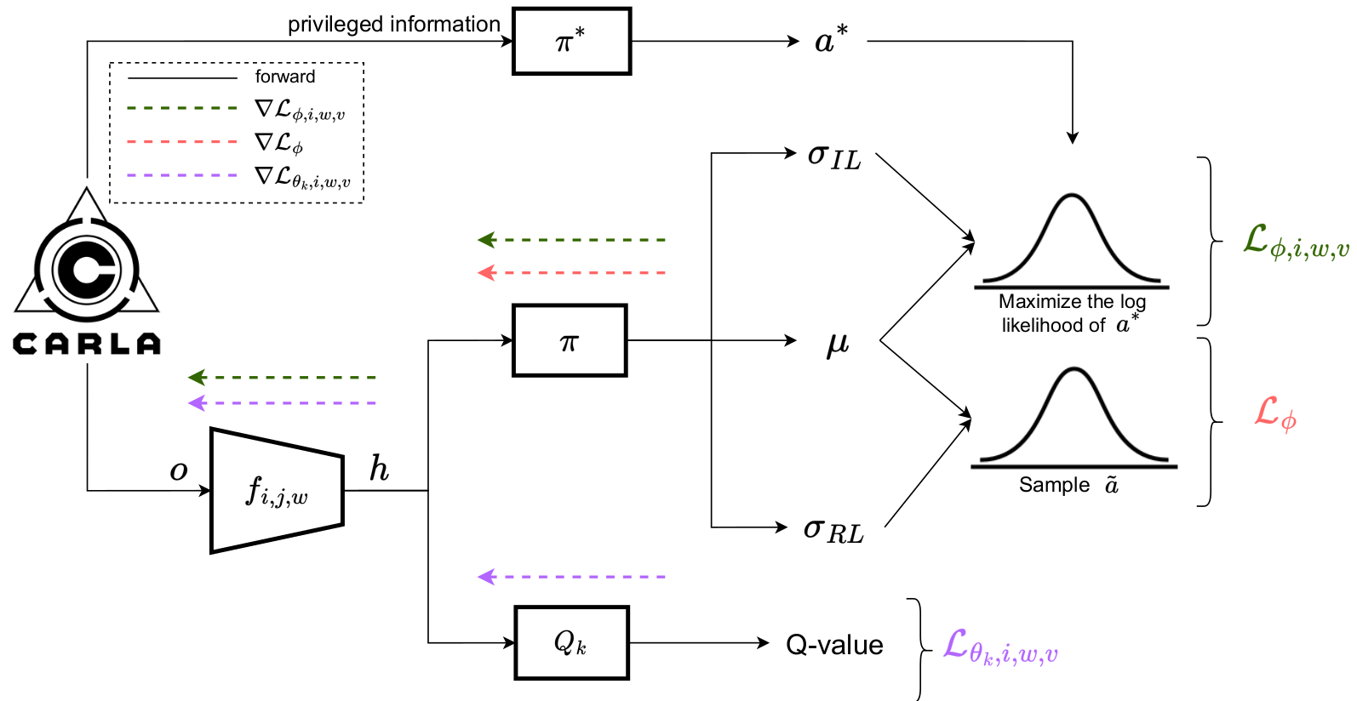
RLfOLD
3. RLfOLD Aveiro, October 04 2024
Notes:
This is the main architecture of the system.
Our system's architecture encompasses an online expert at the top, a dual standard deviation policy in the middle, and the double Q networks, typical in the SAC algorithm, at the bottom.
The dashed arrows illustrate which parameters are updated by each loss.
As depicted in the dashed arrows, we train this algorithm end-to-end, aligning the objectives of all components. To prevent the catastrophic self-overfitting of the encoder, common in pixel-based reinforcement learning, we employ a small encoder. Consistent with practices in pixel-based RL, we ensured the gradients of the RL policy loss do not update encoder parameters.

Slide 37
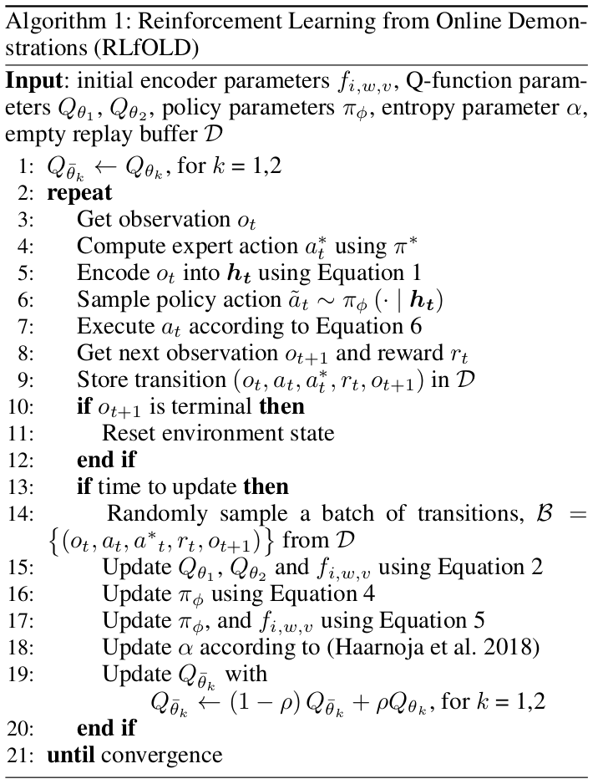
3. RLfOLD Aveiro, October 04 2024
Notes:
This is the main architecture of the system.
Our system's architecture encompasses an online expert at the top, a dual standard deviation policy in the middle, and the double Q networks, typical in the SAC algorithm, at the bottom.
The dashed arrows illustrate which parameters are updated by each loss.
As depicted in the dashed arrows, we train this algorithm end-to-end, aligning the objectives of all components. To prevent the catastrophic self-overfitting of the encoder, common in pixel-based reinforcement learning, we employ a small encoder. Consistent with practices in pixel-based RL, we ensured the gradients of the RL policy loss do not update encoder parameters.

Slide 38
Setup of Experiments: NoCrash Benchmark
3. RLfOLD Aveiro, October 04 2024
Town 01
Town 02

Slide 39
Setup of Experiments: SOTA Methods
3. RLfOLD Aveiro, October 04 2024
RL:
IAs: CVPR 2020
CADRE: AAAI 2022
IL:
CILRS: ICCV 2019
LBC: CoRL 2020
RLfD:
GRIAD: Robotics 2023
WOR: ICCV 2021

Slide 40
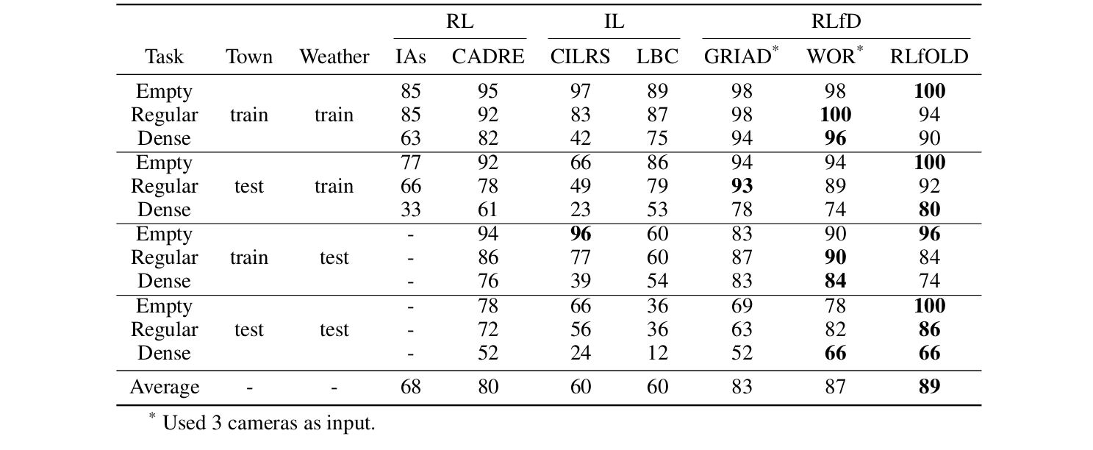
Comparison with SOTA: Success Rate (%)
3. RLfOLD Aveiro, October 04 2024

Slide 41
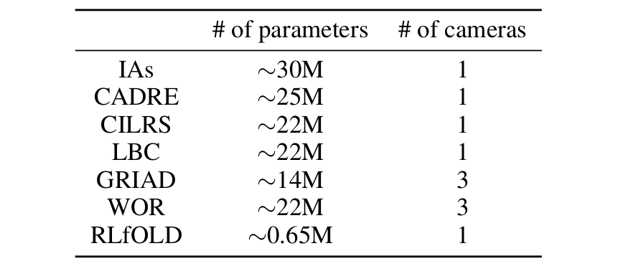
Comparison with SOTA: # of parameters and # of cameras
3. RLfOLD Aveiro, October 04 2024

Slide 42
Ablation Study
3. RLfOLD Aveiro, October 04 2024
Notes:
To gain deeper insights into the strengths of RLfOLD, we conducted an ablation study examining its main components. In addition to measure the success rate, we also measure the route completion, collision with pedestrians, vehicles and layouts, and lastly, the number of blockages of the agent.
Firstly, we established a RL baseline version without demonstrations. This variant achieved a success rate of 52% which stands for a marginal loss of 34% considering the original version of RLfOLD. This difference clearly indicates the challenges of learning complex driving tasks using RL from scratch.
Then, to evaluated the significance of the two standard deviations, we create a variant of RLfOLD that generates only one standard deviation and employs Mean Squared Error (MSE) loss for the IL training (RLfOLD w/o two SDs). This variant achieved a success rate of 64%, which is significantly inferior to the one achieved using the two standard devia-
tions.
Furthermore, to assess the impact of expert-guided exploration based on uncertainty, we experimented with two versions of RLfOLD: one that excludes expert guidance during exploration (RLfOLD w/o uncertainty (p=0.0)) and another that incorporates expert guidance with a fixed probability of 0.3 for each action taken.
When we exclude expert guidance during exploration, the success rate drops to
72%. This indicates that the online expert provides valuable insights to guide the agent’s exploration. Moreover, incorporating the online expert with a fixed probability for each
action achieves a success rate of 80%, which is 8% better than not using the on-
line expert, but is 6% worse than using the expert-guided
exploration based on uncertainty.
So this table clearly demonstrates the usefulness of each component of RLfOLD.

Slide 43
Summary
3. RLfOLD Aveiro, October 04 2024
RLfOLD introduces a seamless integration of IL and RL by leveraging online demonstrations, a dual standard deviation policy network, and an uncertainty-based technique guided by an online expert to enhance the exploration process
Even with a significantly smaller encoder and a single-camera setup, RLfOLD surpasses all state-of-the-art methods on the NoCrash benchmark

Slide 44
4.
PRIBOOT: A New Data-Driven Expert for Improved Driving Simulations
Manuscript submitted at: IEEE Robotics and Automation Letters

Slide 45
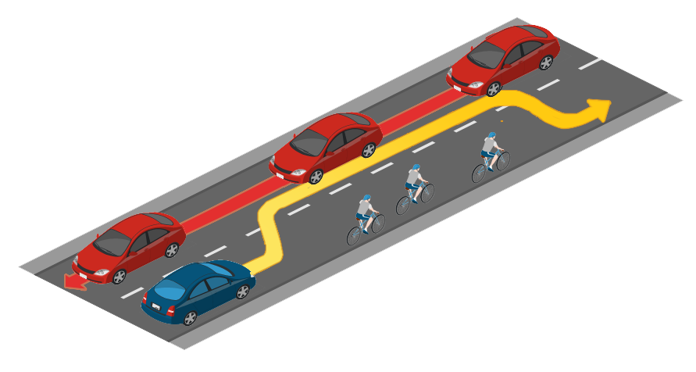
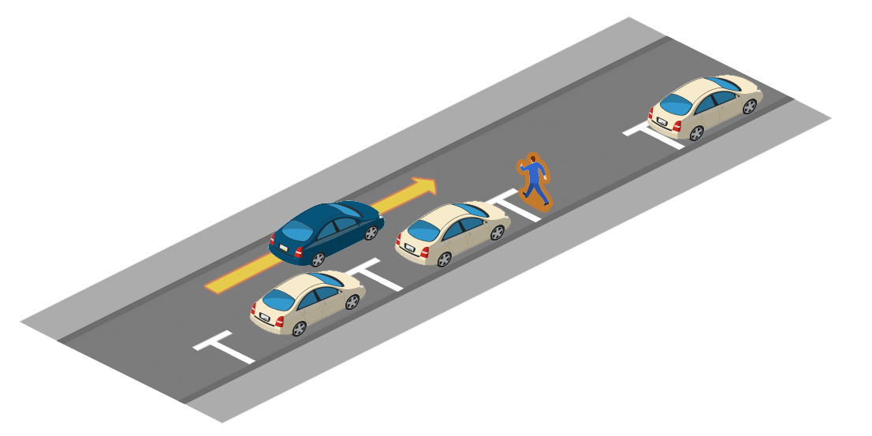
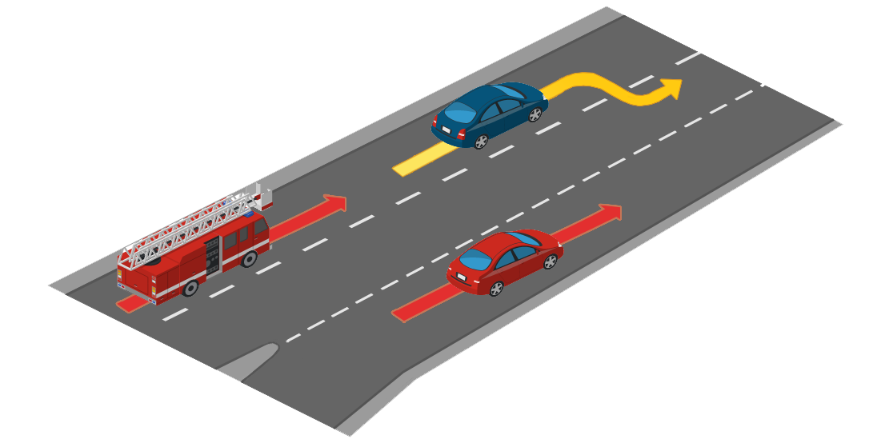
Motivation
4. PRIBOOT Aveiro, October 04 2024
After achieving top performance on the NoCrash benchmark, we advanced to the more recent and challenging CARLA benchmark: Leaderboard 2.0

Slide 46
Motivation
4. PRIBOOT Aveiro, October 04 2024
The objective was to use RLfOLD in Leaderboard 2.0; however, there was no online expert working effectively

Slide 47
PRIBOOT (Privileged Information Bootstrapping)
4. PRIBOOT Aveiro, October 04 2024
This work proposes PRIBOOT, the first functional online expert for the Leaderboard 2.0
CARLA provides human driving logs, which, while insufficient for models requiring sensor inputs, become valuable when combined with privileged information
PRIBOOT is capable of navigating the demanding scenarios presented in Leaderboard 2.0, subsequently enabling the generation of extensive datasets or providing online demonstrations

Slide 48
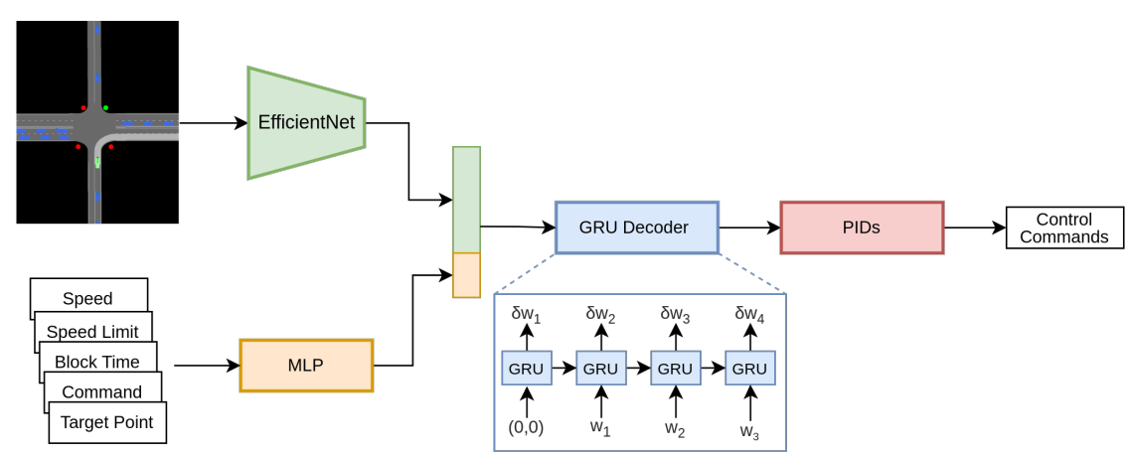
Architecture
4. PRIBOOT Aveiro, October 04 2024

Slide 49
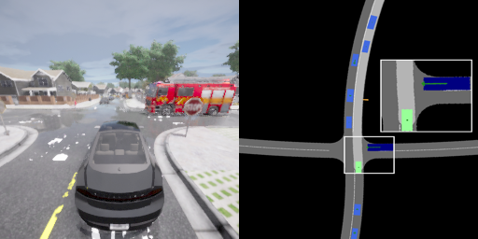
BEV: Example 1
4. PRIBOOT Aveiro, October 04 2024

Slide 50
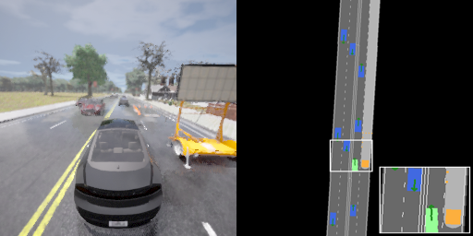
BEV: Example 2
4. PRIBOOT Aveiro, October 04 2024

Slide 51
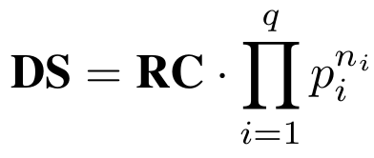
Driving Score (DS)
4. PRIBOOT Aveiro, October 04 2024
DS is the main metric to evaluate the performance of models in Leaderboard 2.0
However, this metric biases against longer routes due to its cumulative penalty for infractions

Slide 52
Driving Score (DS)
4. PRIBOOT Aveiro, October 04 2024
For instance, let’s consider an agent with an average infraction rate of 0.2 collisions per km (penalty=0.6)
Considering that the route completion is 100% we have very different results if we test this agent in a 5 km route or 10 km route
5 km: DS= 1 * 0.6^1 = 0.6
10km: DS = 1* 0.6*2 = 0.36

Slide 53
Infraction Rate Score (IRS)
4. PRIBOOT Aveiro, October 04 2024
To promove fairness, we introduce IRS. This metric accounts for the infraction rate per kilometer, adjusting for route length and providing a balanced evaluation

Slide 54
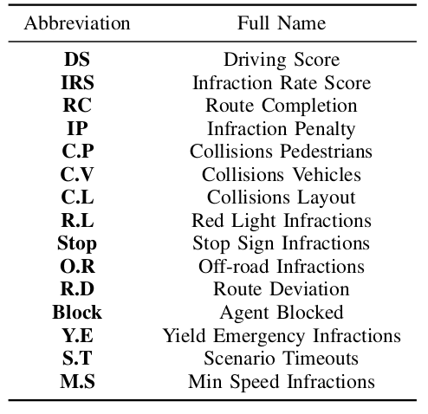
Comparison with Baseline
4. PRIBOOT Aveiro, October 04 2024

Slide 55
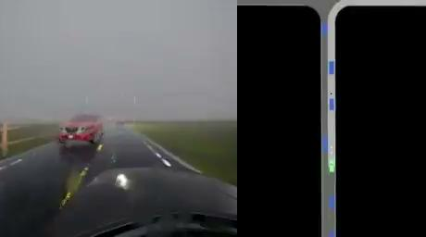
Demonstration of PRIBOOT’ Driving
4. PRIBOOT Aveiro, October 04 2024

Slide 56
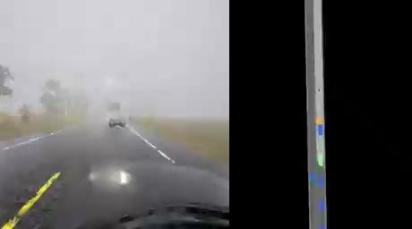
Demonstration of PRIBOOT’ Driving
4. PRIBOOT Aveiro, October 04 2024

Slide 57
Summary
4. PRIBOOT Aveiro, October 04 2024
PRIBOOT is a system that utilizes privileged information alongside limited human driving logs to establish the first expert in the CARLA Leaderboard 2.0
PRIBOOT enables researchers to generate extensive datasets, potentially resolving data availability issues in this benchmark.

Slide 58
5.
Conclusions

Slide 59
Conclusions
5. Conclusions Aveiro, October 04 2024
This thesis presents a significant progress in end-to-end AD for urban environments, with a focus on RL
Introduced RLAD, RLfOLD, and PRIBOOT leveraging RL and IL to achieve state-of-the-art results in the NoCrash benchmark, and to introduce the first online expert of Leaderboard 2.0

Slide 60
Contributions
5. Conclusions Aveiro, October 04 2024
A Review of End-to-End Autonomous Driving in Urban Environments
IEEE Access, 2022
RLAD: Reinforcement Learning From Pixels for Autonomous Driving in Urban Environments
IEEE Transactions on Automation Science and Engineering, 2023
RLfOLD: Reinforcement Learning from Online Demonstrations in Urban Autonomous Driving
Proceedings of the AAAI Conference on Artificial Intelligence, 2024
PRIBOOT: A New Data-Driven Expert for Improved Driving Simulations
Submitted at IEEE Robotics and Automation Letters

Slide 61
Research Objectives
5. Conclusions Aveiro, October 04 2024
Development of End-to-End RL Architectures for AD Systems in Urban Environments → RLAD
Integration of Expert Demonstrations in an End-to-End RL Architecture for AD Systems → RLfOLD
Development of a Data-Driven Expert Agent for Improved Driving Simulations → PRIBOOT

Slide 62
Future Work: RLfOLD + PRIBOOT
5. Conclusions Aveiro, October 04 2024
PRIBOOT

Slide 63
Aveiro, October 04 2024
End-to-End Reinforcement Learning for Autonomous Driving in Urban Environments
Thank you for your time!
Notes:
This finishes my presentation. Thank you for your time.

