Slide 1
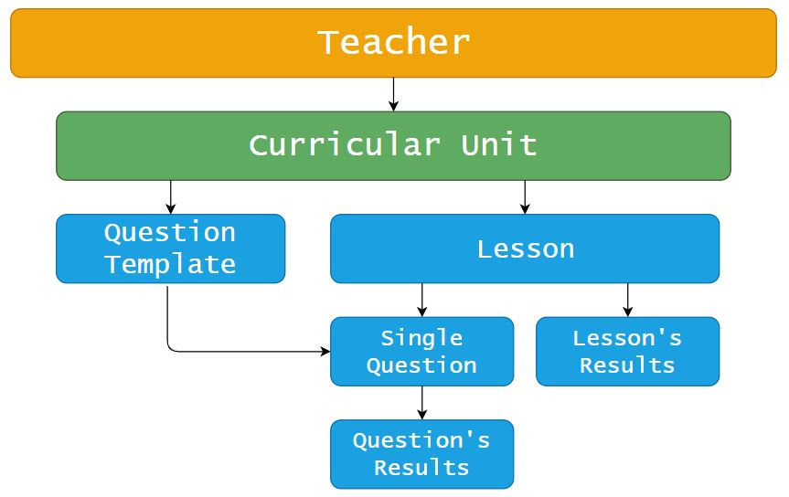
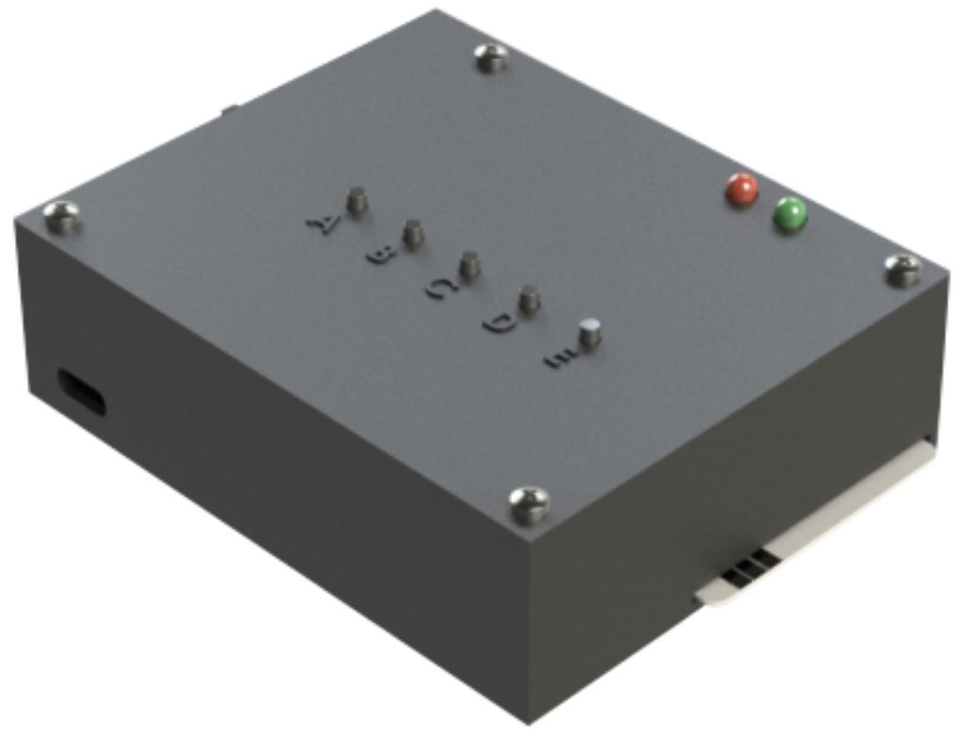
CLASSQUIZ
Secure and integrated real-time assessment and surveying in large scale classroom
João Moreira, Vítor Santos
Departamento de Engenharia Mecânica, Universidade de Aveiro
Abstract
CLASSQUIZ is an innovative system that allows teachers to carry out surveys, quizzes and multiple choice exams in a classroom, or any other similar closed environment. The solution has a strong concern for security and the ability to properly identify students, and allows both the evaluation of the students and for the purpose of anonymous surveys. Thus, CLASSQUIZ provides a much more interactive classroom experience by promoting students’ participation during lessons, which in turn helps them to stay focused on the subject being presented.
The system consists of a server and a set of individual terminals, through which the students are able to answer to multiple choice questions posed globally. Student authentication is done through their ID cards, which must remain inserted in the individual terminal during the quiz or survey. In addition, the system also operates without the ID card for anonymous inquiries. In order to ensure that only the students present in the classroom can participate in the surveys, the system is connected through a dedicated local network using a specific protocol and registered ID of the terminals, thus preventing access from the outside. Databases are used to manage the information flow during the entire process.
Instead of needing to install additional software on their personal computers, teachers can access the CLASSQUIZ User Interface from any device with a browser, allowing them to keep using their favorite device during lessons, regardless of it being a tablet, laptop or even a smartphone. Each survey is associated with a URL, which can be inserted in any existing presentation, and allows teachers to keep the flow of
the lesson. At the end of a lesson, or after each question, it is possible to make the results available, allowing the participants to receive immediate feedback on their performance.
System Infrastructure
The system consists of four distinct elements:
A server, which is responsible for all the logical processing of the application and management of the database;
A client, which corresponds to the teacher’s browser;
A local network, to which all components of the system are connected;
A set of individual terminals, through which students answer to the multiple-choice questions posed globally.
This infrastructure ensures that the participants must be in the classroom, or in its immediate surroundings in order to participate in any given quiz, thus denying access from an outside source.
Web Application
The web application allows teachers, through their personal accounts, to create question templates, and store them in the server’s database, so that they can be performed later. To do this, teachers must start a lesson, which will group the questions performed, thus allowing the execution of quizzes and surveys (figure 2).
A lesson, which is associated with a curricular unit, can be used in a number of different ways: it can consist of only one question, one class or subject, or span multiple sessions. It also allows the same question to be performed several times, as if they were different ones.
As students can answer multiple times
Fig.2 Web application’s data hierarchy.
to the same question, the system also allows the teacher to determine some evaluation criteria of the quizzes, such as the definition of the answer submitted by students that should be considered valid (the first or the last one submitted).
Students’ Authentication
The use of the students’ ID card as a form of authentication allows the attainment of a robust and reliable system, as evidenced by its multiple fields of application, and that is easy to use and has a low implementation cost, thus allowing a simple implementation of the system on a large scale.
Individual Terminals
The individual terminals used by the students are identified by the server through their MAC addresses. This methodology helps ensure that it is only possible to submit answers through devices properly identified and registered in the system, adding a layer of security to it. In addition, a terminal can only be used by one student
during the duration of a question, which in association with the fact that the presence of the student’s ID card is necessary, ensures the correct authentication and identification of the participant.
The terminals have an easy to use card insertion system, and can be used with an ID card to answer authenticated questions, or without one in an anonymous survey scenario.
These devices are powered by a battery that can easily be recharged through a USB cable, and have a range of several days of use.
Conclusions
The CLASSQUIZ system allows the creation of small moments of evaluation and inquiry during classes, without disrupting their flow.
The implementation of this system can result in an increase in the level of attention of the students, since they may be subject, at all times, to participate in small quizzes and inquiries about the subject matter.
The system can either be used as a way to stimulate student’s interest in the subject exposed, or as a form of auxiliary evaluation, and may lead to the creation of new evaluation models for curricular units. However, if not dosed correctly, it may cause an adverse effect, resulting in the burnout of the students’ attention.
Still, the system presents itself as a new and dynamic model of interaction between students and teachers, with potential for excellent results in terms of students’ academic achievement.
Fig.1 System infrastructure.
Fig.3 Individual terminal.
00
Não preencher este espaço
Título Título TítuloTítulo TítuloTítulo Título Título Título
Autor Autor Autor Autor Autor Autor Autor Autor Autor
Título Título TítuloTítulo TítuloTítulo Título Título Título
Autor Autor Autor Autor Autor Autor Autor Autor Autor
Título Título TítuloTítulo TítuloTítulo Título Título Título
Autor Autor Autor Autor Autor Autor Autor Autor Autor
Título Título TítuloTítulo TítuloTítulo Título Título Título
Autor Autor Autor Autor Autor Autor Autor Autor Autor
Título Título TítuloTítulo TítuloTítulo Título Título Título
Autor Autor Autor Autor Autor Autor Autor Autor Autor
Título Título TítuloTítulo TítuloTítulo Título Título Título
Autor Autor Autor Autor Autor Autor Autor Autor Autor
Título Título TítuloTítulo TítuloTítulo Título Título Título
Autor Autor Autor Autor Autor Autor Autor Autor Autor

