Slide 1
Traffic Lights Detection
Using Blob Analysis and Pattern Recognition
Jaromír Zavadil

Slide 2
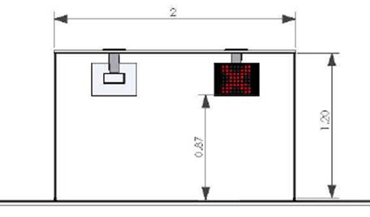
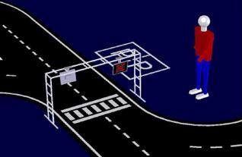
Competition
Signaling Panels
[Robotica 2011]

Slide 3



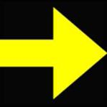
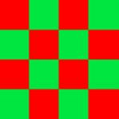
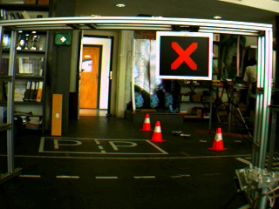
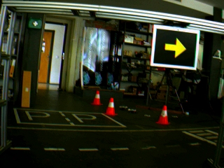
Task to solve
Symbols to be recognized

Slide 4
Methods used
Color Segmentation
  HSV Color Space
Blob analysis
  regionprops()
Pattern Recognition
  Mahalanobis distance
[MathWorks]

Slide 5
Blob Analysis
regionprops()
  Area
  Solidity
  Eccentricity
  Extent
  Perimeter
  Orientation
  EulerNumber
  MajorAxisLength
  MinorAxisLength
  BoundingBox
  Centroid

Slide 6
Blobs
Green Arrow
  Area > 200; Eccentricity < 0.9; Extent > 0.4;
  EulerNumber > -20; Solidity < 0.83; 60 < Orientation < - 60
Yellow Arrow
  Area > 200; Eccentricity < 0.9; Extent > 0.35;
  EulerNumber > -8; Solidity < 0.83; -25 < Orientation < 25
Red Cross
  Area > 200; Eccentricity < 0.7; 0.3 < Extent < 0.8;
  EulerNumber > -8; 0.4 < Solidity < 0.8; -25 < Orientation 25

Slide 7
Blobs
Red and Green Chessboard
  Area > 40; Eccentricity < 0.97
  if number of blobs > 7
    compute number of pixels
In the end compare all found blobs

Slide 8
Direction of the Yellow Arrow
  cut the blob using centroid and compare the left and the right part of the blob
508
342

Slide 9
Results
Tested Images |  |  |  |  |  |  | Results
red cross | left arrow | green arrow | right arrow | red & green | without light | total | missed | wrong
92 | 113 | 73 | 49 | 103 | 20 | 450 | 34 | 2

Slide 10
False Positives

Slide 11
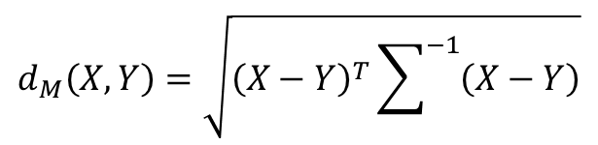
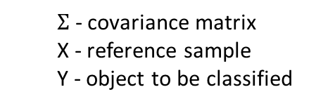
Pattern Recognition
Mahalanobis distance
In MATLAB – mahal() function
>> d = mahal(X, Y);
$$d_{M}\left(X,Y\right)=\sqrt{{\left(X−Y\right)}^{T}\sum^{−1}{\left(X−Y\right)}}$$
  $Σ$ - covariance matrix
  X - reference sample
  Y - object to be classified
  X - reference sample
  Y - object to be classified

Slide 12
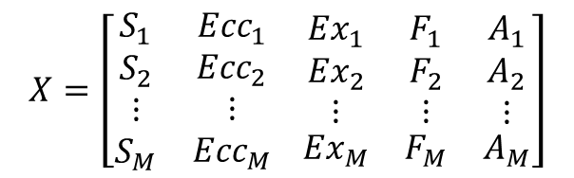
Patterns
Descriptors
  Solidity
  Eccentricity
  Extent
  Form Factor
  Axis Proportion
$$X=\left[\begin{matrix}S_{1} & {Ecc}_{1} \\ \begin{matrix}S_{2} \\ ⋮ \\ S_{M}\end{matrix} & \begin{matrix}{Ecc}_{2} \\ ⋮ \\ {Ecc}_{M}\end{matrix}\end{matrix} \begin{matrix}\begin{matrix}{Ex}_{1} \\ {Ex}_{2} \\ ⋮\end{matrix} & \begin{matrix}F_{1} \\ F_{2} \\ ⋮\end{matrix} & \begin{matrix}A_{1} \\ A_{2} \\ ⋮\end{matrix} \\ {Ex}_{M} & F_{M} & A_{M}\end{matrix}\right]$$

Slide 13
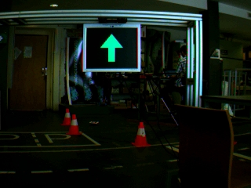
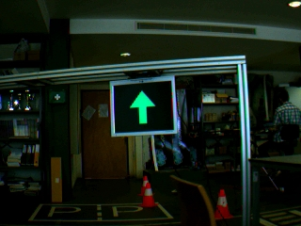
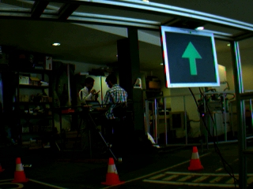


Patterns
12 examples for each symbol
  10 very good images + 2 images with distortion
$$…$$
1
2
$$X=\left[\begin{matrix}S_{1} & {Ecc}_{1} \\ \begin{matrix}S_{2} \\ ⋮ \\ S_{12}\end{matrix} & \begin{matrix}{Ecc}_{2} \\ ⋮ \\ {Ecc}_{12}\end{matrix}\end{matrix} \begin{matrix}\begin{matrix}{Ex}_{1} \\ {Ex}_{2} \\ ⋮\end{matrix} & \begin{matrix}F_{1} \\ F_{2} \\ ⋮\end{matrix} & \begin{matrix}A_{1} \\ A_{2} \\ ⋮\end{matrix} \\ {Ex}_{12} & F_{12} & A_{12}\end{matrix}\right]$$
12

Slide 14
Color
Segmentation
0.2 < H < 0.54; S > 0.4; V > 0.4
0 < H < 0.07 & 0.96 < H < 1;
S > 0.5; V > 0.4
0.11 < H < 0.2; S > 0.5; V > 0.4

Slide 15
Blobs
Selection
Area > 35; Eccentricity < 0.98
Area > 35; Eccentricity < 0.98
Area > 180; Eccentricity < 0.9;
0.55 < Solidity < 0.83; Extent > 0.35;
- 25 < Orientation < 25; EulerNumber > -8

Slide 16
M. Distance < 100; Area > 150
Mahalanobis
distance
M. Distance < 300; Area > 150
M. Distance < 100

Slide 17
Results
Tested Images |  |  |  |  |  |  | Results
red cross | left arrow | green arrow | right arrow | red & green | without light | total | missed | wrong
92 | 113 | 73 | 49 | 103 | 20 | 450 | 23 | 0

Slide 18
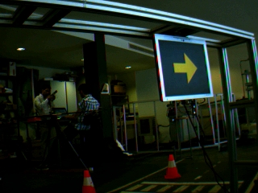
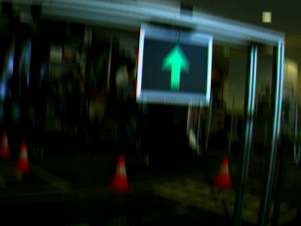
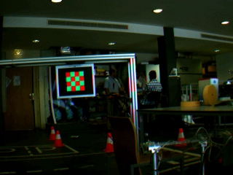
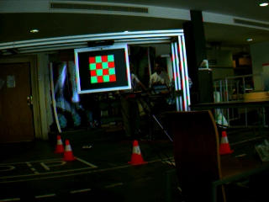
Missed Symbols
d_{M} = 152,8
d_{M} = 189
too small blobs
too small blobs

Slide 19
Maximum distances
Arrows and Red Cross
  2,5 m
Red & Green Chessboard
  2 m

Slide 20
Future work
Build a bigger set of good examples.
Compute probability of detected symbols.
Try to use a neural network for classification.
Try to process images from a real road.

Slide 21
Traffic Lights Detection
Using Blob Analysis and Pattern Recognition
Jaromír Zavadil

